Slide 1

Improvement to the MEDLINE indexing algorithm: from MTIA (Medical Text Indexer-Automated) to MTIX (Medical
Text Indexer-neXt generation)
Scilla Pizzarelli
Istituto Superiore di Sanità
Rome, Italy

Slide 2
Algorithmic indexing
MeSH predictions based on the title and abstract of citations
MTIA
Medical Text Indexer-Automated
(April 2022)
MTIX
Medical Text Indexer-neXt generation
(April 2024)
Natural Language Processing technology
Deep Learning technology
Rules for predictions created by humans
Creates its own rules for predictions
Literal word matches
prone to errors with
metaphorical/ambiguous terms
Handles indirect/complex concepts
Understands context
(less contextual errors)
Scilla Pizzarelli, Istituto Superiore di Sanità, Rome, Italy

Slide 3

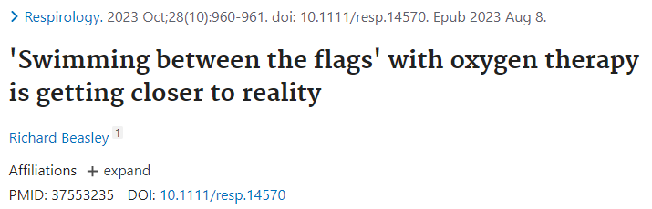
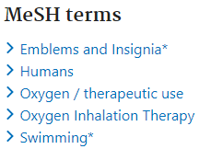
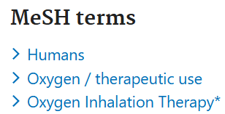

MTIA contextual error
"Swimming between the flags"
Wrong Indexing
Correct Indexing
Scilla Pizzarelli, Istituto Superiore di Sanità, Rome, Italy
Notes:
Espressione metaforica usata per indicare norme di Buona Pratica Clinica per l'ossigenoterapia di
pazienti con BPCO (broncopneumopatia cronica ostruttiva) in condizioni critiche.
Consiste nel somministrare tanto ossigeno quanto necessario a mantenere il livello di ossigeno nel sangue entro valori sicuri (non deve essere somministrato né troppo né poco ossigeno) compresi tra l'88% e il 92%

Slide 4
Number of descriptors assigned
New MeSH terms
MTIA
MTIX
New terms added to the lookup lists
Requires new training data
Performance subject to:
  comprehensiveness of synonyms’ list
  word matching
For the time being a system similar to MTIA
Human Indexers
10-15 terms per citation
MTIA
7-8 terms per citation (higher precision)
MTIX
13 terms per citation (higher recall)
Scilla Pizzarelli, Istituto Superiore di Sanità, Rome, Italy

Slide 5
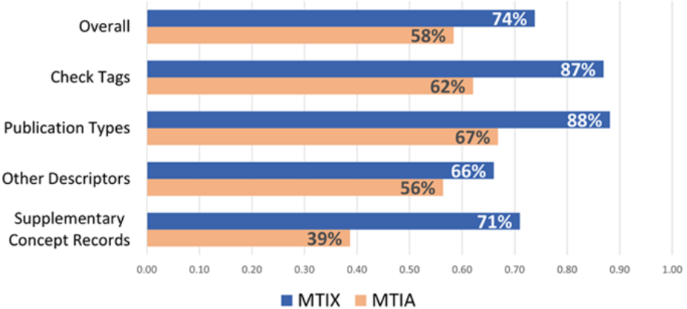
MTIX vs MTIA F1 scores
MTIX: the Next-Generation Algorithm for Automated Indexing of MEDLINE. NLM Tech Bull. 2024 Mar-Apr;(457):e4.
Random sample of ~40,000 MEDLINE citations published between 2017-2022
F1 score = harmonic mean of precision and recall
Scilla Pizzarelli, Istituto Superiore di Sanità, Rome, Italy

