Slide 1


Exploring the impact of scientific research using citation analysis tools in policies and guidelines
Valeria Scotti¹, Annalisa De Silvestri²
¹ UOSD Grant Office, TTO and Scientific Documentation, Fondazione IRCCS Policlinico San Matteo, Pavia, Italy
² Unit of Clinical Epidemiology and Biostatistics, Fondazione IRCCS Policlinico San Matteo, Pavia, Italy
Notes:
Good afternoon, I’m a biomedical librarian at one of the largest hospitals in northern Italy.
I have been studying alternative metrics since 2011 and how to use them together with traditional metrics such as the Impact Factor and H-index.

Slide 2

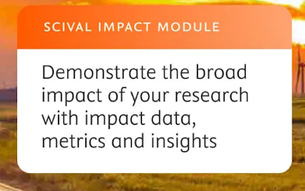
Go Beyond..
Measuring research impact now includes not just academic influence, but also real-world effects on policies and guidelines.
Tools like BMJ Impact Analytics, SCIVAL Impact, Overton, and Altmetric.com help measure research impact on policy, clinical guidelines, and social relevance.
For our purpose, we analyzed data from SCIVAL Impact Module
Notes:
Over the last few years, there’s been a growing shift in how we measure the impact of scientific research. It's no longer just about citations in academic journals—now, we’re asking: Is this research actually making a difference in the real world? Are policies changing? Are clinical guidelines being updated? That’s where tools like BMJ Impact Analytics, Overton, and Altmetric come in—they help us trace the path from research to real-world outcomes.
In our institution, we use it for the IMPACT module of SciVal.

Slide 3
What kind of impact the measure?
These tools extend citation tracking beyond academia to include:
Academic literature
Policy documents
Government reports
International guidelines
Notes:
We’ve been using the tool to get a clearer picture of how our studies influence policy and practice. This tool connects scientific papers with policy documents, guidelines, and reports from major organizations like the WHO and NICE. So, instead of just counting citations in journals, we’re tracking how research is being used to shape real-world decisions. Please note that these citations are not tracked by citation databases like Scopus or Web of Science, and they are not included in the h-index of the researchers.
And the results have been incredibly encouraging.

Slide 4
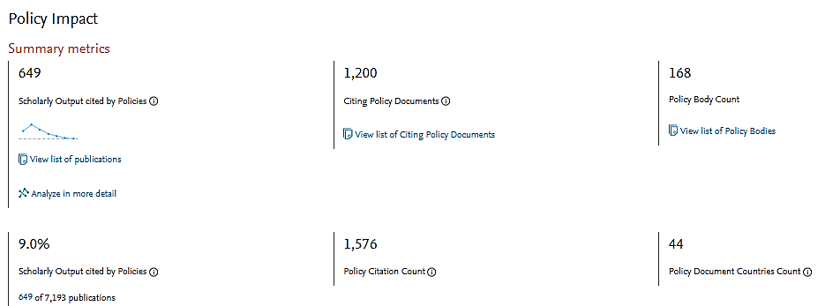
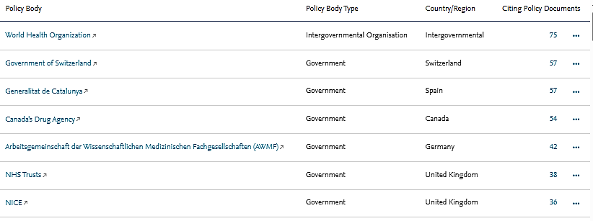
Our policy impact
Notes:
So far, more than six hundred of our articles have been cited in policy documents and guidelines across 44 different countries and by over 100 organizations.
[ANIMATION] In the table, we can see the types of policy bodies and how many of our articles each has cited.“
Percentage of academic output cited in policy documents, offering a size-neutral indicator of impact.
The can be considered “time-independent metrics”, which provide useful, reliable information immediately
upon publication and do not rely on the passing of time for useful data to accumulate

Slide 5
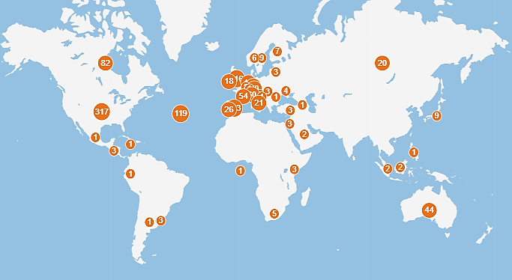
Our policy impact
Notes:
This is a graphical representation of the impact of our publications on policies worldwide.

Slide 6
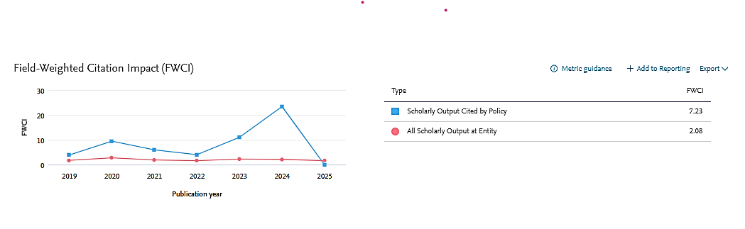
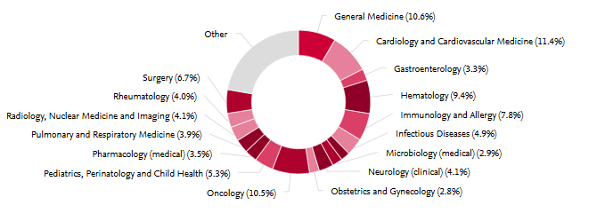
Citation impact
Notes:
Articles cited in policy documents show a much higher Field-Weighted Citation Impact than our overall scholarly output.“
The main areas of impact? From general Medicine to surgery-

Slide 7

How to use this information?
Tools offer a broader view of societal impact
Support institutional strategy with evidence
Enhance visibility and funding attractiveness
Guidelines shape healthcare systems and outcomes
Citation tools integrate academic and real-world impact
Support strategic directions with measurable evidence
Notes:
This kind of impact—societal impact that’s this close to the patient—has never been tracked so clearly before. It represents a real breakthrough in how we understand the value of our research.
And it’s not just about recognition. Having this kind of data helps us support our researchers, guide our institutional strategy, and demonstrate our value to funders and stakeholders. It gives us a much more complete—and meaningful—picture of what scientific impact looks like today.

Slide 8

Thanks for your attention

Slide 9
Societal impact
Tools offer a broader view of societal impact
Support institutional strategy with evidence
Enhance visibility and funding attractiveness
Guidelines shape healthcare systems and outcomes
Citation tools integrate academic and real-world impact
Support strategic directions with measurable evidence

Slide 10
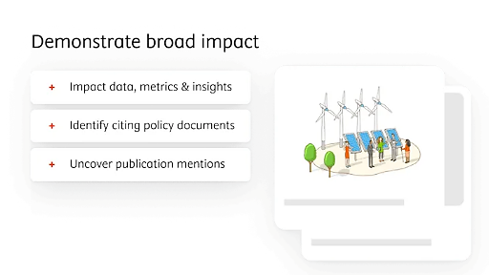
What kind of impact the measure?
These tools extend citation tracking beyond academia to include:
‣ Academic literature
‣ Policy documents
‣ Government reports
‣ International guidelines
Notes:
This citation are not track from citation database like Scopus, Web of science in h-index

