Slide 1

How health libraries at SBUHB are growing a heart to help with staff wellbeing.
Betsy Morgan¹, Lizzy Evans²
¹ Trainee Clinical Librarian, Swansea Bay University Health Board, NHS Wales
² Library and Knowledge Service Manager, Swansea Bay University Health Board, NHS Wales
Notes:
Hello I’m Betsy
Hello I’m Lizzy
We’re here today to explain how we’ve grown our library service within our health board to engage and network with a wider range of staff.

Slide 2

Background: 2020
Declining footfall post-COVID ​
Broaden our user base​
Support Health Board staff wellbeing
Notes:
Betsy
In 2020, our footfall and usage declined, which was primarily due to the COVID-19 pandemic. ​
​In an attempt to counter this, we discussed and implemented a strategy to broaden our user base beyond our traditional clinical staff. ​
​One method was contributing to the HB's wellbeing initiatives.
The HB's wellbeing strategy has continued to gain momentum since 2020, as has our involvement on a number of levels.

Slide 3
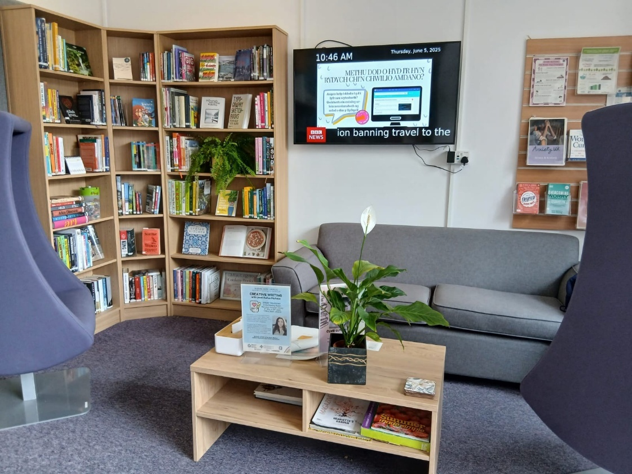
How
Collections
Events
Initiatives
Notes:
Lizzy
Our approach had three main strands; create a wellbeing collection, deliver wellbeing events and support HB wellbeing initiatives.
Our wellbeing collection includes books on cooking, the outdoors, travel and fitness. The section is growing in popularity and footfall has increased.
Each of the libraries in the health board have organised Wellbeing events, collaborating with a range of departments in the health board and with external organisations.​ These include Wellbeing days, Coffee Mornings, poetry workshops, yoga sessions, therapy dog visits, a monthly book club and one library installed a temporary historical exhibition, which was open to the public.
To support one of the Health board’s wellbeing initiatives, we established a patient book trolley with the Memory Impairment Team and Volunteer Service. This has helped increase the library’s visibility in clinical settings and been of great benefit to patients. This service won an award in 2024 for its contribution to patient wellbeing.
This new way of working has helped make the library service an integral part of the HB’s wellbeing strategy.

Slide 4
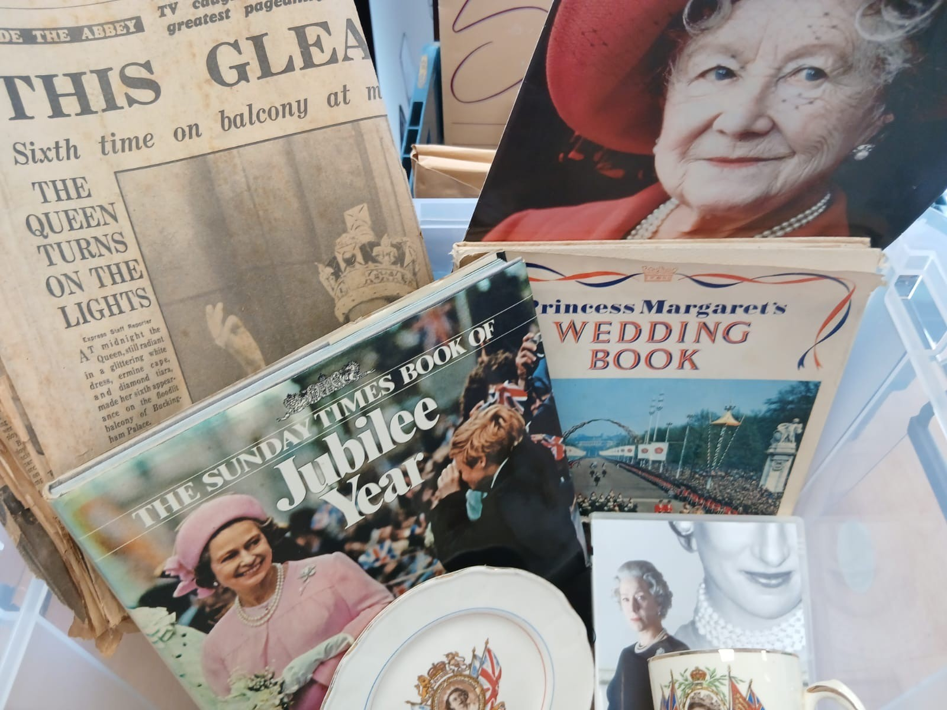
What next?
Grow ​
Explore
Network
Notes:
Betsy
We started with a wellbeing focus, but this has led to involvement in broader health board agendas.
To grow and embed the library service in clinical practice, we have started a partnership with the Quality Improvement Team, to support their national work in preventing physical and cognitive decline in patients. The library has created reminiscence boxes, which are collections of items from the past 100 years. These items have been donated by HB staff and members of the public. We have collated the items into themed boxes which therapists use in sessions with patients prompting discussion and memory stimulation.
​We aim to explore new avenues for our collections and services, to engage with more departments and further our influence across the health board. Our next step is to contact the Research and Development team to increase our collaborative working relationship, establishing a consistent work flow and ensuring library support in all aspects of health board research.
We would like to expand our professional network, both nationally and internationally, to enable us to draw on colleague’s experiences and learning from best practice. This learning we can then apply, informing and improving our professional practice, in turn supporting the entire health board.
​
By continuing to deliver our existing services, growing the library’s role in clinical practice, exploring new areas for collaboration, and networking with other library colleagues, we will secure the Swansea Bay University Health Board Library Service as the heart of the health board.

Slide 5
Thank you for listening.
References
Better Health, Better Care, Better Lives: Our Organisational Strategy, 2019-2030. Abertawe Bro Morgannwg University Health Board, now Swansea Bay University Health Board. 2019.
One Bay Way Staff Award: Arts in Healthcare. 2024.

