Slide 1

Teaching Anatomy in 3D: A Comparison of Available Digital Anatomy Applications
Erik Verraedt¹, Karsten Bellis¹, Laurie Priemen¹, Christine Claessen¹, Thomas Vandendriessche¹
¹ KU Leuven Libraries 2Bergen

Slide 2

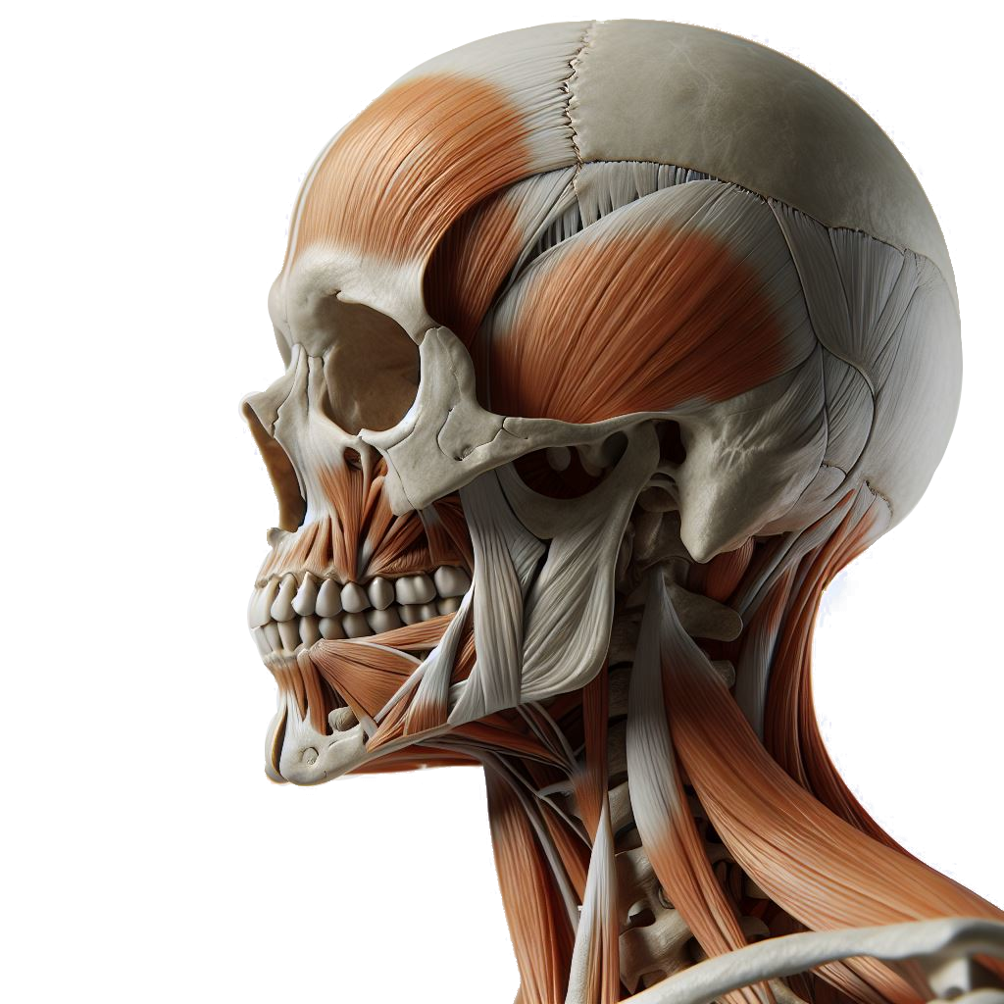
3D digital anatomy models
  Used by students and staff
  Acces provided via library
Which anatomical database?
  Quality, content
  Budget
→ Methodology for comparison

Slide 3

Explore the market
10
Which anatomical databases are available?
  Search strategy based on Zilverschoon et al. (2019)
Zilverschoon, M., Kotte, E. M. G., van Esch, B., Ten Cate, O., Custers, E. J., & Bleys, R. L. A. W. (2019). Comparing the critical features of e-applications for three-dimensional anatomy education. Annals of anatomy = Anatomischer Anzeiger : official organ of the Anatomische Gesellschaft, 222, 28–39. https://doi.org/10.1016/j.aanat.2018.11.001

Slide 4


Explore the market
Trial access for library personnel
7 criteria were scored (0-2) (Zilverschoon et al., 2019)
  Model rotation
  Model displacement
  Zooming
  Clickable structures
  Transparency
  Anatomical information
  Virtual dissection
Additional criteria
  Dynamic biomechanical models
  Medical imaging
  Model complexity
  General ease of use
  App-availability
Selection based
on functionality
3

Slide 5

Explore the market
Selection based
on functionality
Approximate price range
2
Financial viability

Slide 6
Explore the market
Selection based
on functionality
Trial access for students and staff
Professors: accuracy of content in their field of expertise
Students: test for content they needed in the last year
Documenting the use of anatomy models
1
Trial and survey
Financial viability

Slide 7

Explore the market
Financial and
legal details
Selection based
on functionality
Price negotiations
Contract review
Final decision
Trial and survey
Financial viability

Slide 8

Communication
Explore the market
Financial and
legal details
Selection based
on functionality
Informing staff and students
Change of anatomy model: following up on feedback
Trial and survey
Financial viability

Slide 9


Communication
Explore the market
Financial and
legal details
Selection based
on functionality
More information?
Other experiences?
erik.verraedt@kuleuven.be
Trial and survey
Financial viability

