Slide 1

Imagine a world of health equity: Collaboration and partnerships to promote equity in access to health information through MLA Allied Representatives
Rena Lubker
Medical University of South Carolina

Slide 2
Why does MLA appoint AR’s
Objective: MLA strives to strengthen cooperation among health sciences librarians and library associations worldwide.
Goal: Provide reliable health information for all.
Strategy: Utilize Allied Representatives (ARs) from the MLA International Cooperation Caucus.

Slide 3


How do ARs Achieve the Goal of providing access to health information for all?
Equity in Access: Promote equitable access to health information.
Skill Building: Help international colleagues build skills impacting health sciences education, research, and practice.
Bilateral Agreements: Maintain agreements with ten international partners.
Conference Participation: Attend and represent MLA at international conferences.

Slide 4

https://ahila.org/
Notes:
AHILA Congress meets every other year
Founded in August 1984. With 46 member countries, partners and collaborators worldwide
Chapters, sections and standing committees
Partners: EAHIL, IFLA, MLA and AfLIA - Africa Library & Information Association & Institutions (AfLIA)

Slide 5

Challenges and Solutions for AHILA
Challenges:
Maintaining bilateral agreements.
Lack of resources for professional development.
Limited conference attendance due to funding constraints, geography, instability and language.
Solutions:
Strengthen cooperation through ARs.
Partner with US-based libraries to address resource gaps.
Mentoring librarians
Attending AHILA congress and providing CE
Knowledge sharing amongst AHILA members

Slide 6
AHILA
“In recent years, tremendous progress has been made toward providing health information in Africa, in part because of technological advancements. Nevertheless, ensuring that information is accessible, comprehensible, and usable remains problematic, and there remain needs in many settings to address issues such as computer and information skills, literacy, and the infrastructure to access information.” Mrs. Mercy Monde Kakoma – AHILA President

Slide 7

Conclusions
Ongoing Efforts: ARs will continue to strengthen international cooperation
US Library Initiatives: Collaborate with US libraries to support global health sciences libraries
Information Sharing: Enhance sharing of information and resources among international health sciences librarians

Slide 8
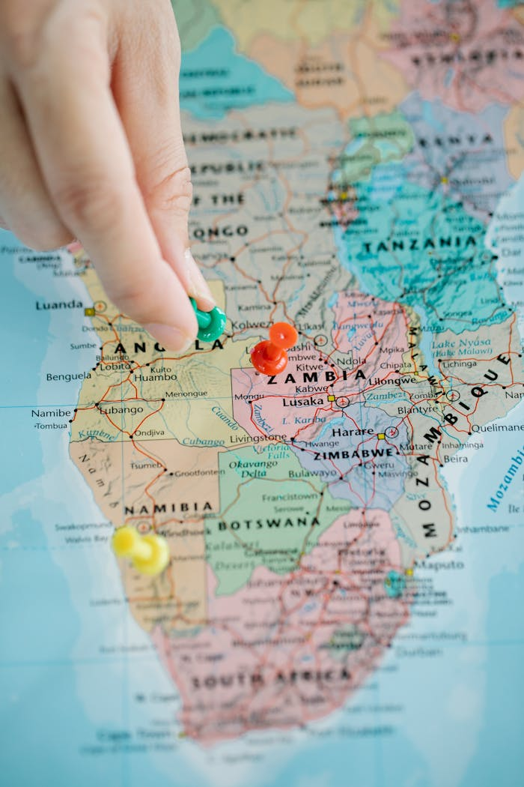

18th Congress of AHILA
30 Sept – 04 Oct 2025
Mulungushi International Conference Centre, Lusaka, Zambia

Slide 9


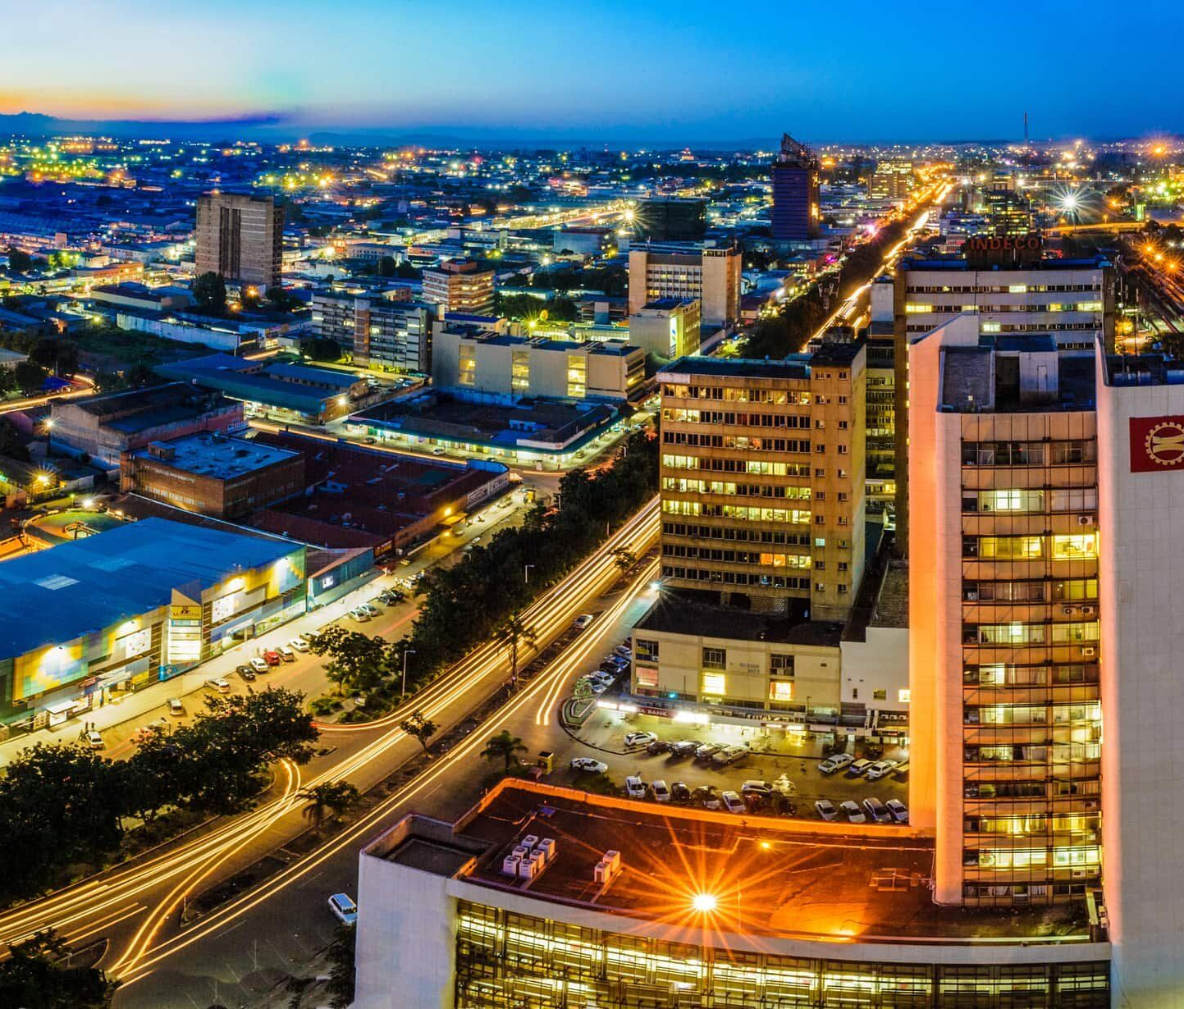
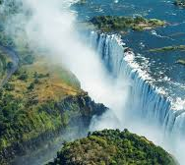
ZAMBIA!

Slide 10

What can the EAHIL community do?
Mentor librarians from AHILA
Share resources that are open for distribution
Invite AHILA librarians to free webinars (time zones)
Attend AHILA Congress (every other year)
Brainstorm ideas and share them!

Slide 11
References
Ajuwon, G. A., & Rhine, L. (2008). The level of Internet access and ICT training for health information professionals in sub-Saharan Africa. Health Information and Libraries Journal, 25(3), 175–185. https://10.1111/j.1471-1842.2007.00758.x
Haruna, H., Mtoroki, M., Gerendasy, D. D., & Detlefsen, E. G. (2016). Health Libraries and Information Services in Tanzania: A Strategic Assessment. Annals of Global Health, 82(5), 912–921.e3. https://10.1016/j.aogh.2016.10.003
Hashemian, M., Rahimi, A., Yamani, N., Adibi, P., & Zare-Farashbandi, F. (2020). Clinical informationist educational needs and goals: A scoping review. Journal of Education and Health Promotion, 9, 193. https://10.4103/jehp.jehp_272_20
Ikolo, V. E., & Nongo, C. J. (2022). Training needs of medical librarians in Nigeria: A survey. Health Information and Libraries Journal, 39(2), 155–165. https://10.1111/hir.12383
Obasola, O. I., Kinengyere, A. A., Peter, D., Chiweza, D., Ross-White, A., & Godfrey, C. (2022). Perceptions, experiences, and attitudes of health care professionals regarding the role of librarians in fostering evidence-based health practice: a systematic review protocol. JBI Evidence Synthesis, 20(1), 181–188. https://10.11124/JBIES-20-00497
Olayemi, O. M., & Olayemi, K. J. (2021). Knowledge sharing practices among African health sciences librarians. Journal of the Medical Library Association : JMLA, 109(4), 624–630. https://10.5195/jmla.2021.1183
Popoola, B. O., Uzoagba, N. C., & Rabiu, N. (2020). "What's happening over there?": a study of the current state of services, challenges, and prospects in Nigerian medical libraries. Journal of the Medical Library Association : JMLA, 108(3), 398–407. https://10.5195/jmla.2020.607

Slide 12
Thank you!
Rena Lubker lubker@musc.edu
Medical Library Association Representative to AHILA
Medical University of South Carolina Libraries
Charleston, South Carolina

