Slide 1


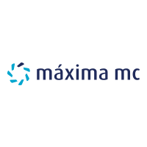



Connecting the Dutch STZ-hospitals to the national Open Science programme
STZ Open Science Work Group:
Marion Heymans Zuyderland
Eugenie Delvaux Maxima Medical Center
Marjan Bakker Northwest Clinics
Chantal den Haan OLVG
Notes:
Goodmorning everyone, and welcome to our session.
We’d like to share how the STZ hospitals in the Netherlands connected to the national Open Science Programme.
The National Programme Open Science brings together stakeholders from across the country to work collaboratively on realizing Open Science, and on embedding open practices into the research.
STZ stands for Samenwerkende Topklinische Ziekenhuizen – a network of top clinical teaching hospitals in the Netherlands.
Today, we’ll tell you how we connected– as librarians within the STZ – got involved and became part of this national collaboration around Open Science.
We hope it inspires you to take initiative in your own context.

Slide 2


It started with…
”Did you know that the STZ hospitals together publish 5% of all Dutch scientific articles?”
Can we reach 100% open access together?
.
Notes:
In the national program the Dutch university hospitals were already involved in the UKB consortium (university libraries and the national library). Through Read & Publish agreements, they had access to thousands of journals and could publish open access at no extra cost.
That consortium is not open to STZ hospitals.
The very first step from STZ towards the national consortium? It was simply a phone call. In 2020, we were contacted. Not through a formal request from the STZ board, not by the management, but because we – individual libraries – were already visible in a just published report, the Pleiade report.
The authors of this new report called Marjan and Chantal and they asked : Did you know that the STZ hospitals together publish 5% of all dutch scientific articles? They wanted to achieve 100% open access, so they need “our” 5% from the STZ!
We didn’t know, but we realized that we as STZ hospitals publish a lot! Suddenly – we were on the radar. From that moment on, we didn’t let go. We actively stepped into the picture.
That first step – was crucial for us. And maybe it resonates with you too.
Let’s have a closer look to OS in the Netherlands.

Slide 3


Open Science in the Netherlands
Facilitates national collaboration
Input from all Dutch scientific institutes
including STZ hospitals
NPOS2030 Ambition document and Rolling Agenda make 100% open science the norm in the Netherlands by 2030
Notes:
Open science is the international movement that promotes a more open and participatory approach to research.
In the Netherlands, a national programme drives this transition: Open Science NL. This initiative, which builds on the earlier National Programme Open Science (NPOS), has a clear mission: To make 100% open science the norm in the Netherlands by 2030.
This ambition is described in the NPOS2030 Ambition Document and Rolling Agenda, which was developed in 2022.
So, what does Open Science NL actually do?
It accelerates the transition to open science
It connects stakeholders at every level—from individual researchers to institutions and policymakers
It broadens the scope, as non-academic institutions such STZ hospitals are explicitly invited to participate.
This is a major step forward, as it signals a more inclusive national open science strategy.
In March 2023, 16 organisations signed a covenant to establish Open Science NL as a new national governance structure.
Let’s now have a closer look at the STZ.

Slide 4

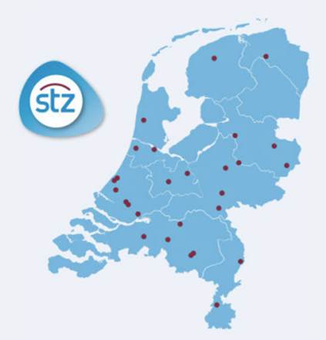

STZ hospitals and Open Science
Not an official signatory of NPOS2030 ambition
Open Science in STZ ambition statement 2023-2027
Top-clinical care
Education
Research
Notes:
The STZ – the Association of Collaborating Top Clinical Teaching Hospitals in the Netherlands, is a powerful network of 27 non-academic hospitals, all committed to delivering top clinical care, supporting education, and conducting scientific research.
Because STZ hospitals treat large and diverse patient populations, they have a strong integration of clinical practice and applied scientific research which gives them a unique position.
But here’s the challenge: 16 national partners signed the NPOS2030 covenant. Unfortunately, STZ was not among the signatories. STZ did not sign.
So, how can STZ meaningfully participate in the national Open Science programme if we weren’t part of the formal agreement?
STZ recognizes the importance of Open Science, including open access in its ambition statement.
But if we want STZ to play a serious role in the national Open Science movement, we need to:
Make open science more visible in the internal strategy and external communications.
Embed it as a core task - and put it in practice.
How can we expect others to take our role in open science seriously?

Slide 5


STZ Open Science
Working group
Looking for connection with:
National collaboration
Board of the STZ
Awareness for STZ libraries
Notes:
As librarians within STZ hospitals, we wanted to contribute to the development of Open Science at the national level.
STZ information specialists had already been in touch regularly, for example to discuss consortia. But in 2021, four of us decided to take it a step further.
We formed a small separate working group — and since then, we’ve been meeting online every two weeks. We share updates, exchange what we hear from the national field, and support each other in navigating these developments.
Our goal was simple: to make a connection.
We reached out to NPOS stakeholders. We contacted the STZ Board.
We looked for ways to raise awareness of Open Science within our own hospitals.
We broadened the conversation to include information specialists from all STZ hospitals— to explore: What does this national programme mean for us, as non-academic hospitals?
In theory, this all sounds logical.
But in practice, it wasn’t easy. How to connect and how to start?
Let’s start with connecting with the national program

Slide 6

Connecting with the national programme
Participant at the NPOS table
Participant in the Full OA project
  Inventory of possible publishers for OA deals
  Contributing to the first national deal with full gold open access publisher
Participant in a national inventory of new ways of collaboration in future deals with publishers
Notes:
The working group emphasized the importance of STZ hospitals having a seat at the table with the policymakers who were shaping the national program. We expressed our willingness to be involved and offered to provide people to collaborate on the program.
In April 2022, we were invited to join the national table. Eugenie participated on behalf of the working group. From there, she shared draft reports that were often extensive and written in quite complex policy language. Many different parties had their own interests, which sometimes made participation challenging. Nonetheless, we felt engaged and provided joint feedback on behalf of STZ.
We met with project leaders of the national program. One key initiative was the ‘Full Open Access’ project, where an inventory was made of possible full open access publishers to sign a Publish-deal with.
From six publishers identified, two were selected after evaluating their size and quality. Chantal represented us in this project group, and her contribution was supported financially.
In 2024, Marjan participated in a national inventory of new ways of collaboration in future deals with publishers. This concerns both Read and Read & Publishing deals, in any case new deals for which no joint agreements have been made yet. This work is still ongoing.

Slide 7

Connecting within the STZ
NPOS2030 to STZ information specialists
feedback & collecting data
Meetings with STZ policy makers
Policy reports presented to the STZ Board
2021 Open Access and STZ
2023 advisory note approved by the General Assembly
Notes:
Our first step was to inform the STZ librarians about the national ambition document on open science. This helped create awareness around this important topic. We gathered feedback on the national ambition document from all STZ librarians, which we presented to the national program team.
We asked each STZ library to give insights on several key points:
The amount spent on Article Processing Charges (APCs) at each hospital
The number of open access publications
Policies regarding open access publishing within their institutions
It quickly became clear that these questions were not easy to answer within individual hospitals. In particular, financial information was difficult to uncover.
Later on, we gained access to the UKB datahub, which provided us with valuable insights. This platform offered data on the number of publications per institution, with which publishers and detailed information about open access publishing costs.
The working group informed the STZ board about their findings. The first advisory note was sent to the STZ board in 2021, but formal approval only came in two years later. It required patience and persistence to bring the topic to the STZ agenda.
Multiple conversations with STZ policy advisors helped clarify the importance of open science.
At the request of the STZ board, we created an advisory note highlighting the particular importance of open science for the STZ network. This policy report was approved by the STZ General Assembly. Key points included:
Increasing the visibility of STZ publications
Developing open access agreements tailored to STZ, including a sustainable financial model

Slide 8


Success for STZ
First concrete OA deal
STZ impact
research more accessible and visibile
Efficiciency and cost savings
Recognised as important topics
OS workgroup increases librarian visibility within the STZ network
Notes:
STZ researchers are highly motivated to publish their work open access, and many are already doing so.
However, a major challenge remains: financing the publication costs. STZ hospitals currently offer limited financial support for these Article Processing Charges, which presents a barrier for many authors. Even collectively, STZ hospitals do not have enough publishing volume to qualify for read and publish deals with major publishers.
Recently, however, a significant breakthrough was achieved. Seventeen STZ hospitals joined a unique national open access agreement with the non-profit scientific publisher PLOS , that was a result of the Full Open Acces project I mentioned earlier. Thanks to this agreement, researchers from STZ hospitals can publish open access without fees in seven PLOS journals, including PLOS ONE, for the next two years.
For the first time, not only universities but also research institutes like STZ hospitals were included in such a deal. And also, major research funders participate in this national open access agreement.
For STZ, this milestone represents a major step forward.
All these steps that we have made since 2021 have had great impact on the STZ:
As STZ publications become more accessible and visible
For researchers it is more efficient and time saving
Cost will be saved at hospital level
For the STZ board and the management of hospitals OS and OA have become important topics
And by the effort of the working group, the visibility of STZ librarians has increased in their own hospitals but also in the STZ networks

Slide 9
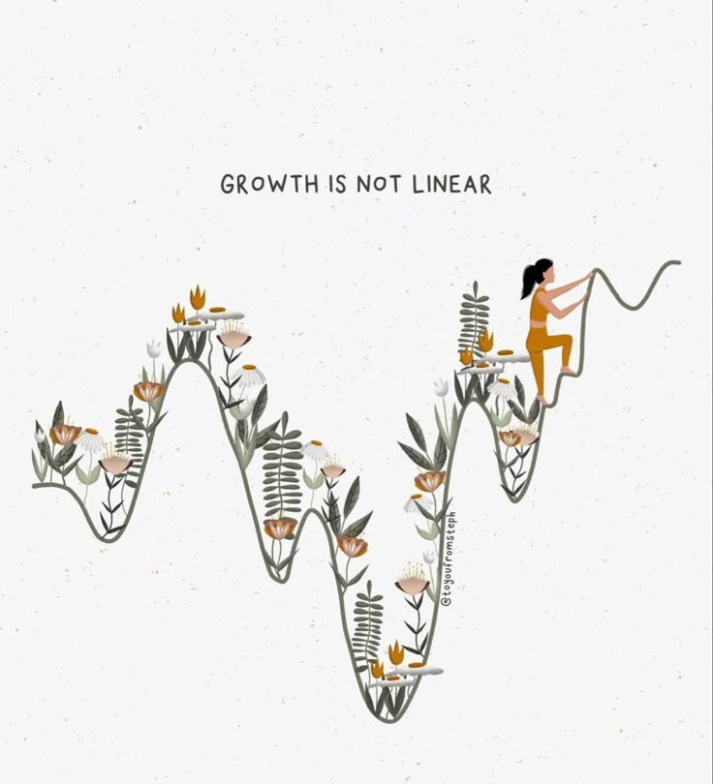
Take home message
Keep raising awareness and building Open Science policy
Together we create a more open, visible and future proof (STZ) research landscape
Future: multiple deals
Cooperation with STZ office, universities, and other research institutes
.
Notes:
As you can see, the connection did not come easily. Integrating STZ into the national OS program was a challenge. Open science was not yet a priority within STZ, so our efforts helped raise awareness.
This process took time.
We linked our results to other relevant networks, like the STZ network of research support departments, recognizing that building open access is complex and requires a practical, collaborative approach
At a national level, we have become recognized partners in the national open science landscape.
We continue to closely follow the national Open Science policies in the Netherlands.
We look forward to continuing to build on these successes and further embed open science principles within STZ research.
We want to share this experience you and with other libraries who might not yet be as involved. Our journey may be an example for other -smaller- institutions.
If you are considering such a project in your own country, here are some key takeaways:
be prepared for a long-term project
Stay proactive and raise awareness continuously.
Lobby and engage in conversations with policymakers and responsible people, ideally those who have science in their portfolio.
Be visible. Be patient and persistent in explaining the importance of open science – not only externally but also within your institution. Change takes time.
And remember: Even a phone call can lead to something meaningful.

Slide 10

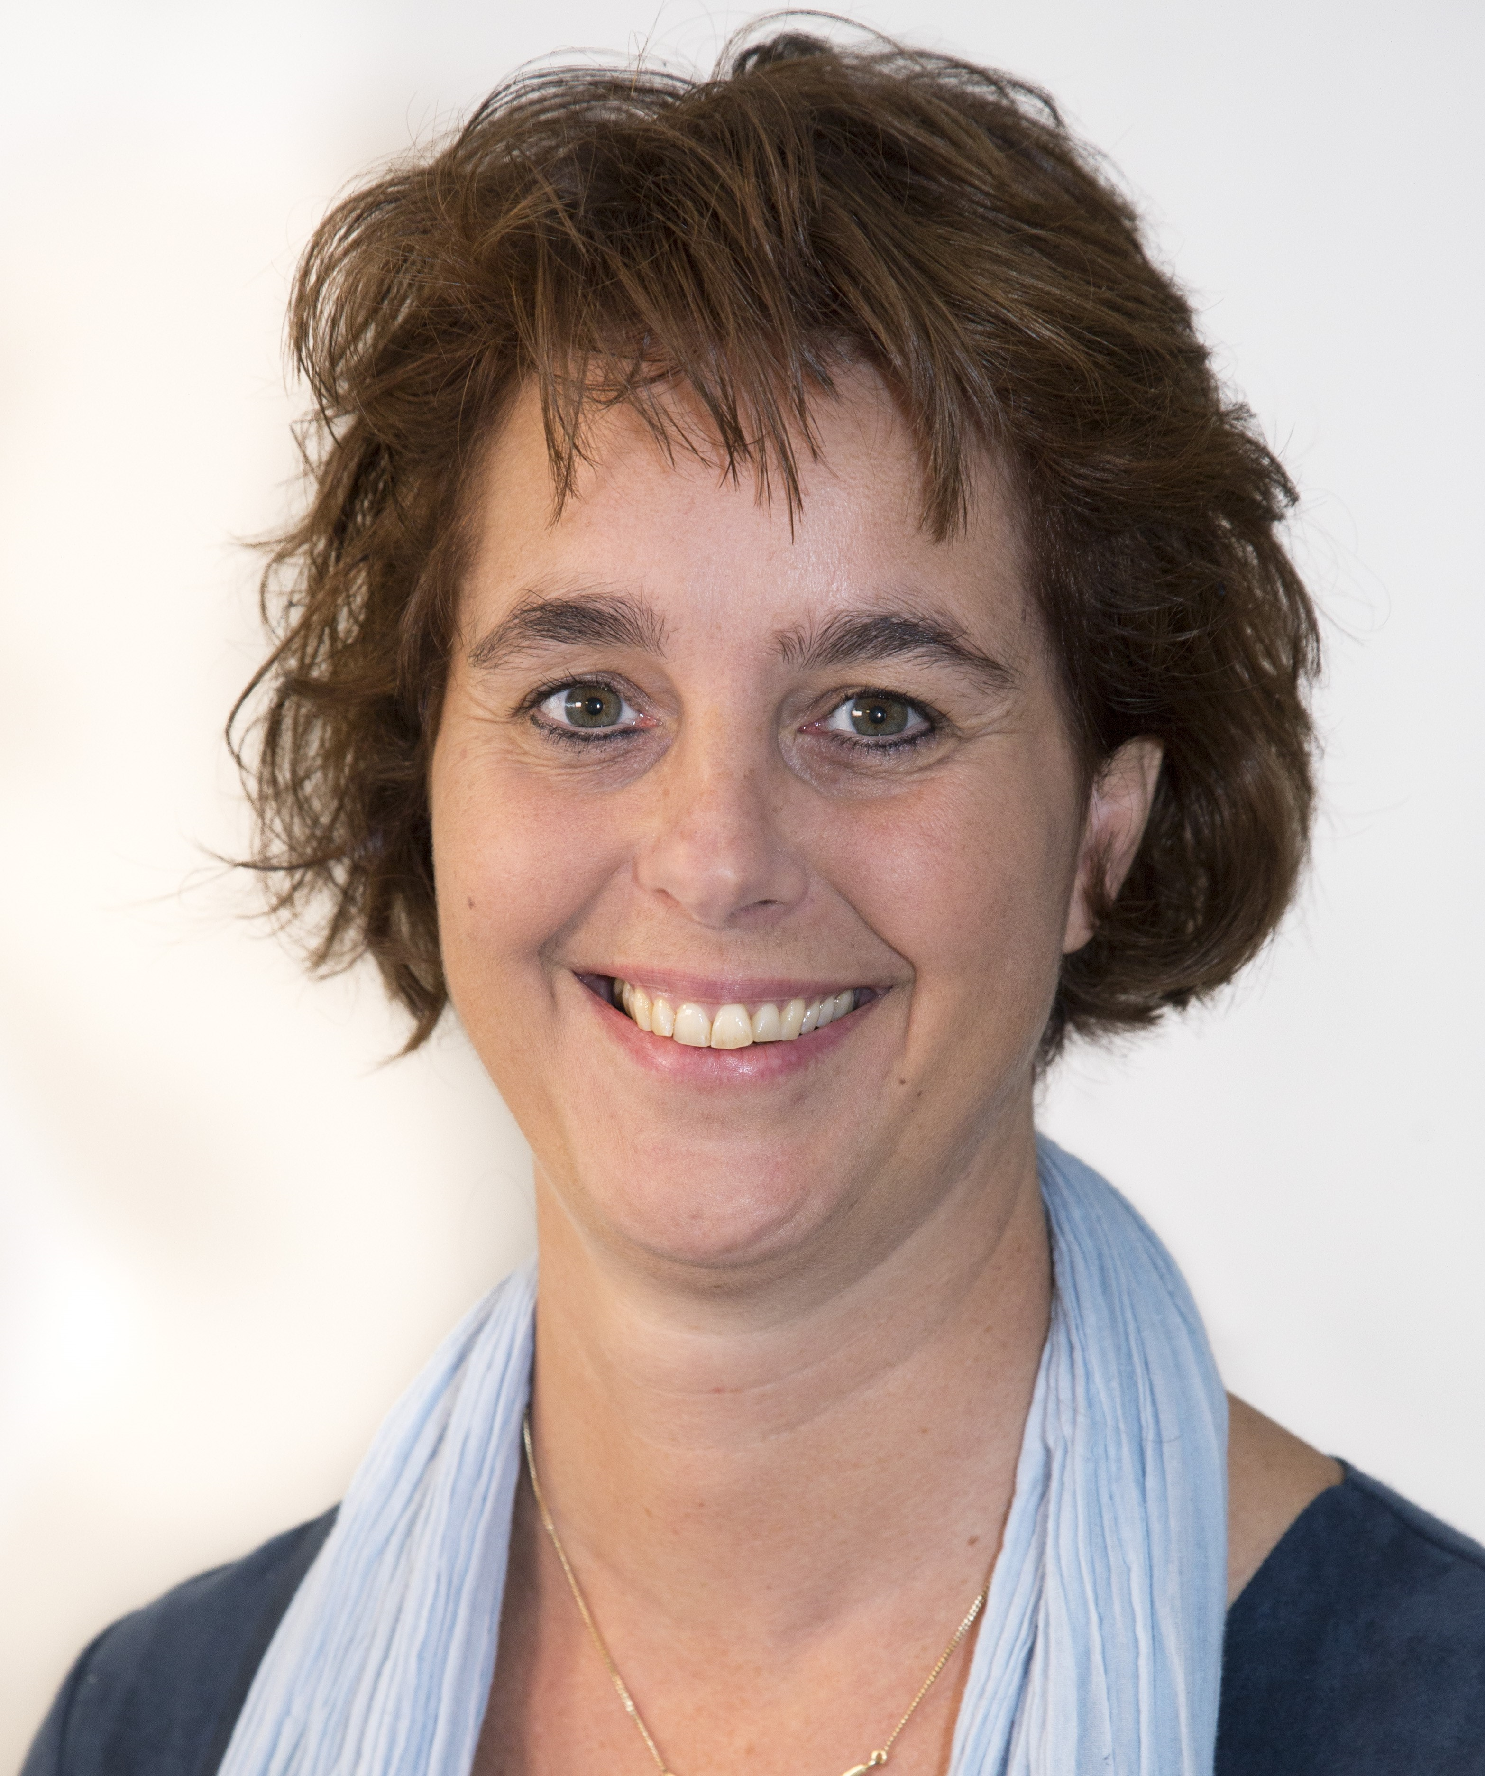


Thank you
Contact us during the EAHIL workshop
m.heymans@zuyderland.nl
Notes:
Thank you for letting me share our experiences here.
I would like to invite you to ask questions? Are there any questions?
Or have you done a similar project yourself? Please, will you share your experience…
If you have any questions or would like to exchange ideas in the coming days, please ask one of the project members, Marjan, Eugenie, Chantal or me. We all are in Lodz!
Thank you very much for joining this session

