Slide 1


Slide 2


Slide 3


Slide 4


Slide 5

Efficiently retrieving publication data -
An automated approach using R and Swepub
Eric Ahl¹
¹ HTA South, Region Skåne, Sweden
Notes:
Thank you for giving me the oppurtunity to present this project that I’ve been work on for more than a year now.
My name is…
R – a simple programming language, designed mainly for working with datasets

Slide 6

The old method: How we used to retrieve bibliographic data
The new method: Retrieving data automatically using R
Learnings
Notes:
The new method, which we are beta testing, you might say
Learnings from designing the method

Slide 7

The old method

Slide 8

The old method - searching author affiliations in Web of Science
Retrieve data on request 1-2 times per year
Design several affiliation/address search queries in Web of Science
(1 query per hospital)
Retrieve records manually in CSV or BibTeX format
Data cleaning and processing in R
Notes:
Requests from decisionmaker (heads of research), researcher strategists etc

Slide 9


The old method - pros and cons
Pretty straight forward method to execute
Represents an external viewpoint
A lot of manual labour to download and clean data
Affiliation data is self-reported and not very trustworthy!
Data cannot be reliably subdivided!
Notes:
Upsides and Downsides.
An external viewpoint – so when The Swedish Research Council evaluates our organisation, this is what they’re able to see.
Authors wilfully or unwilfully misstate their affiations. Discovered some who weren’t actually employed in Region Skåne – or were employed at a different hospital than they stated. Also naming conventions may change over time.
We could break down data per hospital, but necisionmakers requested a more granular view with the data subdivided at lower organisational levels such as hospital departments, subunits etc. Also the ability to specifically evaluate individuals who had received funding.

Slide 10
The new method

Slide 11
The new method - my priorities
Increase the trustworthiness of the data
  Prerequisite: having some verification in registration
Make a database for analysis on all organisational levels
  Prerequisite: working with individual-level data
Automate the process for data retrieval
  Prerequisite: using an API for data retrieval

Slide 12
The new method - it started with looking at Swepub
Maintained by the National Library of Sweden
Gathers data from Swedish institutional repositories
Can be queried using a browser or via an API
Notes:
Data from roughly 40 HE institutions and government agencies in Sweden – Data validated through Irs.

Slide 13
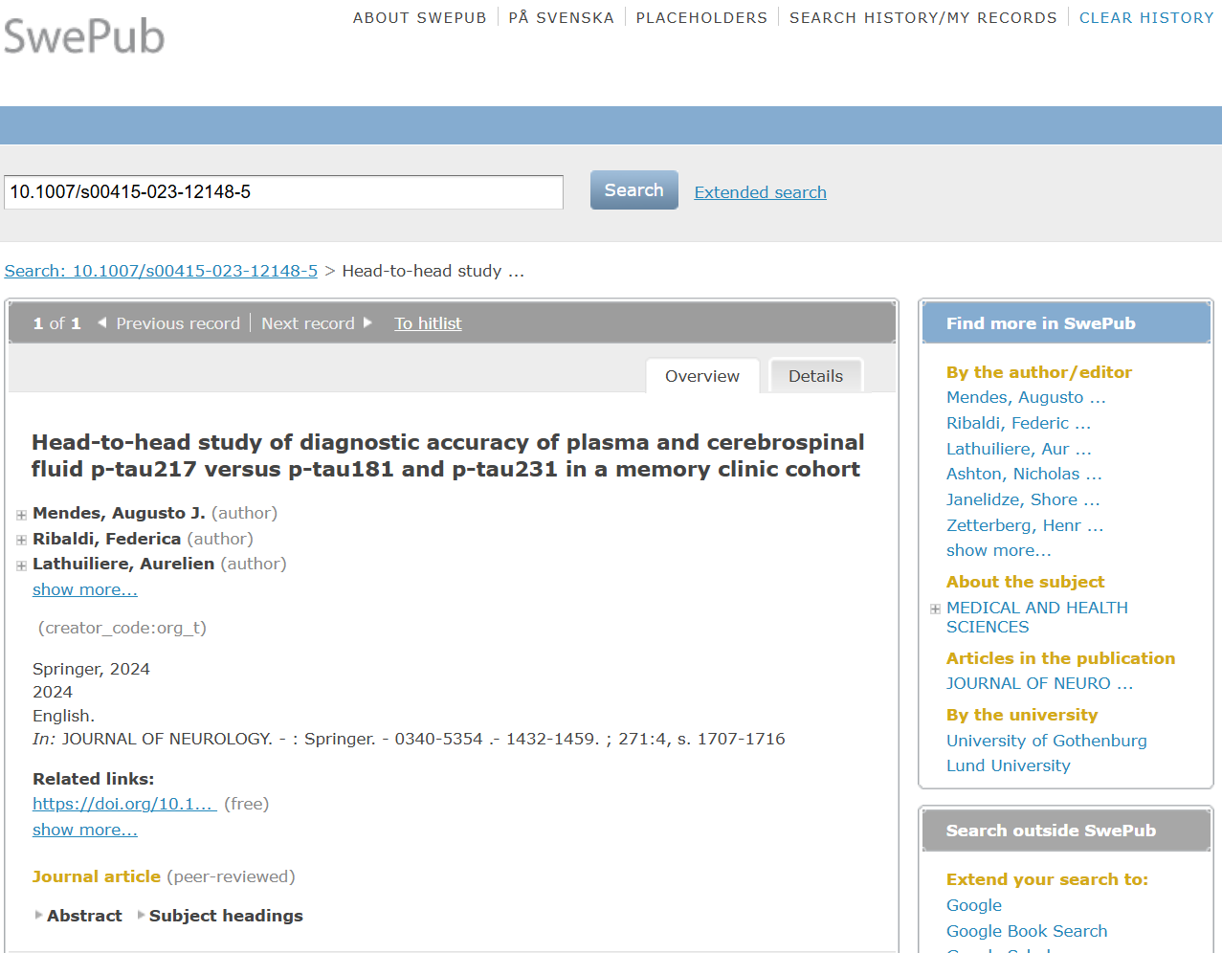
The new method - it started with looking at Swepub

Slide 14
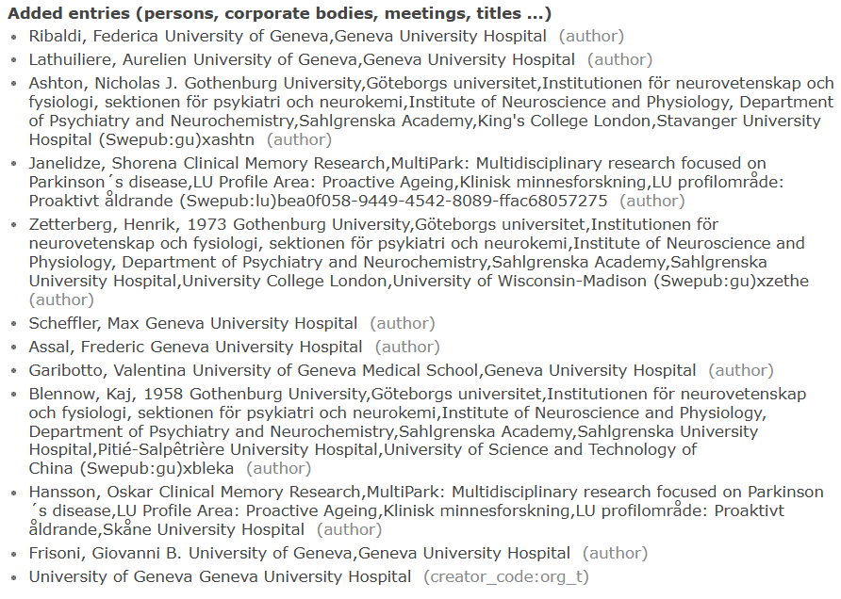
The new method - it started with me looking at Swepub
Notes:
Carries an unique instutional ID that is carried over from the IR.
It was from there that i deviced my plan, so to say

Slide 15
The new method - the method I designed
I created a web application (Shiny app) in R where you can:
  Upload a registry of researchers/authors with unique IDs to locate their published journal articles in Swepub
  Retrieve publication data from Swepub via an API
  Add citation data from Web of Science via an API
  (Add ”experimental” data from OpenAlex via an API)
  Add ESI citation percentiles from based on an Excel file
After each step the app gives you a summary of the results
and an Excel file can be downloaded for each step
Notes:
3. Via the WoS starter API
4. I view it as experimental, as I’m not convinced of the trustworthiness of some of the data points
5. Last – and this is a big one for decision makers

Slide 16
Step 1: Create a registry of authors
Notes:
This is a simplified author registry. The registry consists of employees who author journal articles.

Slide 17
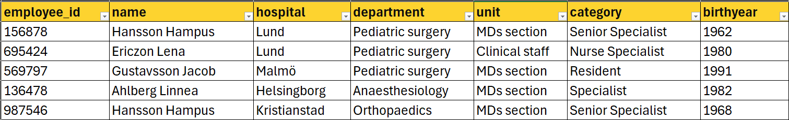
Step 1: Create a registry of authors
Notes:
The coulmns in yellow are data which an HR department might supply.
Employee ID is essential for reliably connecting HR data with data from other parts in the research monitoring framwork (such as research finances)

Slide 18
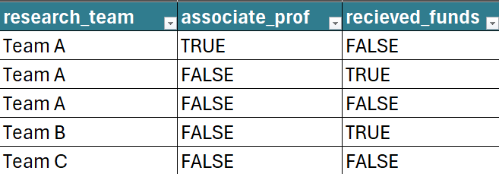
Step 1: Create a registry of authors
Notes:
The blue columns are data which we collect ourself and add into are author registry.
Units which aren’t a in the HR-data.
Academic merits that we want be able to filter our dataset by, such as the number of associate professors.
If the authors have recieved strategic funds.

Slide 19

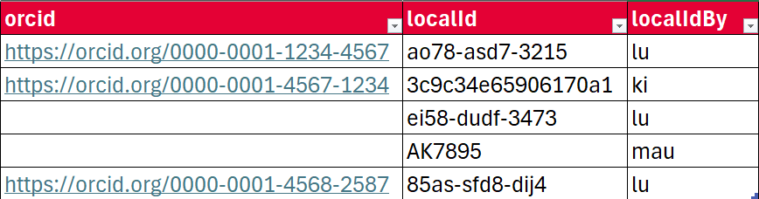
Step 1: Create a registry of authors
Notes:
The red columns are data which are used to locate publications by the authors in Swepub
ORCID, if they have it connected to their IR. If not, a unique (localId) is always carried over

Slide 20
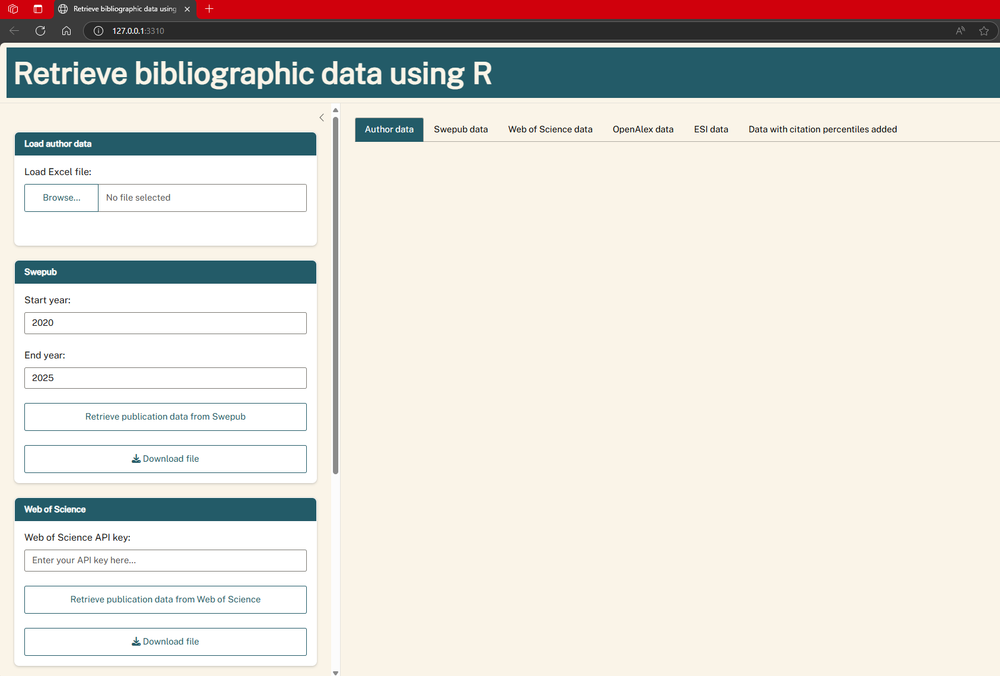
Step 1: Upload the registry in the app
Notes:
This is the web application. Each box on the left belongs to a step in the process that I described earlier
On the right we can view the data relevant for each step.

Slide 21
Step 1: Upload the registry in the app
Notes:
Excel file with our registry of authors

Slide 22
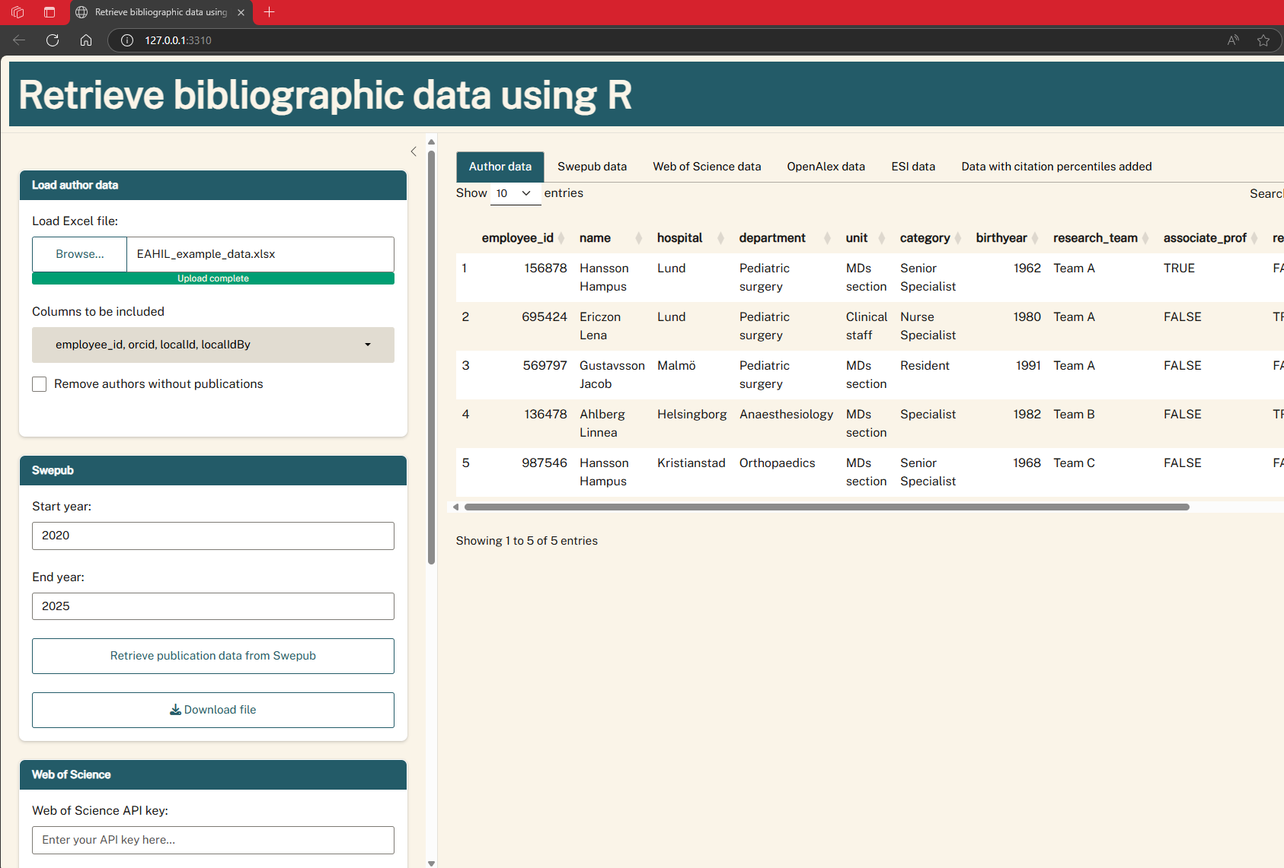
Step 1: Upload the registry in the app
Notes:
Here we see that it has been uploaded into the application and that the data-formatting is correct

Slide 23
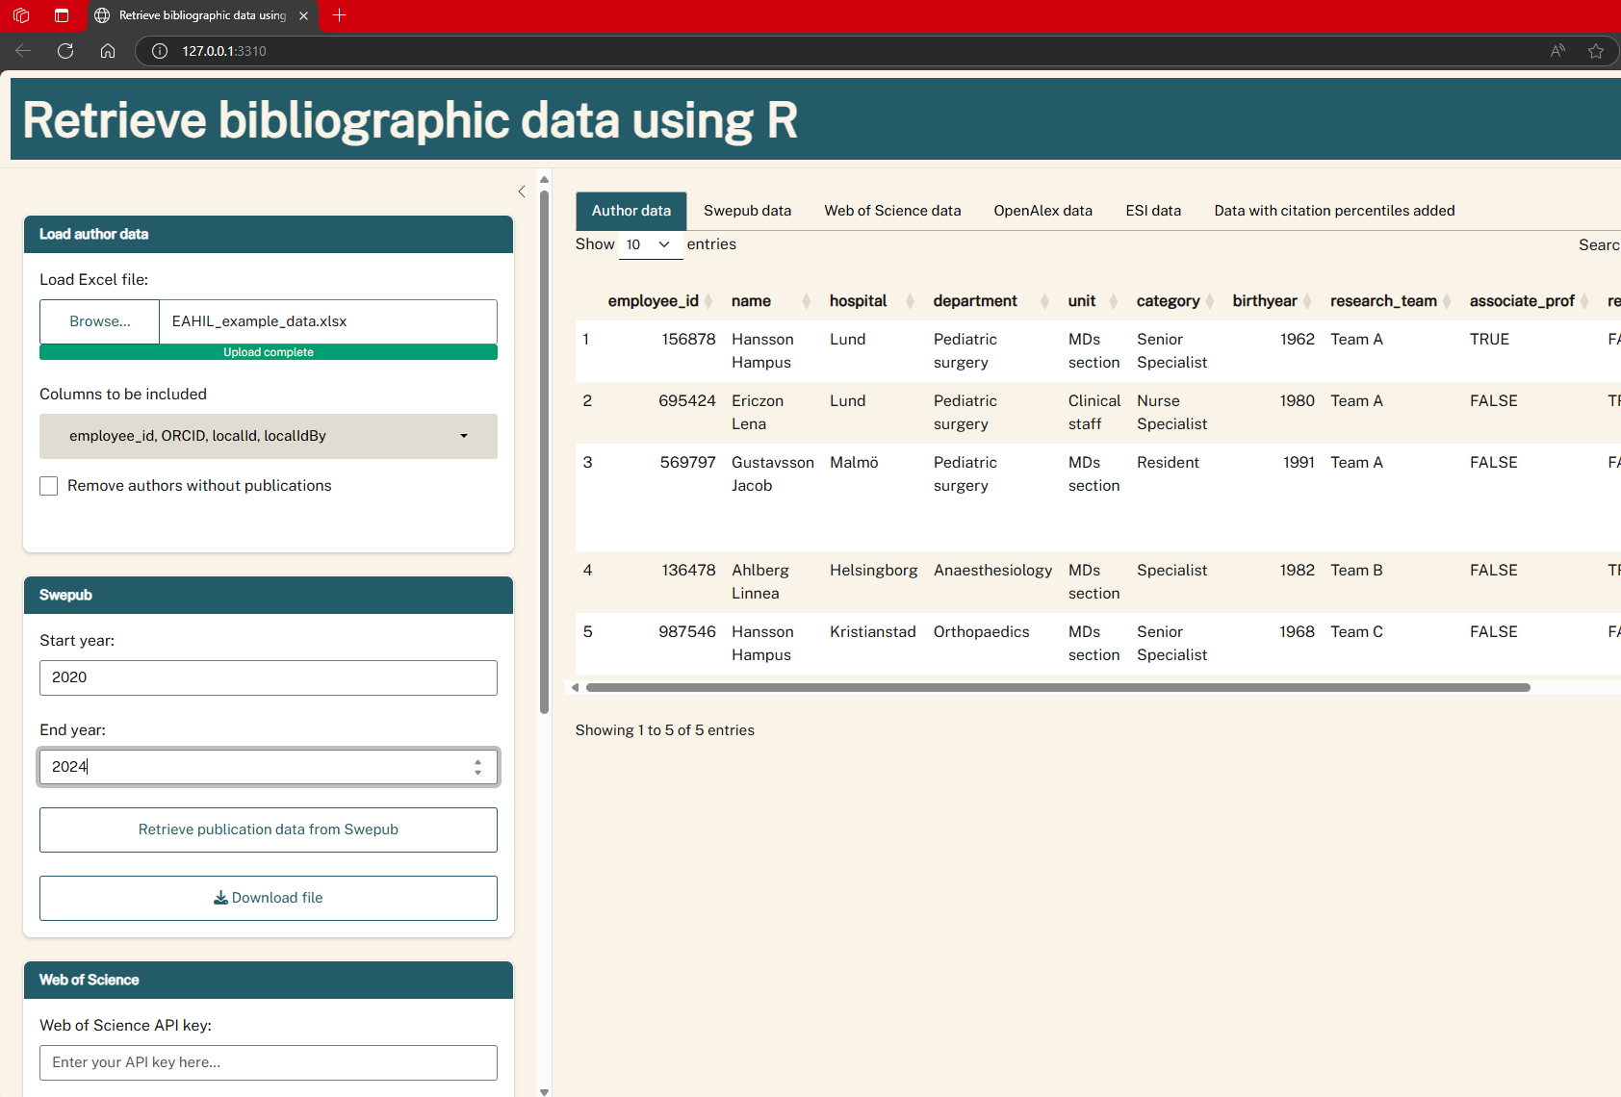
Step 2: Enter years and retrieve Swepub data
Notes:
… And push the button to retrieve records from the Swepub API

Slide 24
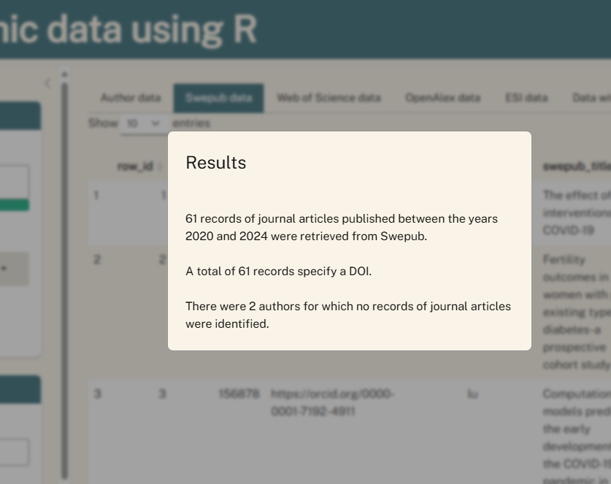
Step 2: Enter years and retrieve Swepub data
Notes:
For each step the application gives you a short summary of the results of the information retrieval
We see that 61 records were retrieved and that all contain a DOI. We also see that no records were retrieved for 2 authors.

Slide 25
Step 2: Enter years and retrieve Swepub data
Uses the ORCID/localId to query and retrieve Swepub data
Retrieves the following data fields from Swepub:
  DOI
  Title
  Journal/publication channel
  Publication year
  Open Access status
  Creator count
  Swepub unique ID
Notes:
15 minutes to perform 1500 queries = 1500 researchers/authors over 5 years
Unique database ID – just in case we want to double check the data or add more data in the future

Slide 26
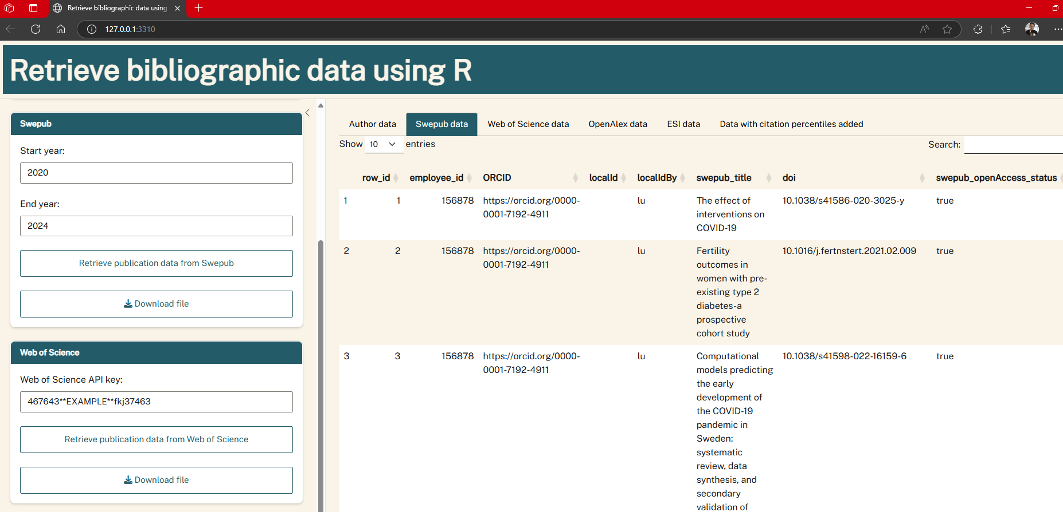
Step 3: Add citation data from Web of Science
Notes:
We enter our key to the Web of Science starter API

Slide 27
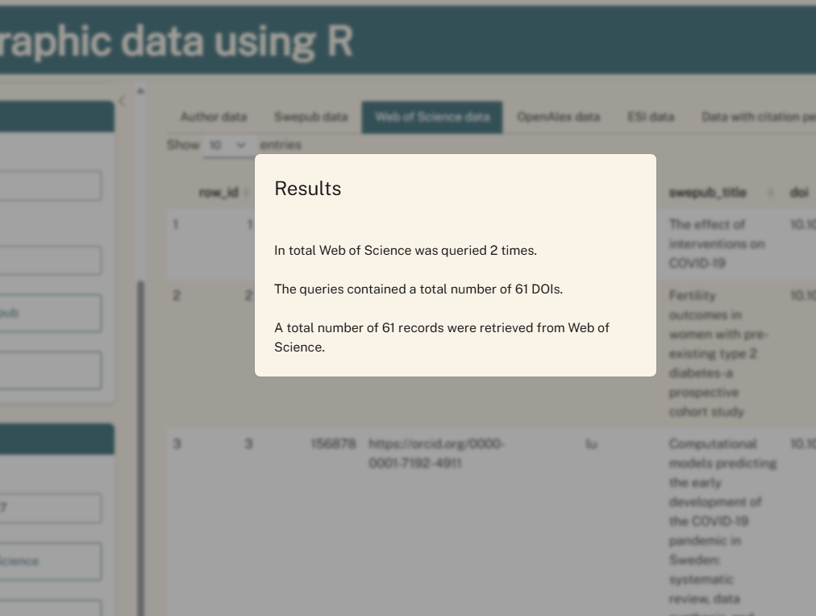
Step 3: Add citation data from Web of Science

Slide 28
Step 3: Add citation data from Web of Science
Uses the DOIs retrieved from Swepub
This step adds the following data fields:
  Citations in Web of Science
  Fractional citations (citations/number of authors in Swepub)
  Document type
  PubMed ID
  Web of Science ID
Notes:
4 minutes for 180 queries (7200 records)

Slide 29
Step 4: Add additional data from OpenAlex
Same process as Web of Science
This step adds the following ”experimental” data fields:
  Citations in OpenAlex
  Funders mentioned in the record
  Institution names and number of institutions
  Name of the first and last author
  Checking for retracted publications
Notes:
Takes about 55 minutes for 180 queries

Slide 30

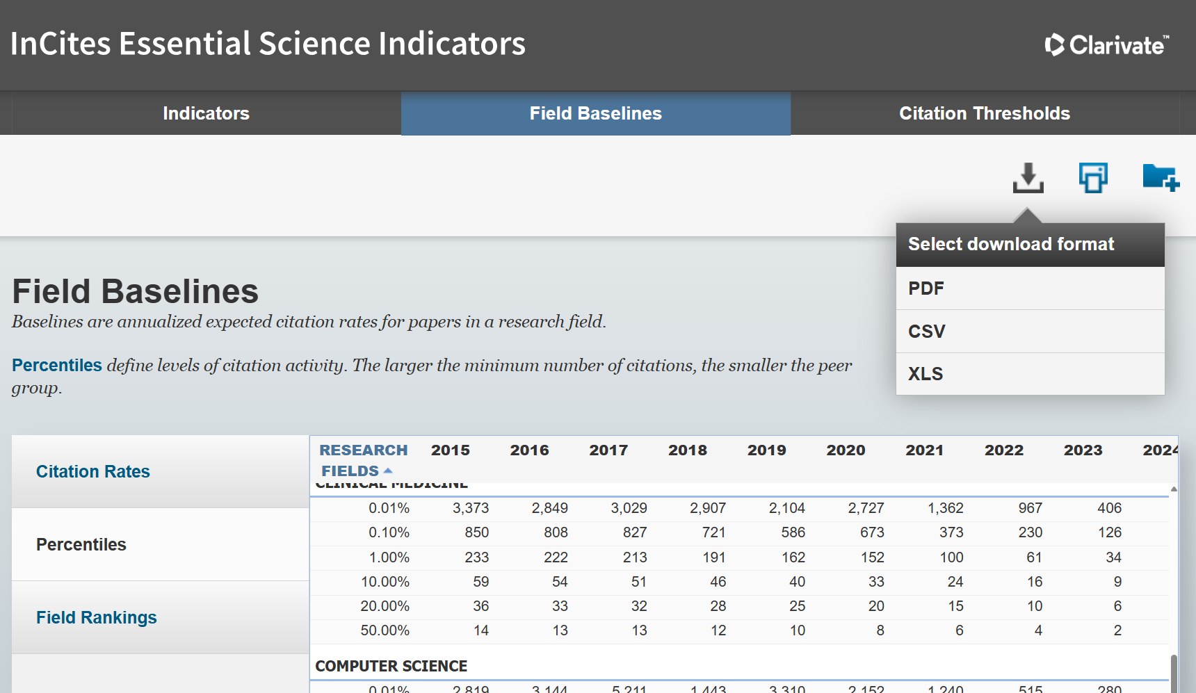
Step 5: Add ESI citation percentiles
Notes:
We also make note of the date that the indicators were last updated, since citation thresholds vary over time

Slide 31
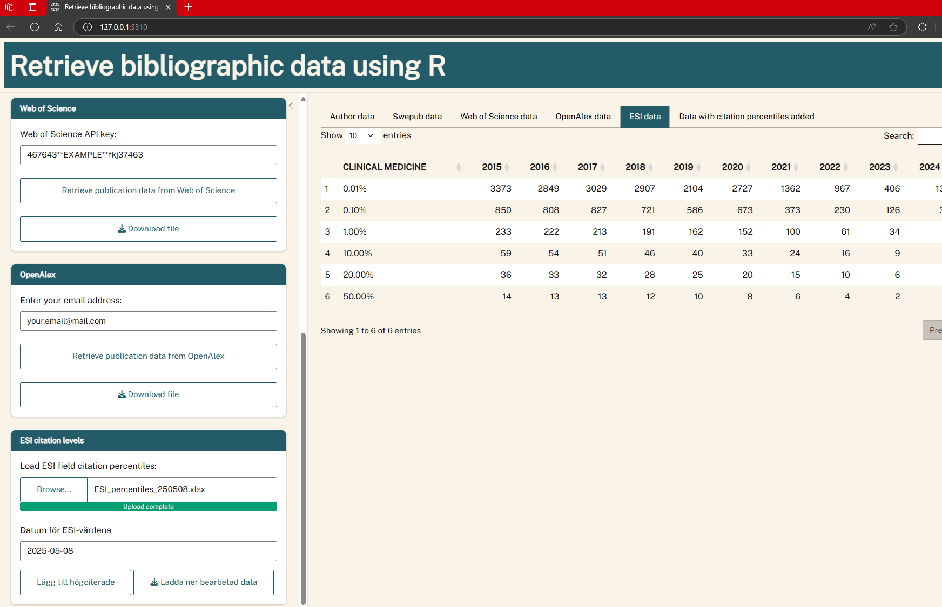
Step 5: Add ESI citation percentiles

Slide 32
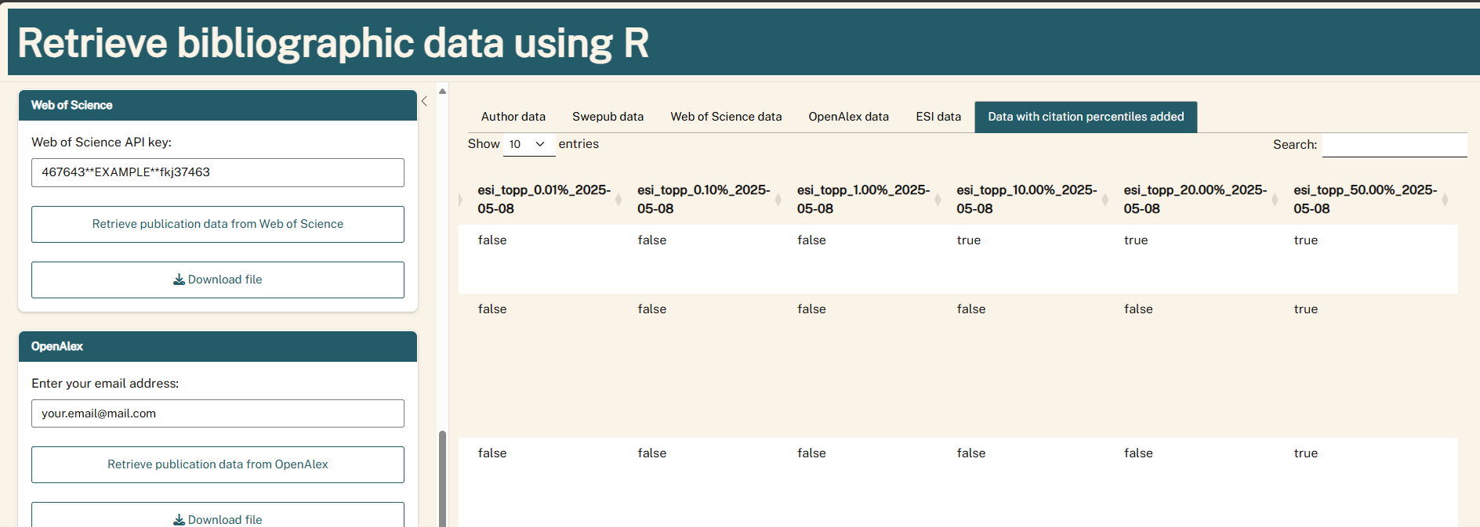
Step 5: Add ESI citation percentiles
Notes:
For this publications it is ”TRUE” that it is in the top 20% most cited publications.

Slide 33
Step 5: Add ESI citation percentiles
This step adds ESI citation percentiles to the dataset
The column name includes the date the ESI data was updated
Each percentile threshold is presented as a boolean (true/false)

Slide 34
The result
Now we download a file with all publications and added data
I’ll show an example were Excel is used to:
  Present the data using pivot tables
  Interact with the data using slicers
  Create dynamic charts that can easily be exported

Slide 35
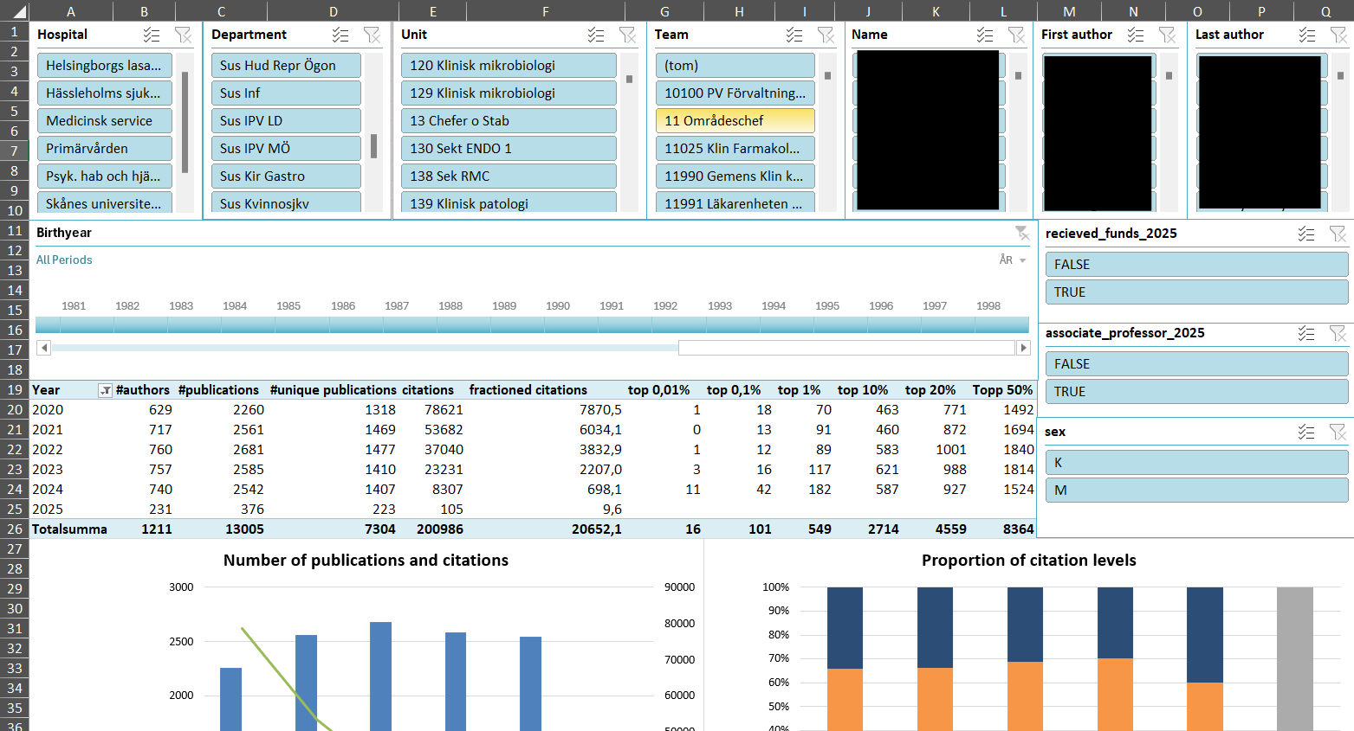
The result – example using Excel to calculate and visualise
Notes:
I’ve blurred the names that otherwise would be visible in the top right corner

Slide 36
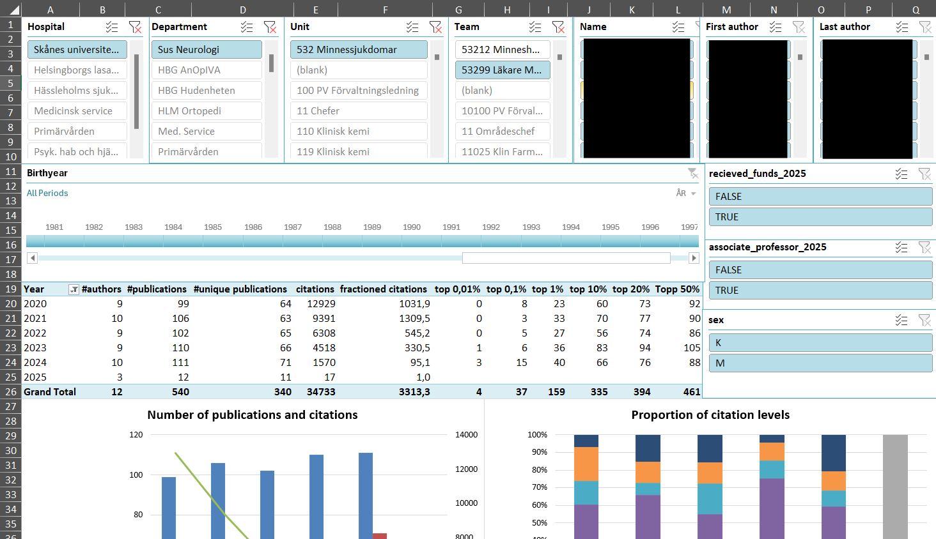
The result – slicers allows you to interact with the dataset
Notes:
The top and right part are made up of so called slicers. Clicking a value in a slicer updates the data in the sheet based on that particular option (or combination of options)

Slide 37
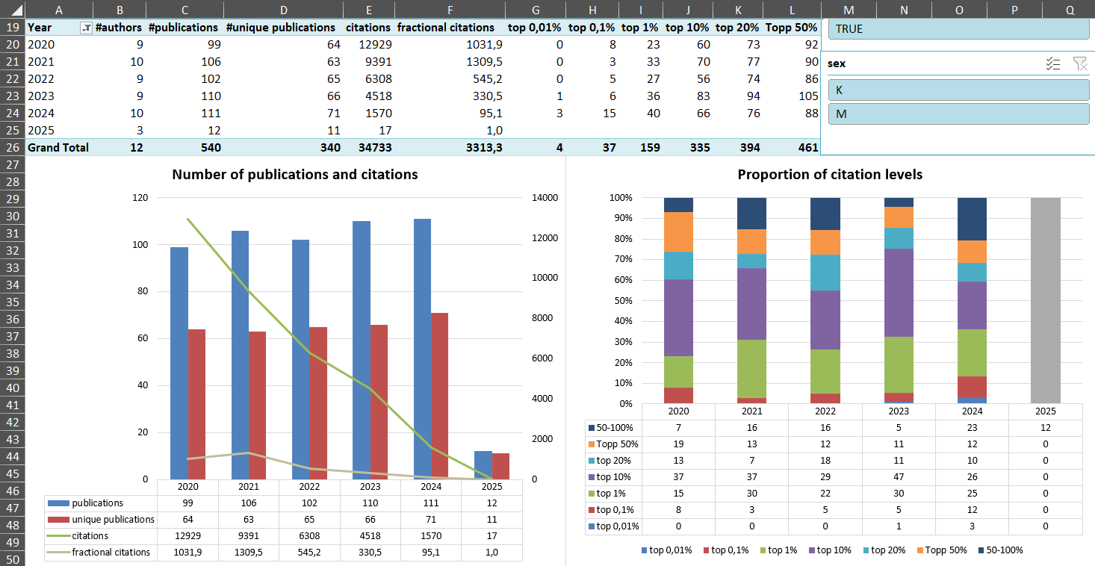
The result – tables and charts are updated automatically
Notes:
In the middle of the sheet there’s a table and in the bottom half of the excel sheet are two charts all of which are updated based on the slicers above.
In the chart left the bars show the # of publications and # of unique publications (The difference is made up of co-authored publications). The lines show number of citations and fractional citations.
The chart on the right illustrate the distribution of citation levels within the publication data, again based on the options chosen in the slicers above

Slide 38
Learnings

Slide 39
Learnings
Pros with the new API-based method:
Automated retrieval is faster and easier (in some ways)
The methods are reproduceable and explainable
A lot of added value by combining publication data with other data sources
Decision makers value being able to interact with the data
Notes:
Since the decision making has to be made a priori and written into the scrips that automate the retrieval, the parameters are reproduced each time and are more consistent and – I feel – easier to explain
Gives us the means to look connect data types.

Slide 40
Learnings
Cons when using the new API-based method:
Creating and maintaining an accurate registry of authors may be
time-consuming
Reliance on other actors (database providers, API developers)
To do: Design data retrieval for authors not in Swepub and select name-searching
Notes:
Depending on how you build your registry, there may be some manual labour involved. I manually checked most of the 1500 names I have in my registry, which took time. But hopefully this was a one-time investment.
In the worst case: the script temporarily breaks down due to updates in R packages or due to changes in the databases on which the data retrieval depends. Mimimising reliance on other parts can be optimised over time – but it will likely take time and experience.
Authors who are not represented in Swepub – rare – affiliated to HE instution in another country. Also name searching select individuals who publish without HE institutions.

Slide 41

Eric Ahl, HTA South, Region Skåne
eric.ahl@skane.se

Slide 42


