Slide 1


Slide 2


Slide 3


Slide 4


Slide 5

How do researchers (re)search - and how can we contribute?
Collaborative approaches to literature searches
Joakim Westerlund¹, Cia Gustrén Holmbergh²
¹ Linköping University library, Campus University Hospital, Linköping, Sweden
² Linköping University library, Campus Norrköping, Norrköping, Sweden

Slide 6

Outline of presentation
About us
How do researchers search?
Our study: background, purpose, aim & methodology
1) Interview study, 2) Service description analysis
How does it align with a collaborative approach?

Slide 7

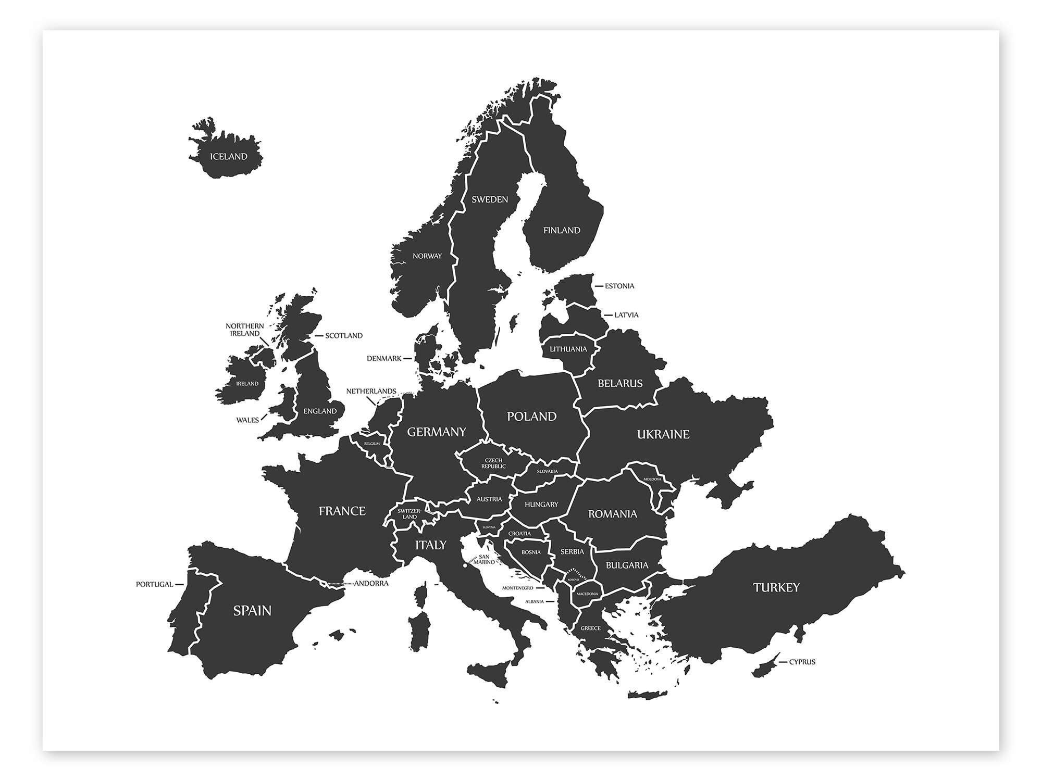
Linköping University library
Linköping University​, County of Östergötland, Sweden
Established in 1975
44 500 students & 4500 employees
Four faculties:
Medical, Technological, Educational, Philosophical
Three campuses = three campus libraries:
In Linköping: Campus Valla & Medical Library ​
In Norrköping: Campus Norrköping​ library

Slide 8
Linköping University library search support
A team of search support divided into two subgroups:
One subgroup directed towards searches within the Medical sciences
One subgroup directed towards searches within Technology, Educational
Sciences, Social sciences, Humanities
We provide researchers with:
search support services (search tutoring):
librarians give advice and guide researchers in the search process
search request services (search assignments):
librarians design and conduct searches

Slide 9
Bookings for search support at LiU
Systematic reviews take most of our time
Directed towards the medical faculty
14 systematic search requests 2024
21 search tutorings

Slide 10
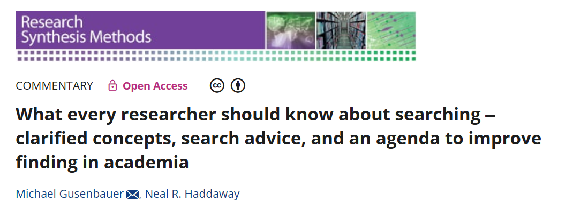
How do researchers search?
A survey of doctoral students’ ways of searching for literature
Before taking the survey, doctoral students were asked to read the following publication which discuss different search behaviors

Slide 11
Systematic searches
Search question: Precise and focused
Search process: Systematic, strict methods, team-work by definition
Exploratory searches
Problem context: Open-ended, persistent, multi-faceted
Search process: Unsystematic, iterative, multi-tactical
Used in: Discovery, learning, decision-making
… and the searcher? Uncertain of goals, fuzzy and dynamic information need,
unfamiliar with domain
Lookup/everyday searches
The Query-response paradigm
Search process: highly personalised and isolated
(White and Roth, 2009; Soufan, et al, 2022)

Slide 12
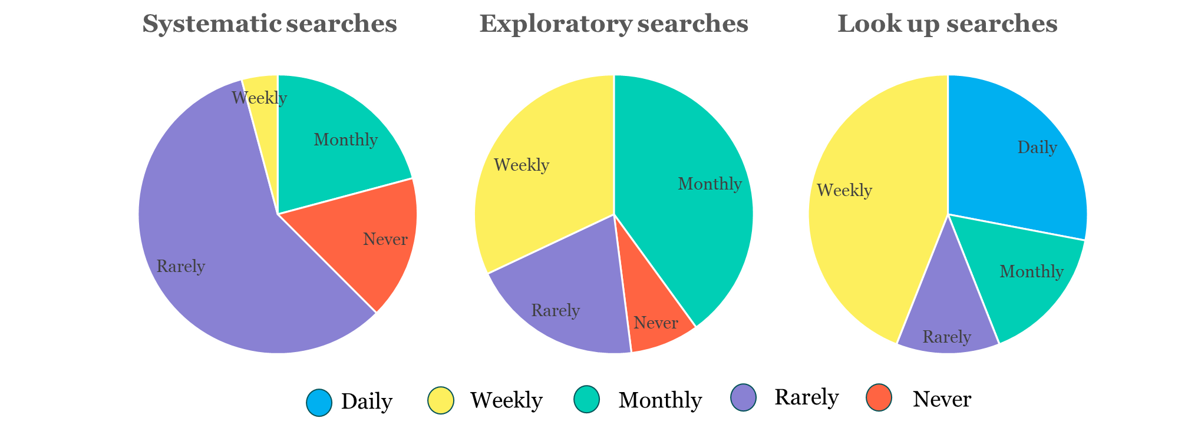
How do researchers search?

Slide 13

"The behavioral patterns are analogous to an artist's palette, in which activities remain available throughout the course of information-seeking“ (Foster, 2004)

Slide 14

Is there an unbalance here?
A lot of time invested by the library in systematic searches
But researchers spend more time with other types of searches
How can we contribute to this art of searching?

Slide 15
1. A short qualitative interview study at LiU
(autumn 2023)
Background: How do we reach out to researchers in the process of searching?
Purpose: To tentatively map the search needs and behaviours of LiU researchers, and think about how to adapt search support to these needs and behaviours
Methodology: Semi-structured interviews with ten researchers at LiU, analysed thematically by concentrating interview statements to their core meaning and categorising these in line with three different search behaviours.

Slide 16
We found that the interviewed LiU researchers:
are engaged in all three types of search behaviours
want to collaborate on systematic searches
express concern about the quality of searches which are not systematic
tell us about a threshold for contacting us
request more teaching, but also informal opportunities to share search-related issues.

Slide 17
2. Service description analysis (spring 2025)
Background: How are library search support services communicated, and to what extent does it align with a collaborative approach to searching?
Purpose: To get an overview of the way other university and academic libraries describe their search support services
Method: Thematic analysis of service descriptions on the websites of ten Swedish university libraries.
Looking at the way these services are named and delimited.
Identifying and exemplifying categories or tiers of search services available to researchers.

Slide 18
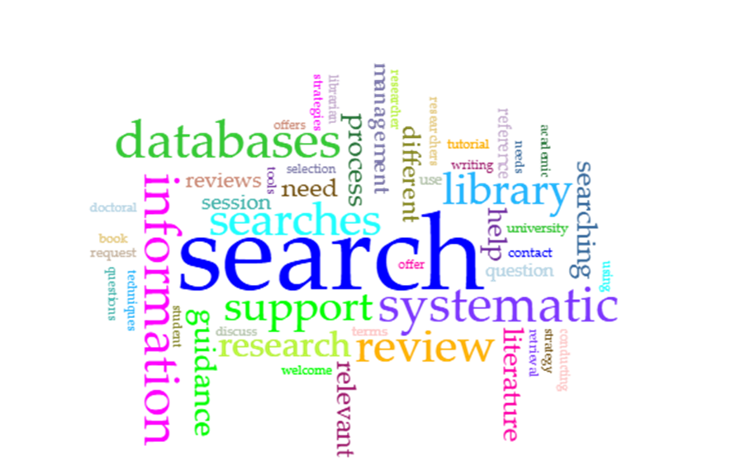
Three tiers of search support services:
Introductory search support
Self-study and help to self-help- guides; providing a
knowledgebase for researchers in searching, tutoring
for the purpose of getting started with searches.
Customised search support
Consultation as to specific searches depending on
where the researcher is in the search process; librarian
designed searches on demand and according to needs
Collaborative search support
Conducting searches in collaboration with researchers;
mediated searches adapted to a research process at large

Slide 19
How does it align with a collaborative approach?

Slide 20
Our aim for collaboration is to promote:
Joint effort: working together towards a shared goal
Equal contribution: forming a team of academic associates
Mutual exchange: resulting in a sense of ownership
Interprofessional openness: fostering trust across boundaries
Shared learning: extending the competencies of the team

Slide 21
For purposes of collaboration in searches:
Need to confirm collaboration within systematic searches, develop collaboration in exploratory searches, learn and teach collaboration in everyday searches
Need to prioritize and demonstrate value of collaboration as collaboration takes a certain amount of time and resources
Need to communicate the importance of searches as situated in context with the research process at large rather than being isolated efforts, to lower the threshold to consult librarians in search-related matters

Slide 22
Refererences
Foster, A. (2004). A nonlinear model of information-seeking behavior. Journal of the American Society for Information Science and Technology, 55(3), 228-237. https://doi.org/https://doi.org/10.1002/asi.10359
Gusenbauer, M., & Haddaway, N. R. (2021). What every researcher should know about searching – clarified concepts, search advice, and an agenda to improve finding in academia. Research Synthesis Methods, 12(2), 136-147. https://doi.org/10.1002/jrsm.1457
Soufan, A., Ruthven, I., & Azzopardi, L. (2022). Searching the Literature: An Analysis of an Exploratory Search Task. ACM SIGIR Conference on Human Information Interaction and Retrieval, 146–157. https://doi.org/10.1145/3498366.3505818
White, R.W. & Roth, R.A. (2009). Exploratory search: beyond the query-response paradigm. [San Rafael, Calif.]: Morgan & Claypool Publishers.

Slide 23

Joakim Westerlund
joakim.westerlund@liu.se
Cia Gustrén Holmbergh
cia.gustren.holmbergh@liu.se

Slide 24


