Slide 1


Slide 2
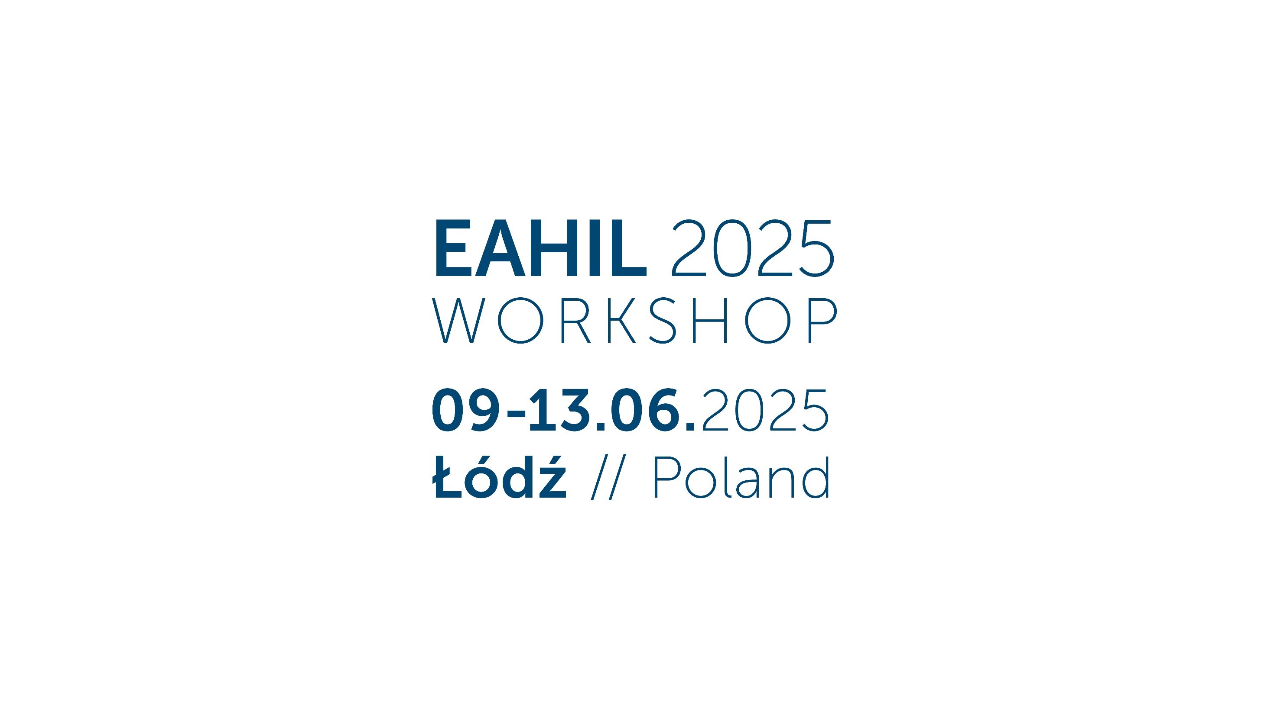

Slide 3


Slide 4


Slide 5

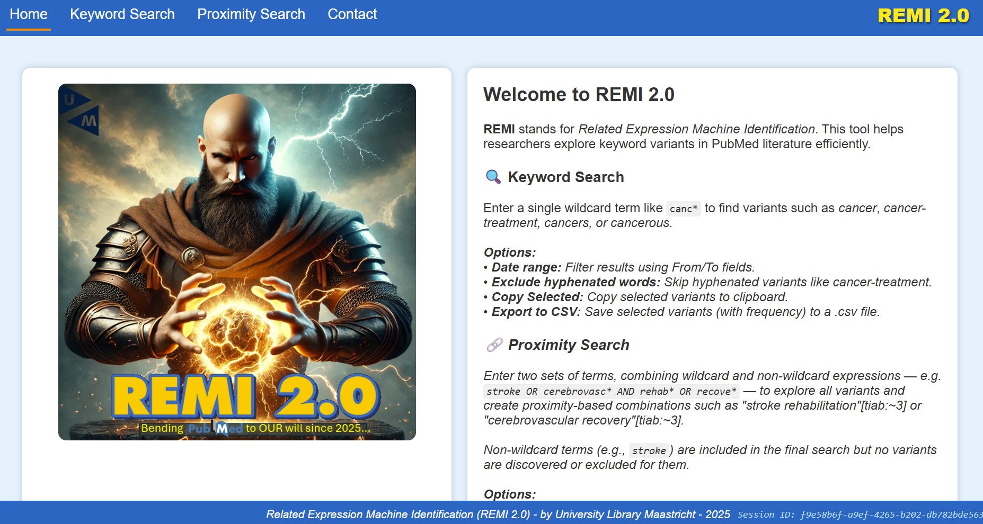
REMI 2.0
Remy van Alebeek¹, Rinus Verdonschot¹, Floor Ruiter¹
¹ Maastricht University Library | Scientific Information Specialist

Slide 6



Do you use PubMed for Systematic Searching?
Yes
No

Slide 7
Are you able to search in MEDLINE through a database that offers functional proximity operators?
Examples: Medline through OVID or EbscoHOST
Yes
No

Slide 8

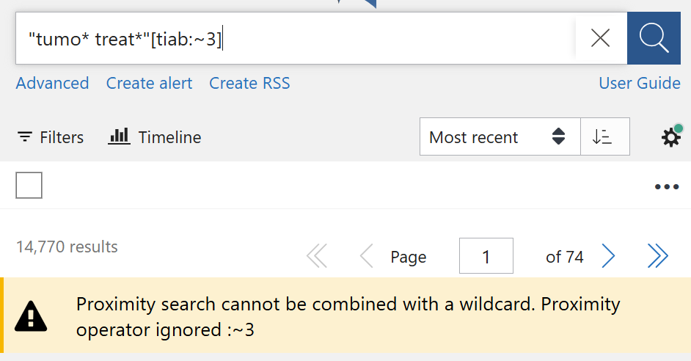
How does this make you feel?

Slide 9
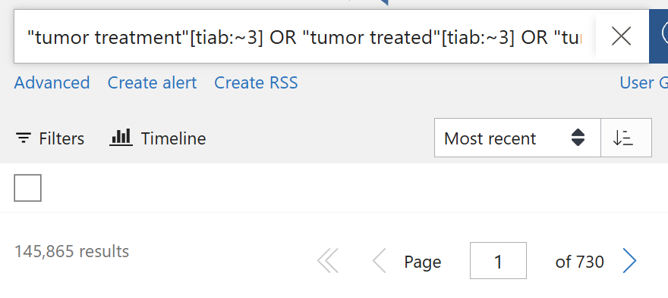

What is REMI2.0?
With REMI 2.0:
Normal truncated proximity
search in PubMed:
REMI 2.0 mimics truncated proximity search within minutes with these steps:
Collect all terms which are found with the first set of truncated term(s)
Collect all terms which are found with the second set of truncated term(s)
Combine all possible combinations of these terms with OR
Through this, truncation proximity searching is now possible in PubMed!

Slide 10
A quick... demonstration!
[Redirect]
← in case of technical difficulties

Slide 11
But, does it work? | Results & Conclusion
Keyword Search (N=5) 21/05/2025
Term | PubMed | REMI 2.0 | Percentage Accuracy
Tumo* | 2.247.390 | 2.247.361 | 99,9987%
Treat* | 7.399.942 | 7.399.912 | 99,9996%
Complian* | 178.288 | 178.286 | 99,9989%
Diagnos* | 3.448.588 | 3.448.568 | 99,9994%
Prognos* | 929.355 | 929.350 | 99,9995%
TOTAL | 14.203.563 | 14.203.477 | 99,9994%
Keyword search is a reliable way to find all keywords identified through a truncated term.
Of course, normal truncation searching is possible in PubMed. This can however used for educational purposes and tracking down whether a truncated term might lead to rubbish.
Currently, only truncation at the END of a term is possible for Keyword Search.

Slide 12
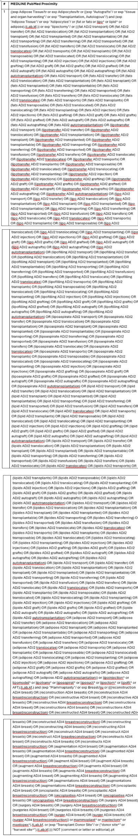
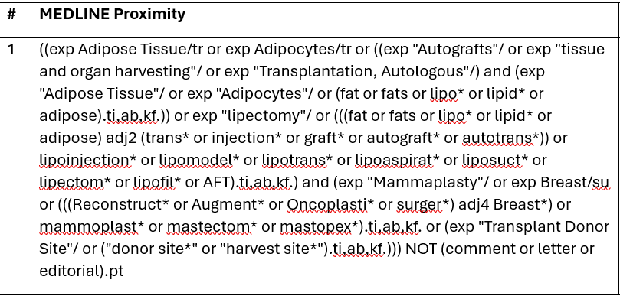
But, does it work? | Results & Conclusion
Proximity Search (N = 4) 26/05/2025
For this test, four search strategies performed in MEDLINE with ADJ searching were compared against proximity searching with REMI2.0. For a fair 1:1 comparison, the REMI2.0 PubMed query was translated to MEDLINE.
Search # | MEDLINE ADJ Hits | MEDLINE REMI2.0 Hits | Percentage Accuracy
Search #1 | 2453 | 2427 | 98.940%
Search #2 | 1806 | 1805 | 99.945%
Search #3 | 3049 | 2998 | 98.327%
Search #4 | 1319 | 1264 | 95.830%
TOTAL | 8627 | 8494 | 98.458%
For small proximity searches where little to no selection of terms is required, REMI 2.0 almost provides perfect accuracy towards its Medline true proximity counterpart.

Slide 13



Conclusion:
It does work! But...
Limited accuracy for complex proximity searches with many terms.
  That said, manual selection of relevant terms ALSO lead to better retrieval of relevant articles. The articles which are lost through REMI 2.0 may not even be relevant.
Maximum of 2048 “combinations”
Truncation only at the end of terms (currently)
It doesn’t look very sexy...
Would you use it?
Yes
No

Slide 14


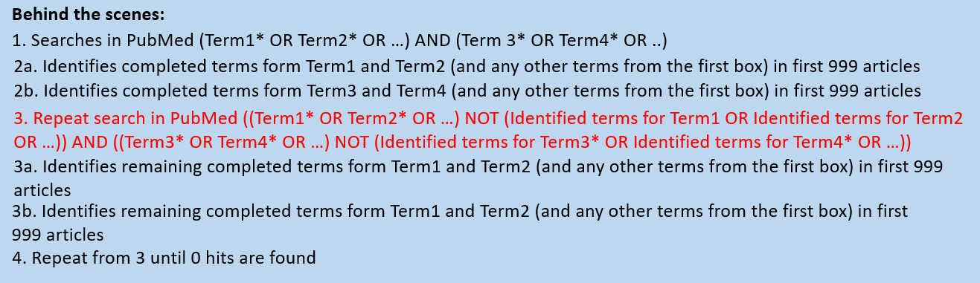
Questions you might have:
Q1] How would I report this according to PRISMA-S?
Q2] How does it work?
Just kidding! It’s in the abstract of the presentation. But also here:

Slide 15
Questions you might have (Part 2):
Q3] What happened to REMI 1.0?
We don’t talk about REMI 1.0. In all seriousness, it was a very early version that was inefficient and didn’t work well.
Q4] When can I use it?
Good question! Currently, I am not sure how it works with multiple concurrent users. In addition, we still want to do some final touches before opening it to the public. Once it is done, we will make sure to communicate it through the expertsearching mailbox (and maybe at next EAHIL...). We think it will be done within a year.
Q5] Are there any plans to use OpenAlex for term identification?
Possibly? Not a priority though. With OpenAlex, more terms will likely be identified. But if these terms do not occur within PubMed, then there is no point searching those in PubMed.

Slide 16
Questions you might have (Part 3)
Q6] What if PubMed goes dark?
I think we will have bigger things to worry about than this tool being useless.
Q7] What if PubMed implements proper proximity searching?
Hahahahhahahahahahahahahahahahah
Keep on dreaming.
Q8] My question hasn’t been listed, can I still ask it?
Okay, but make it quick.

Slide 17

Remy van Alebeek, Rinus Verdonschot, Floor Ruiter
Maastricht University Library
Contact @ UB-SysRev@maastrichtuniversity.nl

Slide 18


Slide 19

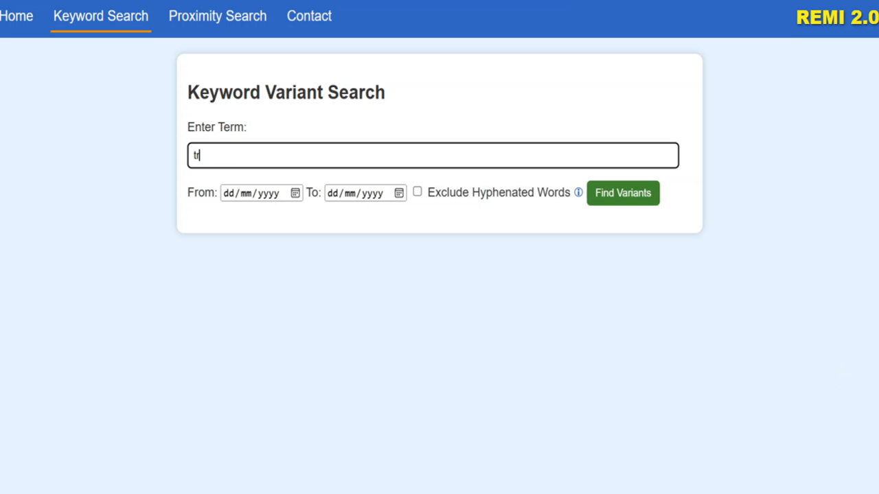
TROUBLESHOOTING
VIDEO Keyword Search

Slide 20
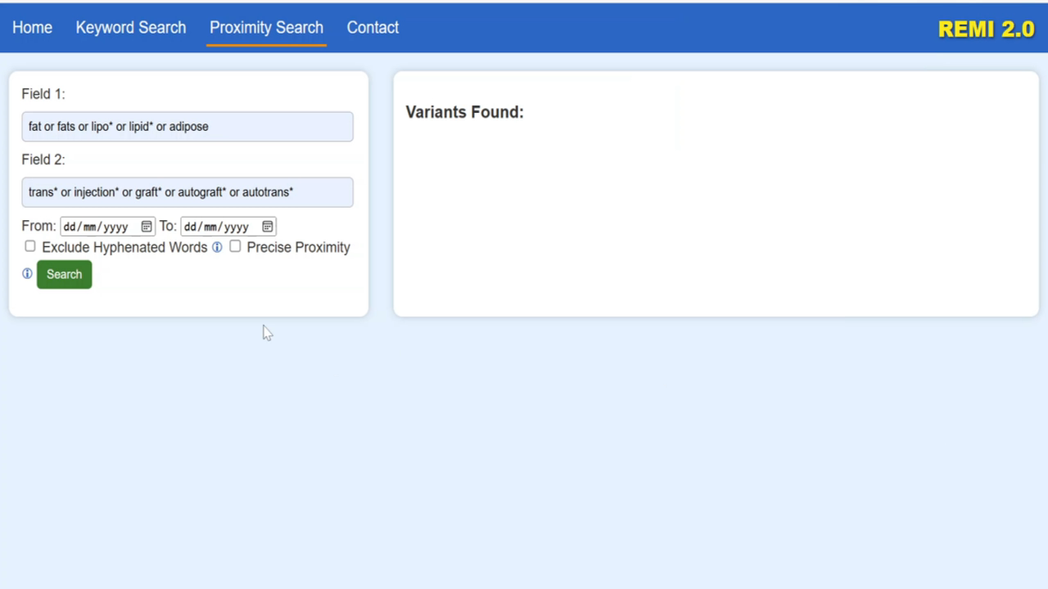
TROUBLESHOOTING
VIDEO Proximity Search

