Slide 1





Identify <--> Update <--> Integrate
The Importance of Managed Corporate (Research) Profiles
Recent Research Support & Library Best Practices
Guus van den Brekel | University Medical Center Groningen, the Netherlands
Notes:
I thought this fitted nicely with the conference themes.
Some of you might ask what are corporate profiles? I will get into that. Thank you for attending to hear my story. Thank you EAHIl local cie and IPC for allowing me to give this oral presentation

Slide 2
About the Presenter
Guus van den Brekel, Medical Information Specialist, UMCG.
Focus: research support, impact analytics, publishing, digital discovery and tools
Works on profiles, policies, tools, and services improving researcher impact and visibility
Notes:
A little context about me: > 10 years research support

Slide 3
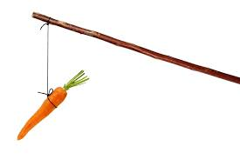
Take Home
Corporate research profiles enhance visibility, collaboration, and impact.
Managed integrated systems benefit both researchers and institutions.
Library focus on profiles via policy, tools, services, and collaboration.
Notes:
While being ignored for a long time, because they fell into the category of the researcher’s responsibility. But there was little info or support let alone a policy
other than the one the Medical Library always has tried to apply : help as many people as possible on demand, personal approach
If you have corporate profiles, its an opportunity for the library to take this under their wings.
If no corporate profiles excist, focus on the other (research) profile tools and platform

Slide 4
Why the library?
We manage and monitor the CRIS
We have expertise in research impact analytics
Participating in assessment policy development in the organization
Responsible for open access publishing policy
We have the overview of stakeholders and are already collaborating with them

Slide 5
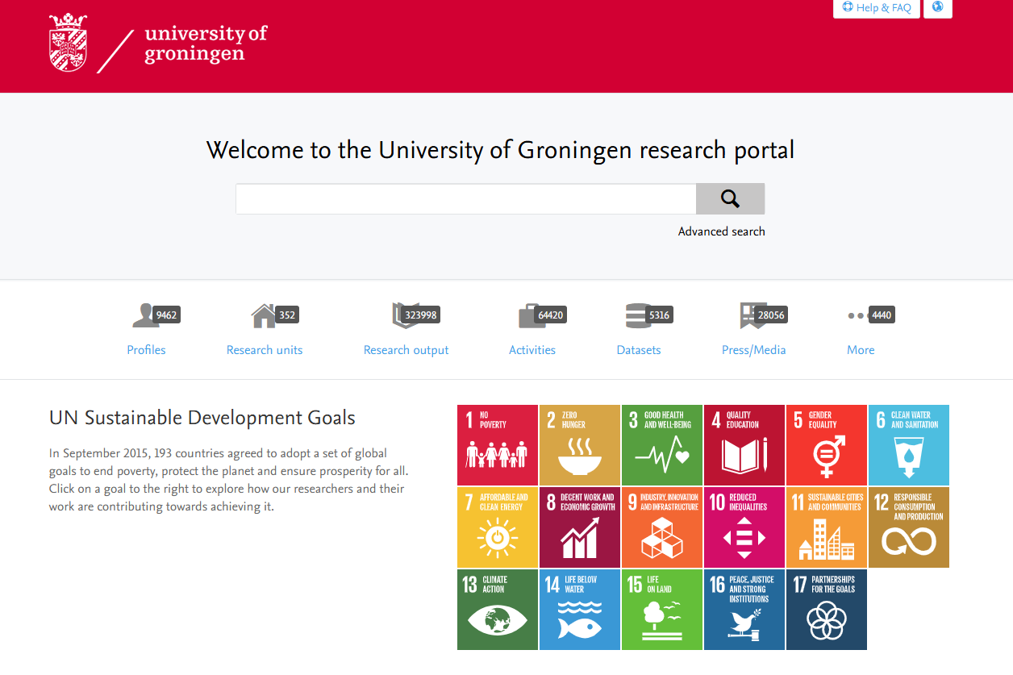
Research Support before CRIS (Pure)
Literature Search
Citation overviews
Reference Management
Document delivery
Notes:
Cutting it short, but that’s waht it came down to

Slide 6
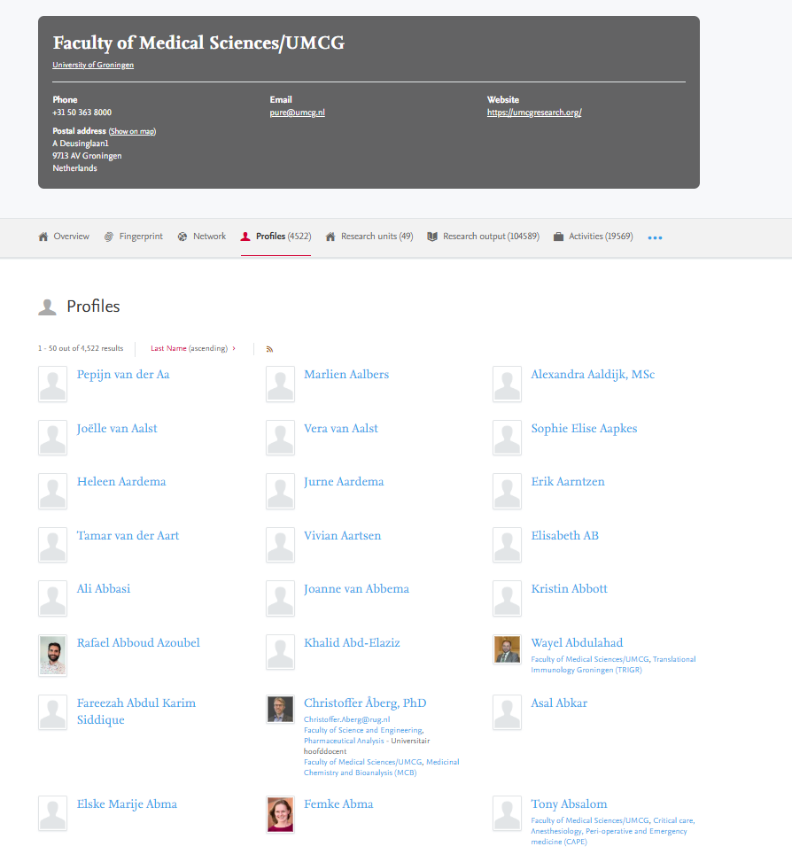
Research Portal (Pure)
Managing research database
Research impact analytics
Research assessments
Research IDs & profiles
Research dashboard and on demand services
…..
Literature Search
Citation overviews
Reference Management
Document delivery
Notes:
Cutting it short, but that’s what it is coming down to. Non-optimal use of profiles made available by your organisation
Screenshot of the first page of UMCG profiles in our research portal Pure. What do you see?

Slide 7
Corporate (Research) Profiles at
University of Groningen(UG) & UMCG
General staff profile UG
(also called MEPA)
Research profile UG
(Pure)
Research profile UMCG
Health care profile UMCG
Notes:
Max 4 corporate profiles, minimal exchange & integration, which means researcher has to put in the extra work to maintain & update all repeatedly

Slide 8
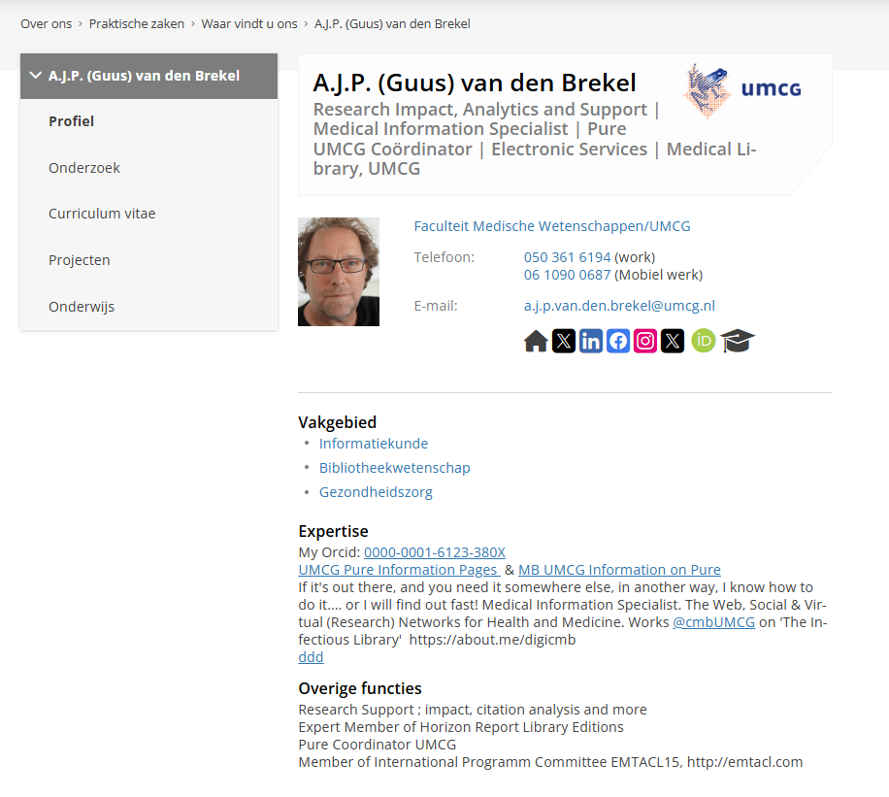
General staff profile UG
(also called MEPA)
Notes:
UG profile, linking to the research UG profile and ORCID, but not to existing UMCG research or healthcare profile

Slide 9
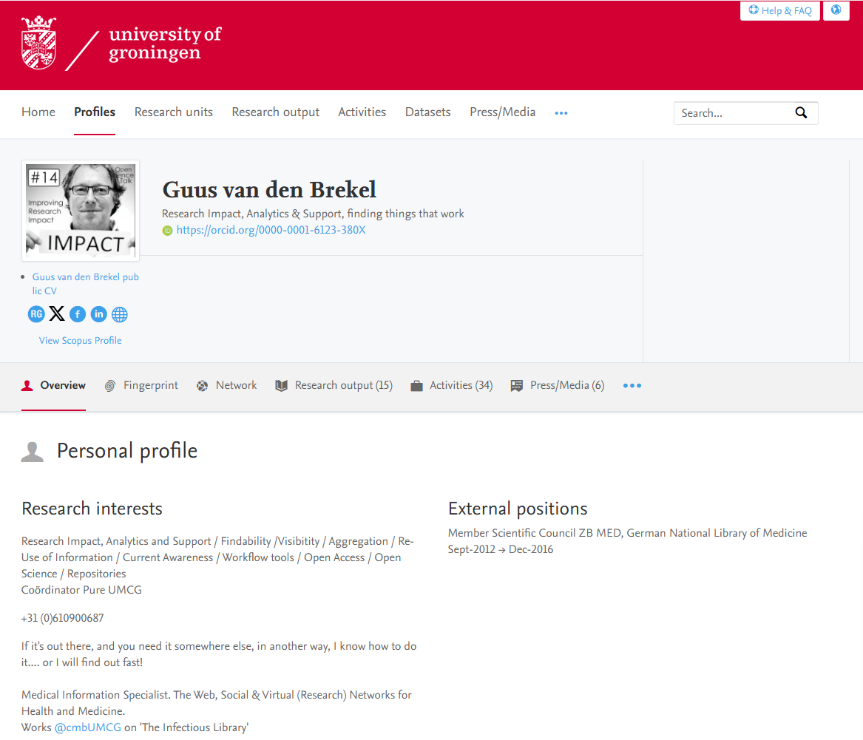
Research profile UG
(Pure)
Notes:
Linking to ORCID, not to UG general profile, not to existing UMCG research or healthcare profile

Slide 10
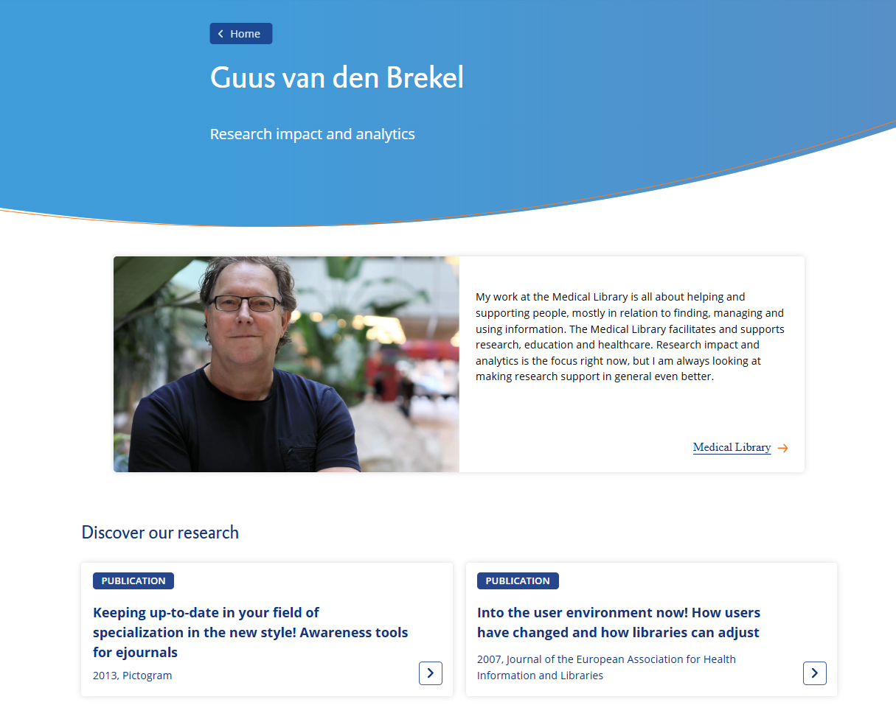
Research profile UMCG
Notes:
Linking to ORCID, research profile UG, but not to general UG profile or healthcare profile

Slide 11
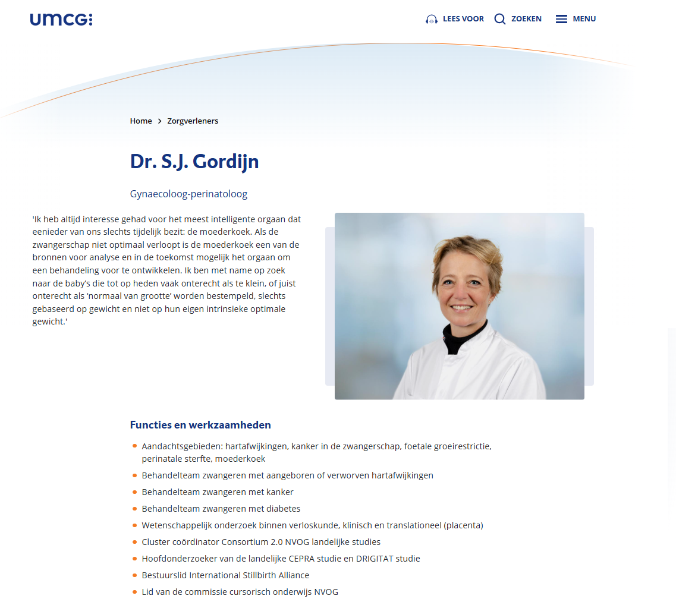
Health care profile UMCG
Notes:
Not linking to ORCID, research UMCG profile or UG research or general profile. Not forgetting to mention: these are generated “manually”

Slide 12
Most used other (research) profiles at
University of Groningen(UG) & UMCG
ORCID
Scopus ID
Researcher ID
Notes:
ORCID is basically their career profile, non-profit, free, not commercial, promoted in NL aand Groningen,

Slide 13
other profiles used at
University of Groningen(UG) & UMCG
Linkedin
Google Scholar
ResearchGate
Notes:
Cutting it short, but that’s waht it came down to

Slide 14
Methods
Literature (2019–2024) and case studies inform our approach.
Policies developed with UMCG Research Office.
Library monitors, manages, and enhances third-party profiles.
Proactive support helps reduce researcher workload.

Slide 15
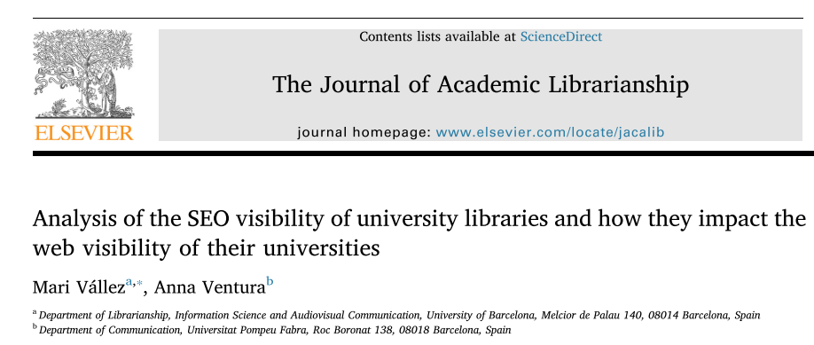
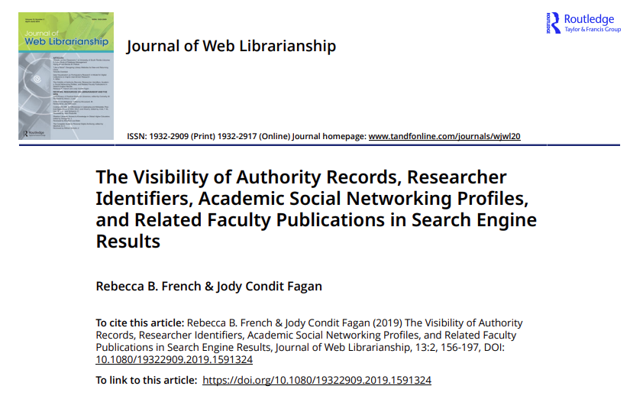
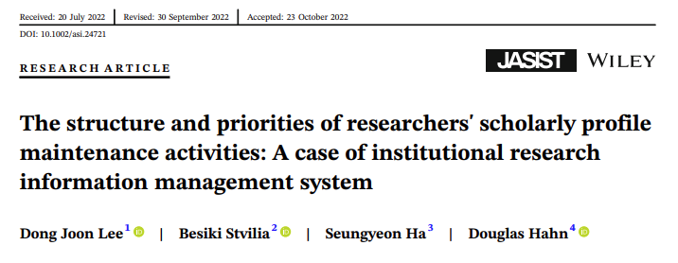
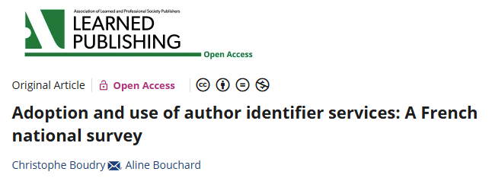
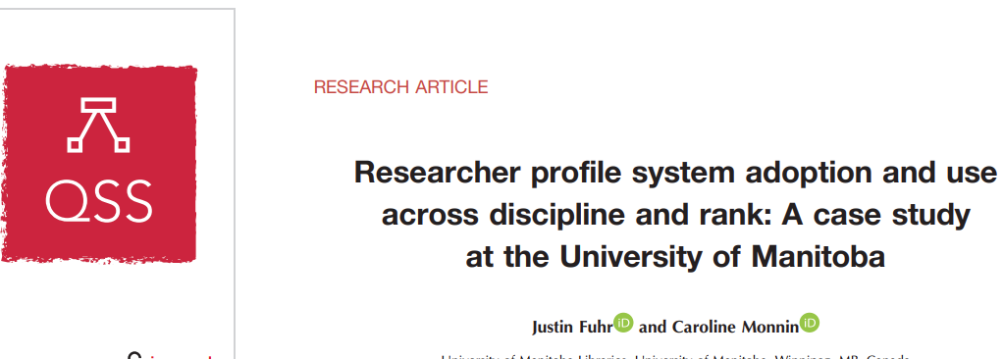
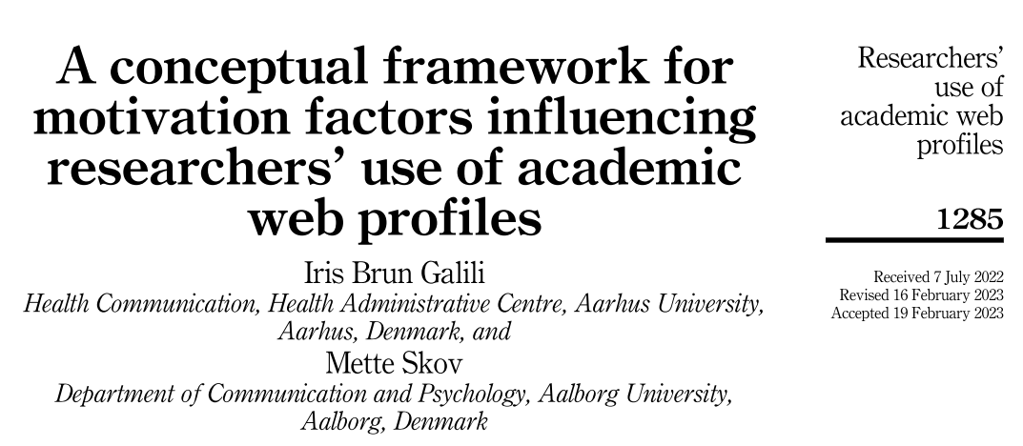
Faculty with more profiles were more visible in search engine results, and faculty with authority records ranked more highly in search engines.
Notes:
1. Search engine optimization very important
2. the use of IDs verified, standardized use of identifiers
3. What do they do the most? Adding content, enhancing research identity, and improving research discoverability
Did I already mention it? Researchers are vain people. Tell them we need their data to do analysis and reports, he is not impressed. Tell him it will improve his visibility and impact, he will engage.
4. National study into awereness and use of …
Turns out quit some group required and indicated they need an proper introduction and even practical training
5. Library is key for instruction and advocacy for students and faculty
3 categories of influences
- identify and professional goals
- organisations and guidelines|
- platforms and technology\
and personality of the researcher plays a role too

Slide 16
Examples of services for researchers
IDENTIFY
INTEGRATE
UPDATE

Slide 17

Checks by default on participants workshops and meetings
  Pure account ID
  Visibility
  ORCID
  Profile pages
  SCOPUS ID
(On demand for researchers & staff)
  Want a complete profile check? Ask us via pure@umcg.nl

Slide 18

Researchers profiles
ORCID (career id, non-profit)
  Promote
  Mandatory for PhDs
  Public
  Working on on-boarding
  Connect other research id’s and corporate info
Scopus ID & Researcher ID
  Portal Pure
  Check multiple profiles
  Request Merge
  Claim / Repair
  Connect ORCID
  Want a complete profile check? Ask us via pure@umcg.nl

Slide 19

Other (research) profiles
Google Scholar
Linkedin
ResearchGate
Wikipedia
MAIN FOCUS:
Mention current affiliation
Synch when possible
Add links & contacts to current affiliation
Keep updated
  Want a complete profile check? Ask us via pure@umcg.nl

Slide 20
More examples
Highly Cited yearly checks
Visual reports on fill grade of research profiles Pure
Developing on-boarding and self-service options for researchers
Emphasizing importance of profiles and IDs in courses and services for PhDs en other researchers

Slide 21
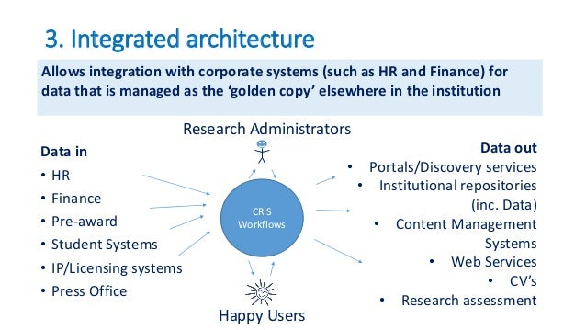
UKSG webinar - Current Research Information Systems (CRIS): What are they and what do they do? 2015!
Notes:
Back then in 2015

Slide 22
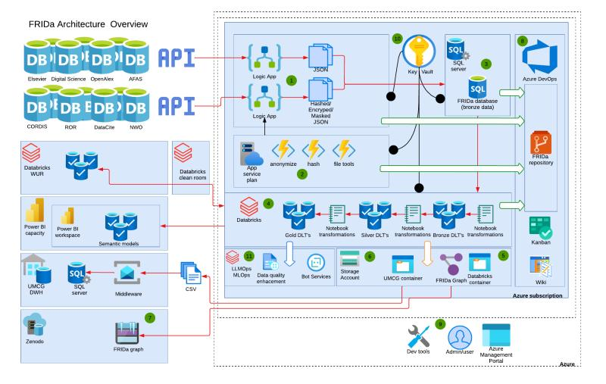
FRIDa Research Information Datawarehouse (Nick Veenstra)
Notes:
Nowadays even much more complicated, but lat of possibilities for integration, with the right data architecture choices

Slide 23
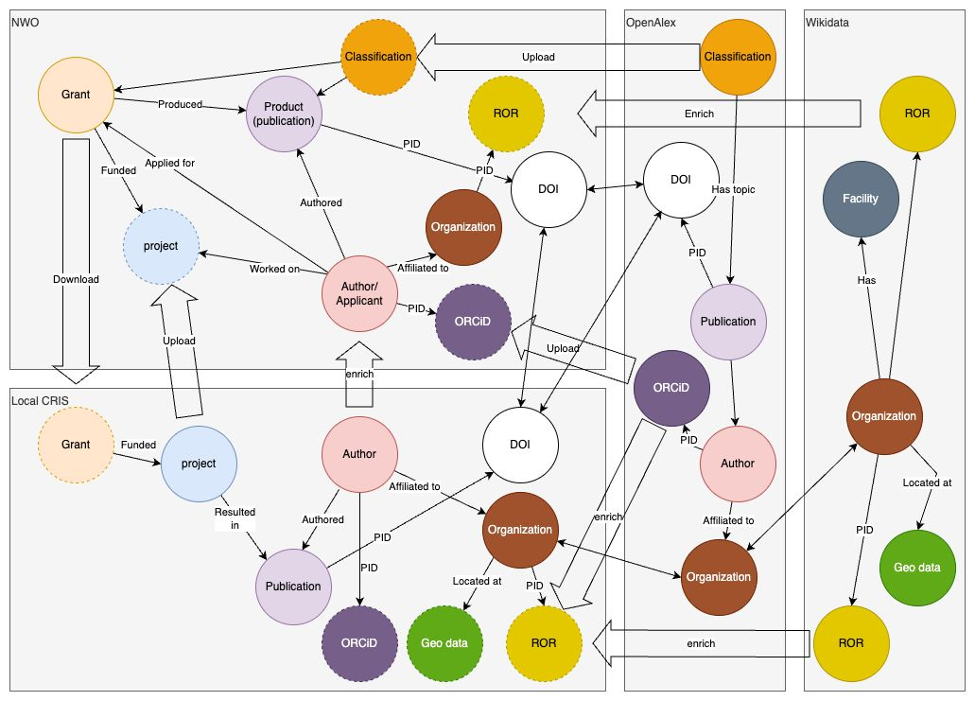
Enrichment of research metadata using graph technology (Nick Veenstra)

Slide 24
Results
Robust research information systems support profile management.
Courses, tools, and personalized services aid researchers.
Integrated approaches relieve administrative burden.
Projects on BI dashboards and AI integration are underway.
Open access and repository work increase research visibility.

Slide 25
Fill grade research profiles
(not the synched data)
% of ORCID use and sync status
Scopus ID
Researcher ID
External positions
Research interests, Biosketch, Teaching, Support, Other interests
Totals on every type of content
Default publishing name
Job descriptions & titles
Visibility
Number of profile pictures
Links and URLs used in profile

Slide 26
Discussion
Multifaceted support strategy needed.
Libraries must invest in infrastructure and training.
Effective collaborations enhance system use.
Best practices advance research analytics and visibility.

Slide 27
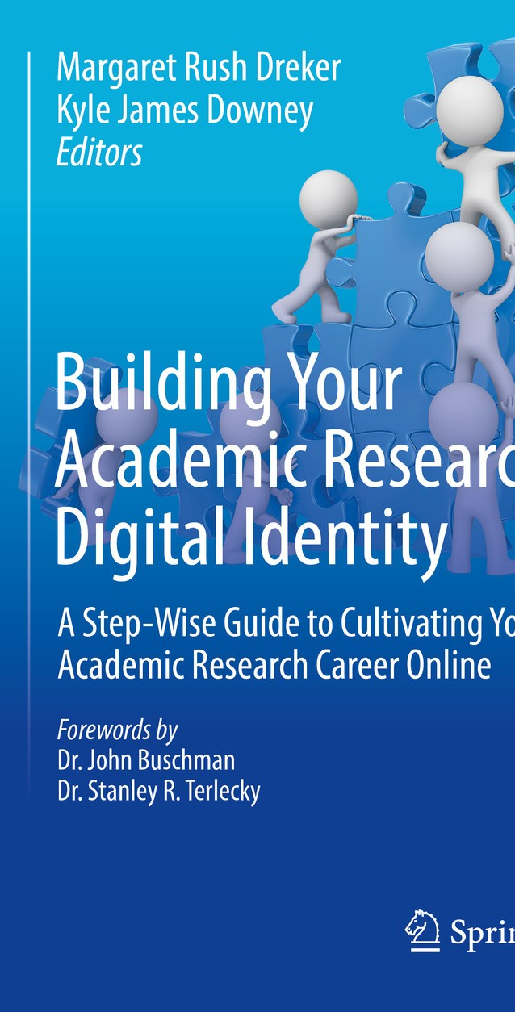
Future Directions
Standardized integrated practices for profile management.
Explore AI and emerging tech to enrich data.
Ongoing evaluation and innovation in support services.

Slide 28
Take Home
Corporate research profiles enhance visibility, collaboration, and impact.
Managed integrated systems benefit both researchers and institutions.
Library focus on profiles via policy, tools, services, and collaboration.
Notes:
While being ignored for a long time, because they fell into the category of the researcher’s responsibility. But there was little info or support let alone a policy
other than the one the Medical Library always has tried to apply : help as many people as possible on demand, personal approach

Slide 29
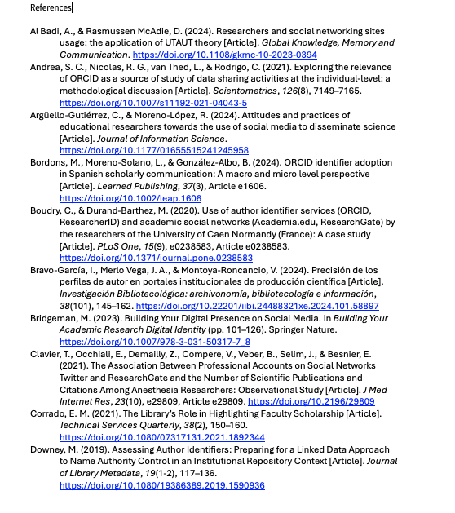
References

Slide 30
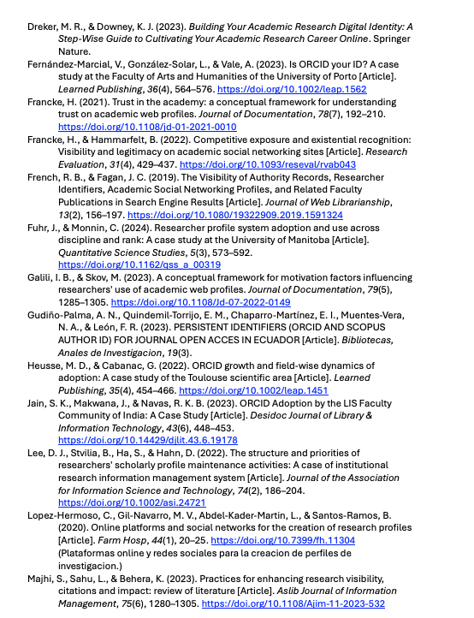
References

Slide 31
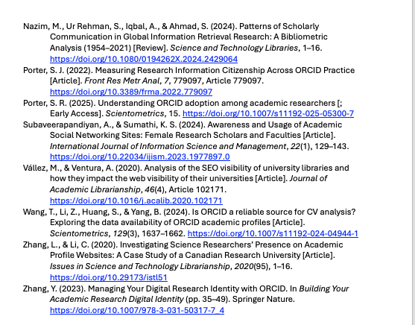
References

Slide 32

