Slide 1


Slide 2


Slide 3


Slide 4
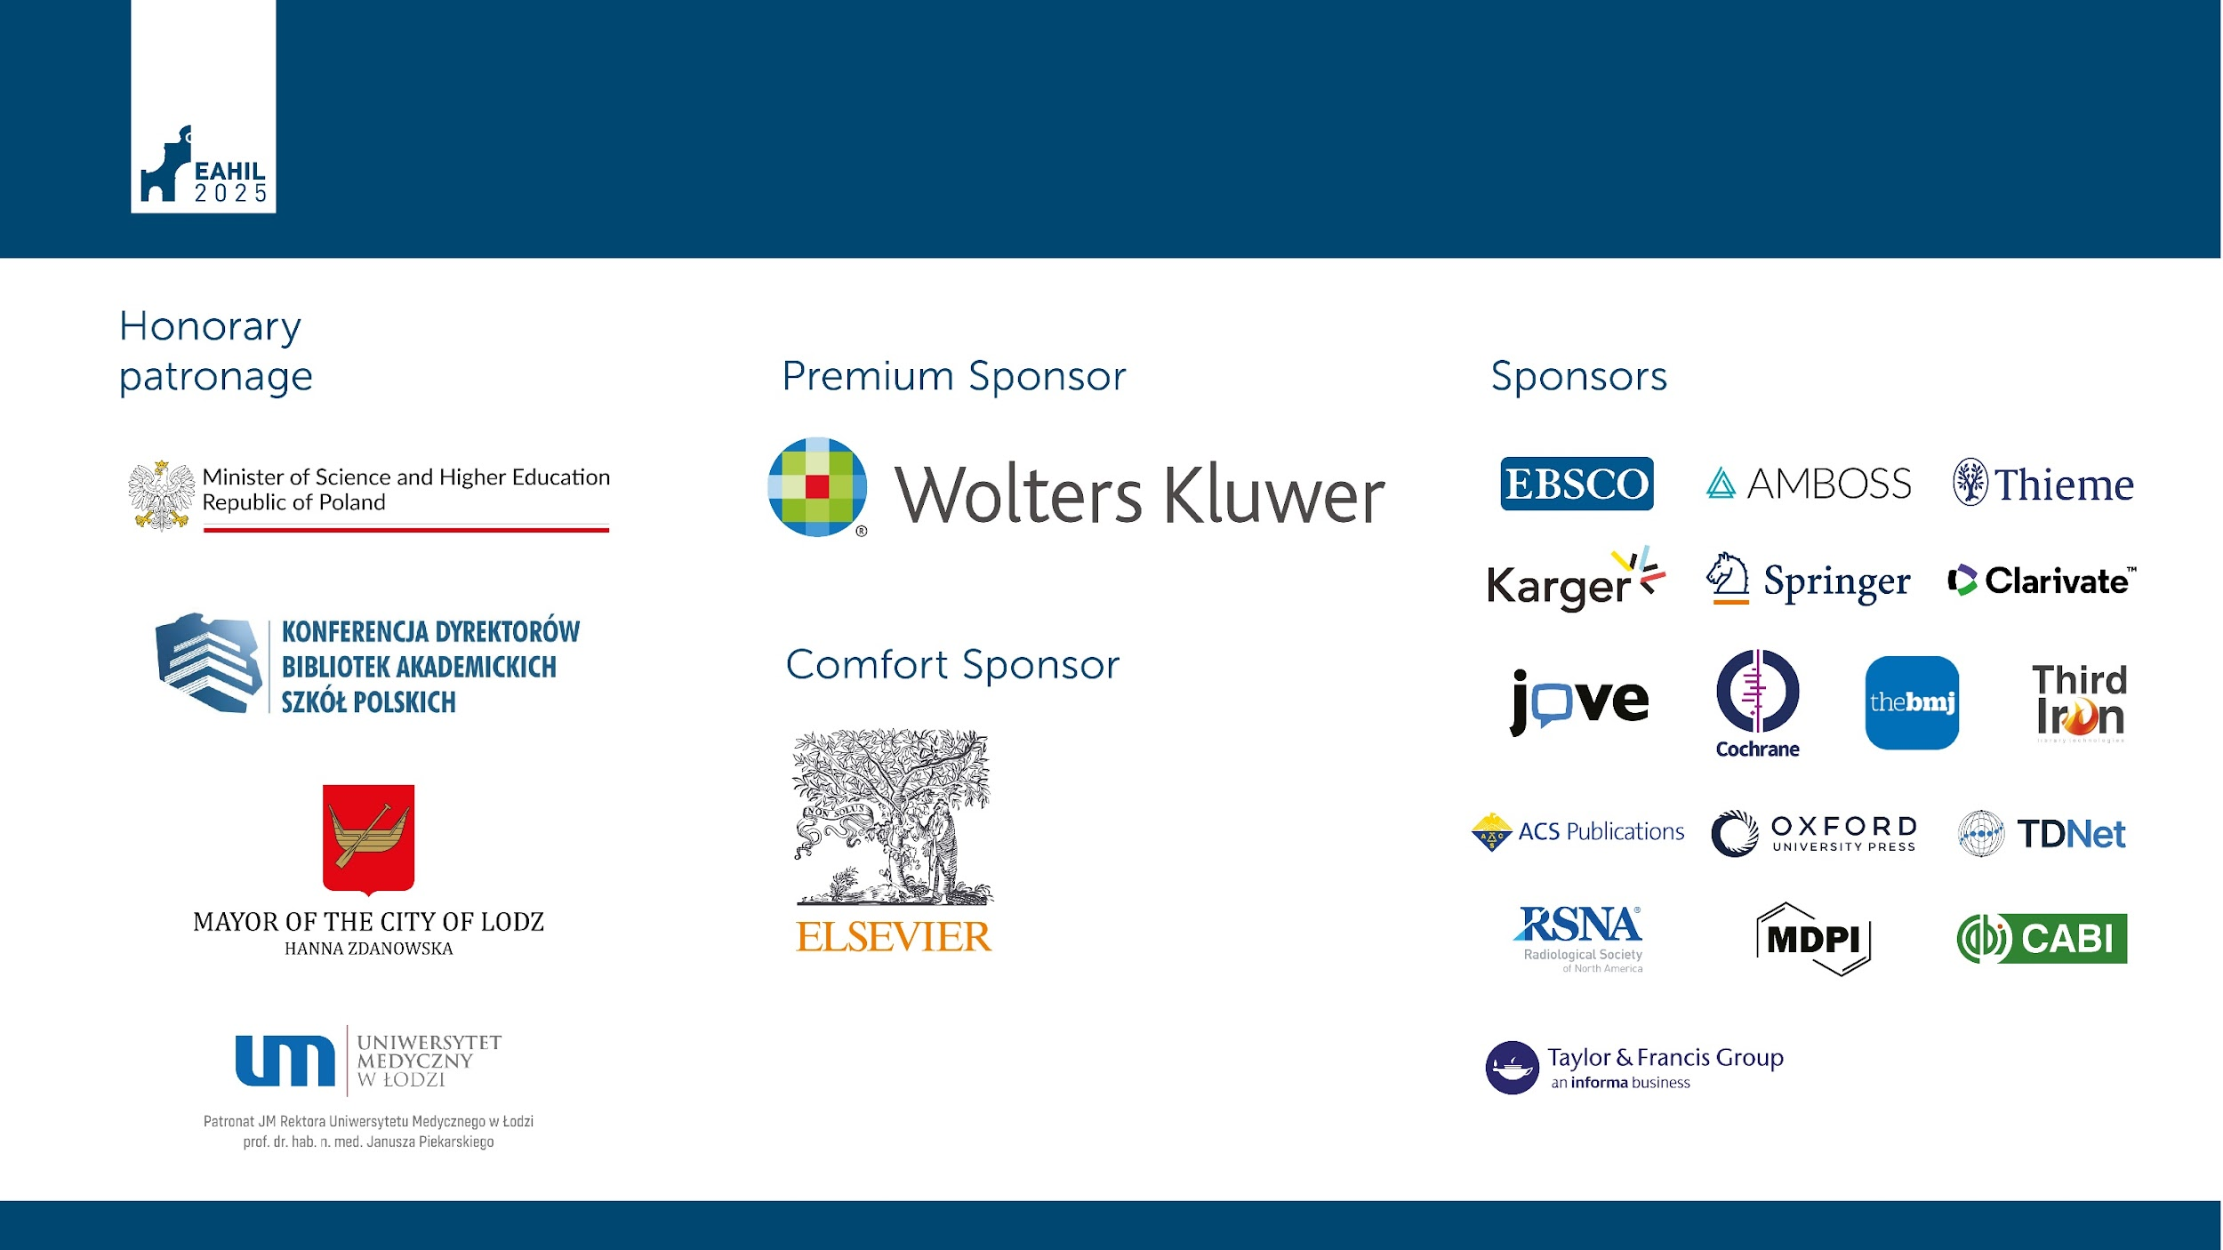

Slide 5
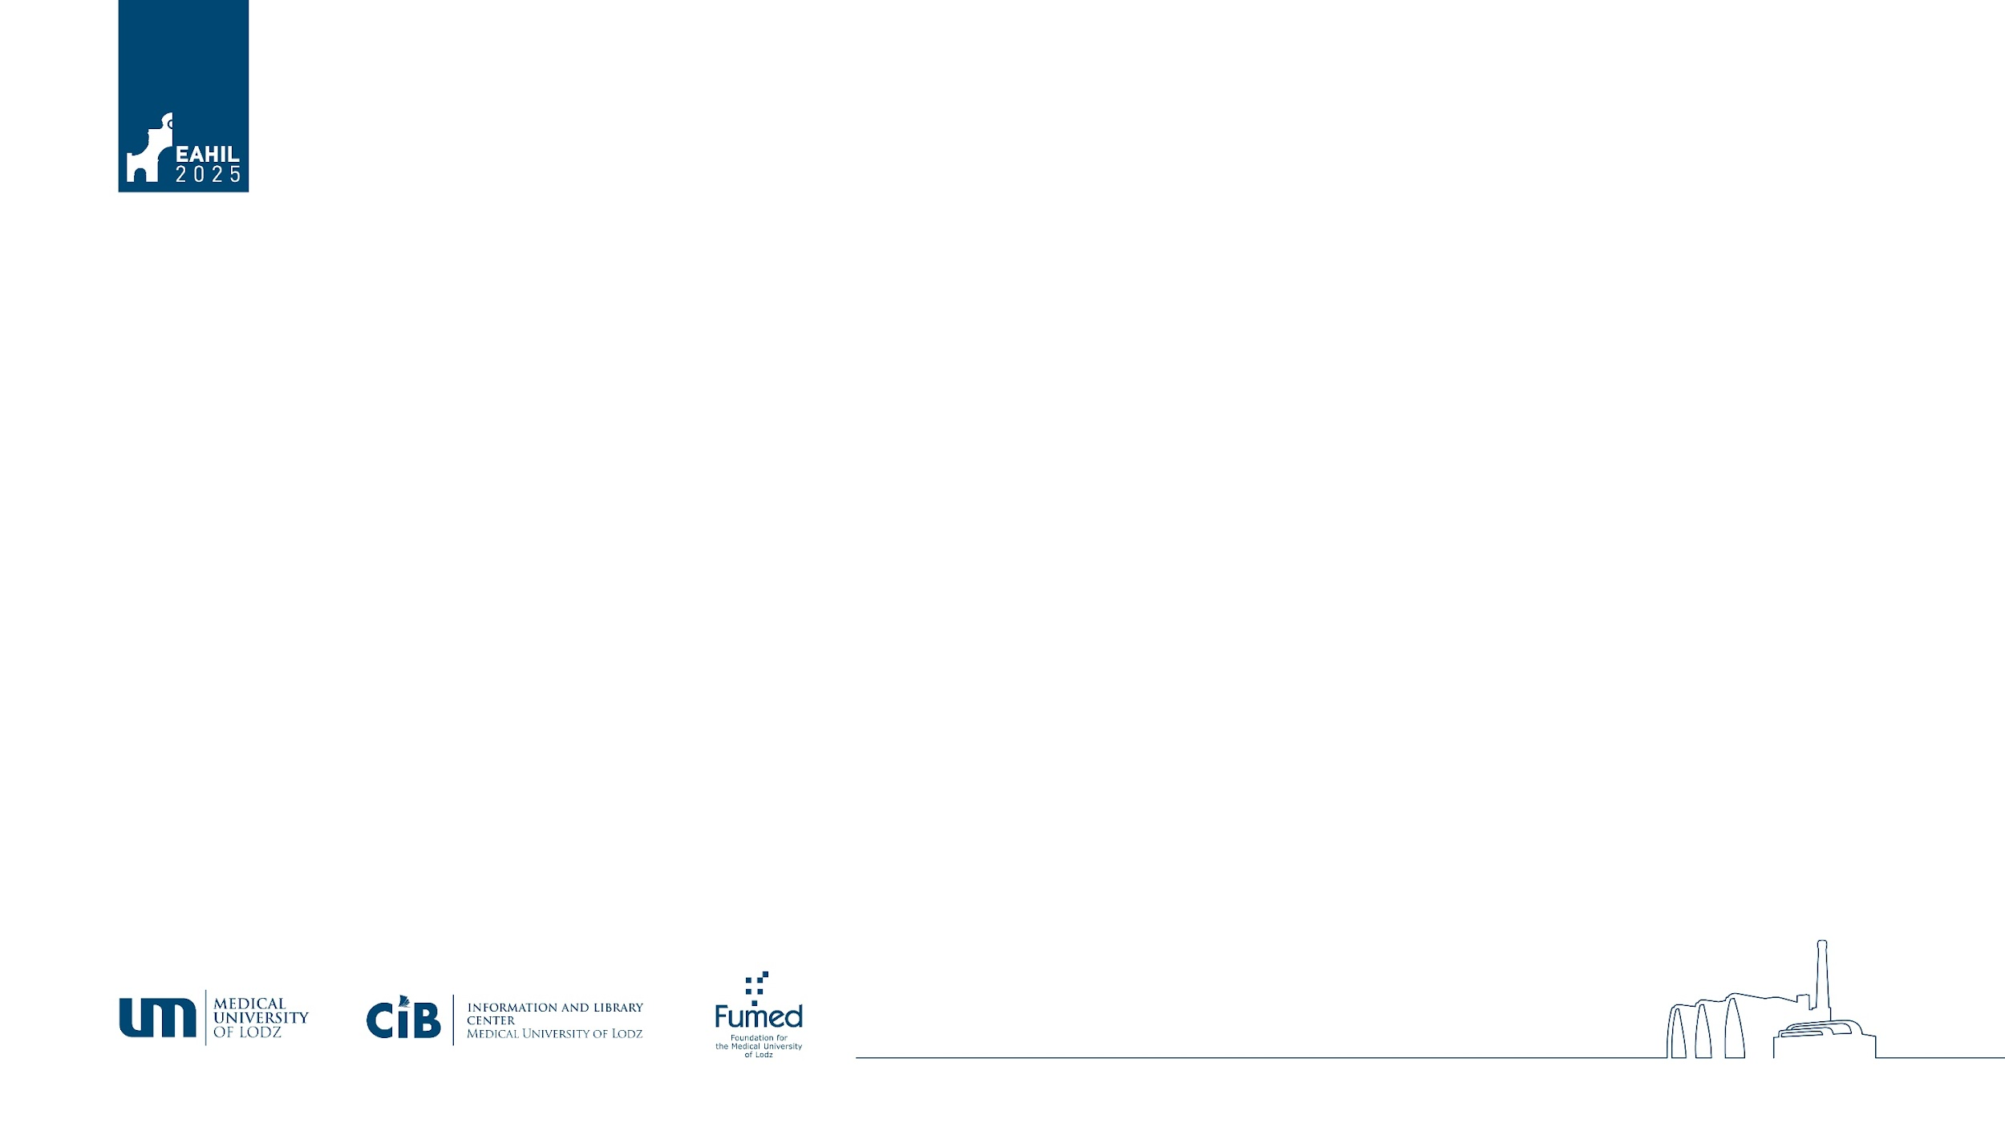
Evaluating the Availability and Use of Drug Information Resources among Practicing Pharmacists in the United States
Rachel Whitney¹, Hilary Jasmin², Christopher Giuliano³, Audrey Kostrzewa⁴, Melissa Hunter⁵, Christopher Wisniewski¹, Emily Gorman⁶
¹ Medical University of South Carolina
² Center for Evidence-based Policy
³ Wayne State University
⁴ Concordia University Wisconsin
⁵ University of Wyoming
⁶ University of Maryland, Baltimore

Slide 6



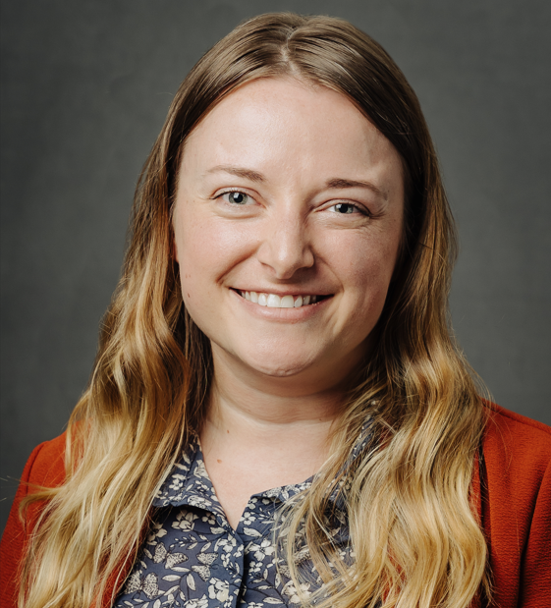

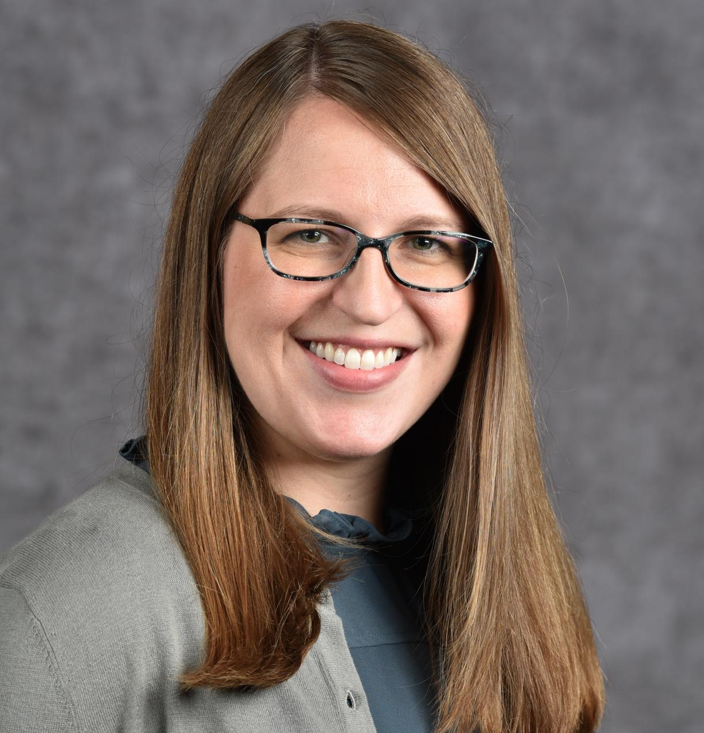
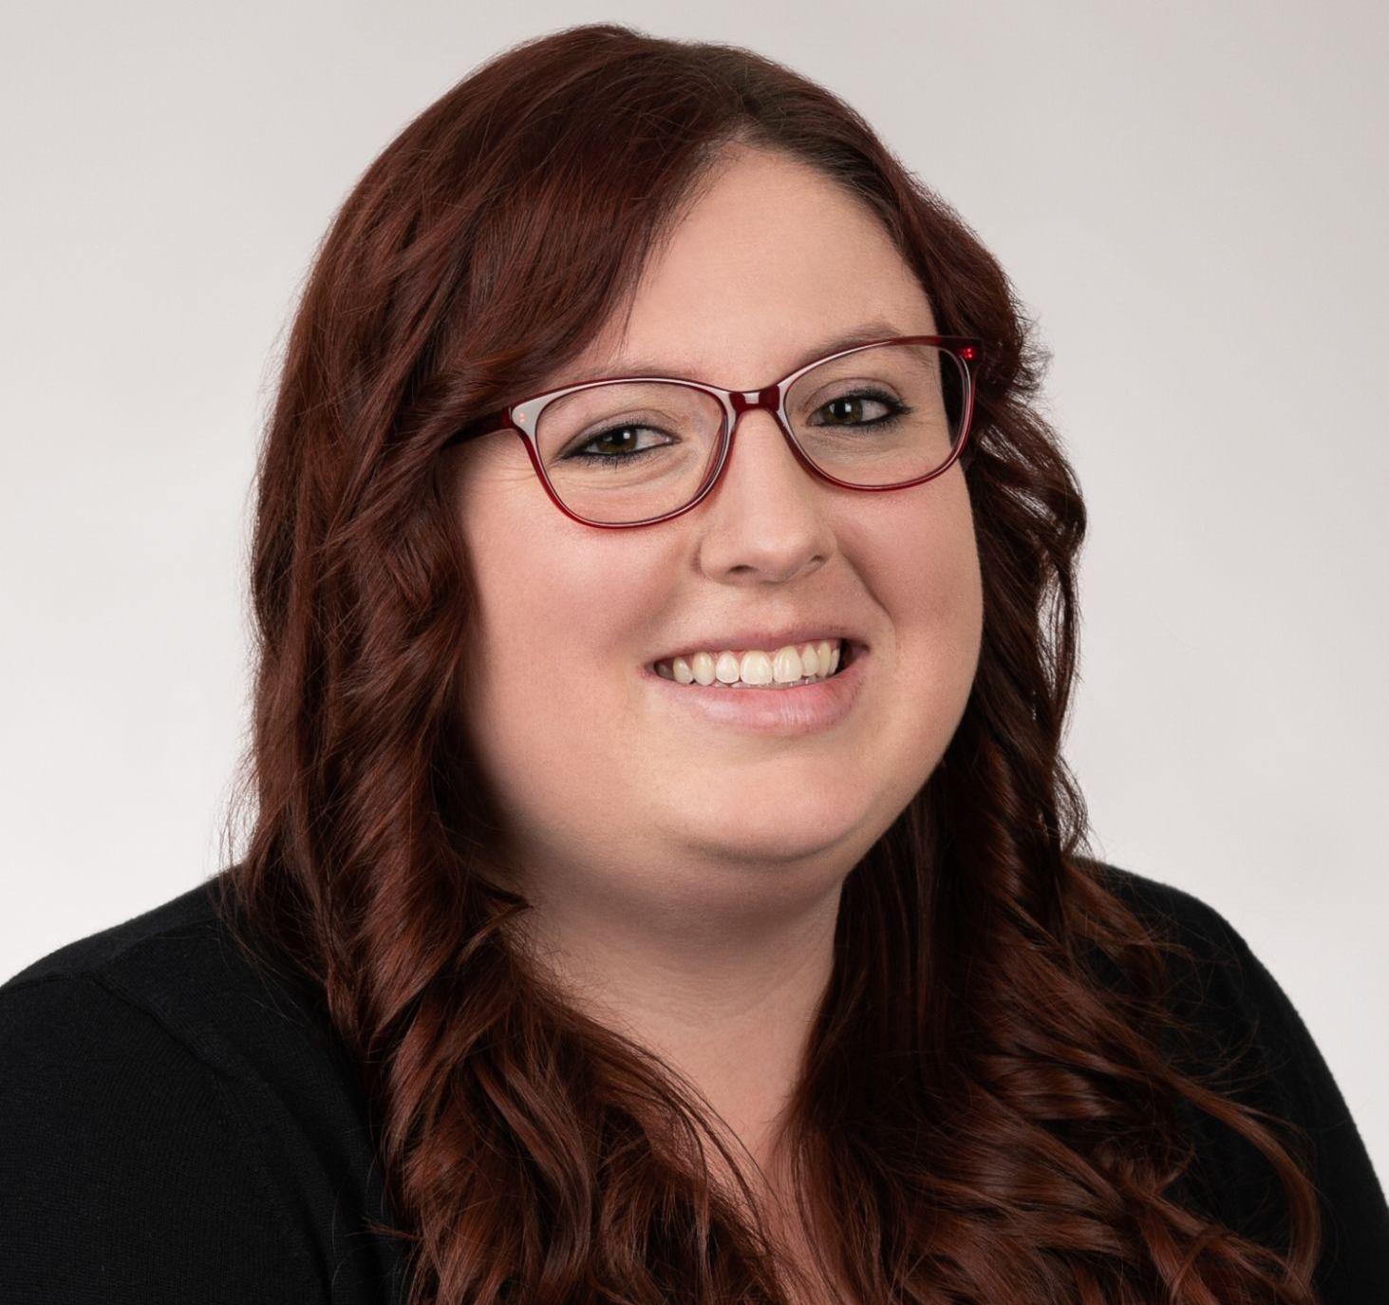

Our Team
Melissa Hunter, PharmD, R.Ph
Drug Information Director
University of Wyoming
Chris Giuliano, PharmD, MPH
Clinical Professor
Wayne State University
Hilary Jasmin, MSIS
Information Specialist
Center for Evidence-based Policy
Emily Gorman, MLIS
Research and Education Librarian
University of Maryland, Baltimore
Audrey Kostrzewa, PharmD, MPH, BCPS
Associate Professor
Concordia University
Rachel Whitney, MLIS, AHIP
Research and Education Informationist
Medical University of South Carolina
Christopher S. Wisniewski, PharmD, MSCR, BCPS
Professor
Medical University of South Carolina
Notes:
Although only I am presenting today, our full research team is 7 collaborators who met through the Drug Information and Library Science Section of the American Association of Colleges of Pharmacy. The team includes three librarians and information specialists, and four pharmacists.

Slide 7
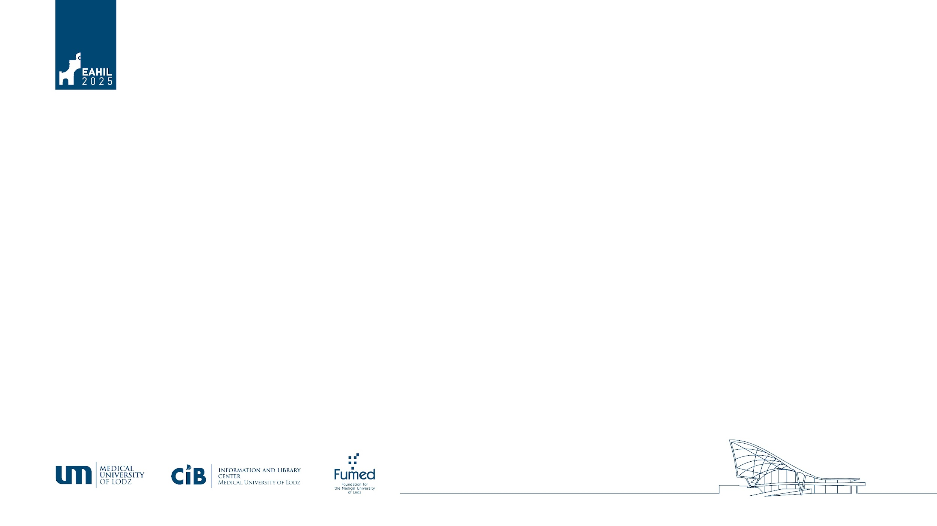
Table of Contents
Background
  Impetus for our study, expected findings
Survey
  IRB, design, dissemination
Results
  Quantitative and qualitative
Implications
  What does this mean for librarians?
Notes:
This session will go through the background of our project, details of the survey we conducted, the qualitative and quantitative results, and how those results could impact librarians.

Slide 8
Background

Slide 9
Drug Information (DI) Resources Defined
Drug Databases
Literature
Clinical Tools
E.g. Micromedex, Lexidrug
Journals, reference books, literature databases
E.g. UpToDate, Pyrls
Notes:
This project centers around drug information resources, so we will start with a definition of what that means for our context. Drug databases are online collections of reference materials about medications. They contain information on dosing, approved and unapproved uses, storage and stability, and much more. Literature resources include journal articles, textbooks, and literature databases such as PubMed. Finally, there are clinical tools such as UpToDate that provide practice guidelines and other point-of-care information.

Slide 10
Research Questions
What DI resources are available to practicing pharmacists?
Are the DI resources being taught in pharmacy school the same ones that are most available and used in practice?
Do pharmacists have sufficient DI resources to practice effectively?
Notes:
That brings us to our research questions. Our team is heavily involved in teaching students drug information resources, and we wanted to know whether the resources we are teaching are ones students are actually able to use when they graduate and begin practicing in various settings. Settings that pharmacists might practice in include community pharmacies, which is the one most visible and familiar to the public, hospitals, online or specialty pharmacies, and federal agenicies such as the FDA. One hypothesis we had was that community pharmacies would have especially few resources. The only literature we found examining the availability of resources in pharmacy practice were either localized to a specific area (e.g. one US state) or were published so long ago that the findings no longer reflect current practice. Therefore we decided to do a national survey of practicing pharmacists to collect data on what resources they have and which ones they actively use.

Slide 11
Survey

Slide 12
Survey Questions
Demographics
Subscription DI resources available through employer
Subscription DI resources used regularly
Comparison between current practice and pharmacy school
Subscription DI resources paid for out of pocket
Wishlist resources
Notes:
We asked a set of questions designed to capture demographics (such as year graduated from pharmacy school, practice setting, location of practice), what fee-based resources they had access to through their employer, which of those resources they use on a regular basis, how they feel the number of resources available to them in practice compares to what they had in pharmacy school, whether they run into issues of not being able to access information needed for practice because of a paywall, whether they pay for any resources with personal funds, and what resources they most wish were provided by their employer.

Slide 13
Survey Distribution
April - May 2024
Email listservs (GPO Vizient, PharmLib)
Professional organizations (AACP, ACCP, APhA, ASHP, MLA, NCPA)
Social media (Facebook, LinkedIn)
Notes:
We decided to restrict our survey to the United States because the health system landscape is unique compared to other countries. We shared the survey on email listservs, through professional organization groups, and on social media. The survey was open for about 5 weeks from April to May 2024.

Slide 14
Results

Slide 15
Mixed-method analysis
Quantitative
All data were analyzed using SPSS v. 29.0 and a predetermined alpha of 0.05 will be used to detect statistical difference
Qualitative
NVivo to code responses from three open-ended survey questions
Notes:
On to our results. For quantitative results, all data were analyzed using SPSS v 29.0 and a pre-determined alpha of 0.05 was used to detect statistical significance. And for qualitative results, Nvivo was used to code open-text responses from our three final survey questions.

Slide 16
Quantitative results
A total of 430 participants initiated the survey
10 non-practicing pharmacists were excluded
All 420 included participants completed the demographics section
385 completed all questions (demographics and resources)
33 participants did not complete the resource section, while 2 participants partially completed it
Notes:
A total of 430 participants initiated the survey, with 10 participants excluded for identifying as a non-practicing pharmacist. The remaining 420 participants completed the demographics section of the survey, 385 completed all questions (both resource and demographics sections) of the survey, 33 did not complete the resource section, and 2 participants had partial completion of the resource use section.

Slide 17
Demographic highlights
All U.S. states were represented with the exception of Hawaii
49% graduated after 2009
59% practiced in hospitals, 19% in ambulatory care, 9% in community, and other (14%)
Respondents in the “other” category included pharmaceutical industry (1%), government (2%), and retired (1%)
Notes:
Of the 387 full and partial respondents all states were represented with the exception of Hawaii. 49% graduated after 2009, 59% practiced in hospitals, 19% in ambulatory care, 9% in community, and 14% in other. Respondents in the other category included pharmaceutical industry, government, retired, and others that were provided via freetext. Of note, Participants who only completed the demographic section were more likely to be employed in an academic hospital pharmacy setting compared to other settings (9.8% vs 4.2%, p=0.03). There were no other differences in participants that completed the demographics section only.

Slide 18
Respondents who graduated before 2009…
Were more likely to have paid for resources with personal funds
Had more access to resources
Paid a higher monetary amount
Experienced less access issues due to cost
Notes:
However, there were differences depending on practice year. Respondents that graduated before 2009 were more likely to have paid for resources with personal funds, had more access to resources overall, paid a higher monetary amount for resources, and experienced less access issues due to cost

Slide 19
41% paid for subscriptions with personal funds
Notes:
To share some results that stood out to us, 41% of respondents paid for subscriptions with personal funds

Slide 20
41% used resources that were unavailable to them in school
Notes:
A similar percentage of 41% noted that they used resources that were unavailable in school. This result is may be partly due to the fact that the online resources did not exist when some of the respondents were in pharmacy school, because they attended pre-Internet.

Slide 21
Of those who paid for resources…
29% Never had access issues related to cost
58% Pay between $101-500 per year
88% Pay for 1-3 resources per year
Notes:
Of those 41 that paid for resources Only 29% of respondents never had access issues related to cost issues over the course of the year. They most frequently paid for 1-3 resources (88%) with most (58%) paying between $101- 500 per year.

Slide 22
Top Employer Provided Resources
Reference Books 50%
Lexidrug 75%
Micromedex 62%
UpToDate 77%
Pharmacist’s Letter 48%
Notes:
This slide demonstrates the top employer provided resources, or resources they were able to access without using personal funds.
UpToDate 77%
Lexicomp 75%
Micromedex 62%
Reference books (e.g. Handbook of Nonprescription Drugs, Goodman & Gilman's, etc.) either in print or as ebooks 50%
Pharmacist's Letter 48%

Slide 23
Top Resources Accessed with Personal Funds
Sanford Guide 26%
Lexidrug 72%
Micromedex 45%
UpToDate 65%
Pharmacist’s Letter 27%
Notes:
These were the overall top paid resources for respondents who did pay for resources with personal funds. There is some overlap between employer provided and paid resources.

Slide 24
Frequently Used Resources
With Access to Employer Paid Resources
Lexidrug (91%)
UpToDate (79%)
Micromedex (68%)
Subscription journals (55%)
Without Access to Employer Paid Resources
UpToDate (18%)
Lexidrug (16%)
Pharmacist's Letter (11%)
Sanford Guide (11%)
Notes:
Lastly, having access to resources significantly increased resource use across all resources. The most frequently used resources in participants that had access through their employer were Lexidrug (91%), UpToDate (79%), Micromedex (68%), and subscription journals (55%). The most frequently used resources in participants without access to employer paid resources were UpToDate (18%), Lexidrug (16%), Pharmacists Letter (11%), and Sanford Guide (11%).

Slide 25
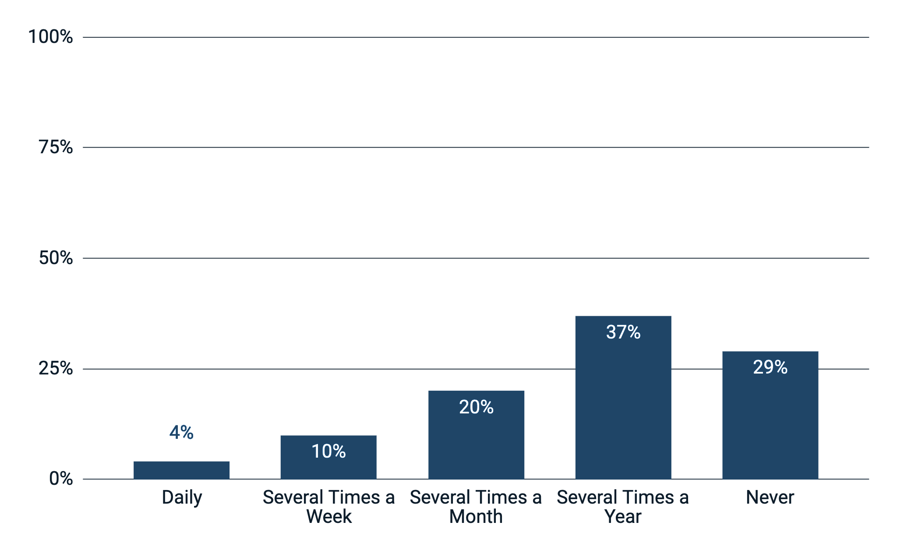
How often are you unable to access resources/articles/information
related to your work/practice due to payment barriers?
Notes:
When respondents were asked how often they are unable to access resources related to their practice due to payment barriers, 37% experienced this several times a year, 20% several times a month, 10% several times a week, and 4% daily. However, 29% reported that they never experienced payment barriers and one possibility for this may be due to the high response rate of 59% of respondents practicing in a hospital setting, and 44% of respondents who either work at a pharmacy school or serve as preceptor. Respondents who have more than one affiliation have more options available to access resources.

Slide 26
Qualitative Results
Our open-ended questions:
  Which of the following subscription/fee-based resources are provided to you through your organization/employer?
  In your current or most recent job, do you use any resources that were unavailable to you in pharmacy school?
  If you could have your employer provide access to one paid/subscription based resource that is currently unavailable to you, what would it be and why?
Notes:
To measure our open text responses, we used nvivo to code the data we received from these three questions. Our open-ended questions were
First, Which of the following subscription/fee-based resources are provided to you through your organization/employer?
This was asked to establish a baseline understanding of what we’re currently teaching that is being used by practicing pharmacists, as well as what we may not be teaching.
Second, In your current or most recent job, do you use any resources that were unavailable to you in pharmacy school?
This was an interesting one, as many folks noted attending pharmacy school before every resource had a digital access point, so many noted they used online tools now that were only paper during their education.
Finally, If you could have your employer provide access to one paid/subscription based resource that is currently unavailable to you, what would it be and why?
I’ll dig deeper into the responses on this one in a moment, but before we go further, lets see our codebook.

Slide 27
Our codebook
Larger, tertiary compendia (eg, AccessMedicine/Pharmacy, ClinicalKey)
Specified resource/textbook (eg, UpToDate, Pharmacist's Letter)
Journals/databases (e.g. Embase, PubMed, etc)
Association-related resources (e.g. ASHP, ACCP, SCCM)
Unspecific (e.g. internet, Google, none)
“I have everything I need”
“I don't know what else I need”
Notes:
After we took all text responses and dropped them into our shared files to review, our themes started to reveal themselves. The largest buckets we were able to parse were larger compendia, like access products; very specific tools, like uptodate, dynamed, pharmarcists letter, things like that; journals and databases, which could be as big as Embase or as narrow as NEJM; association related resources, like proprietary information from American Society of Health-System Pharmacists, American College of Clinical Pharmacy, Society of Critical Care Medicine to name a few; unspecific entries like wanting internet, or google; then we had two non-resource-driven responses. Some folks stated they had all they need, and some folks stated they simply didn’t know what they may need.

Slide 28
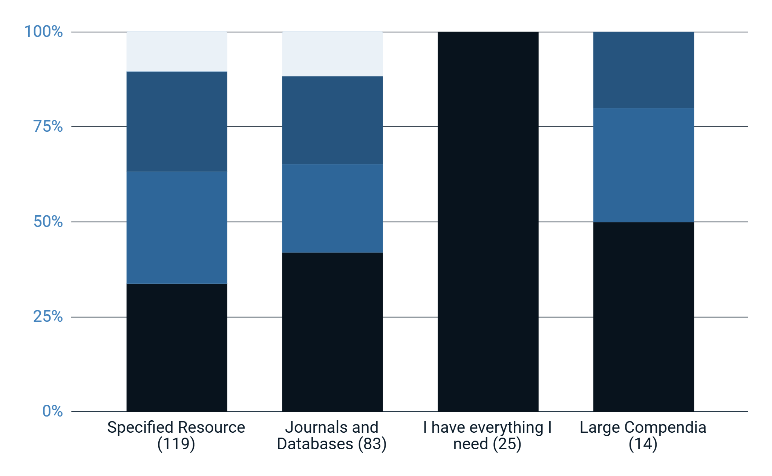
If you could have your employer provide access to one paid resource that is currently unavailable to you, what would it be and why?
Facts & Comparisons
NEJM
ClinicalKey
Sanford Guide
Micromedex
Access Medicine/ Pediatrics/ Pharmacy
Natural Medicines
UpToDate
Clinical Pharma-cology
Pharmacist’s Letter
Lexidrug
Notes:
We’ll have full data on all three qualitative responses in our full results hopefully in an upcoming manuscript, but for today i wanted to share a snapshot of how the final question was answered. These are the top four codes from the question, and their top replies for each code.
For a specific resource, the heaviest hitters were pharmacists letter, which if you havent heard of, is a subscription that includes clinical recommendations, quick reference resources, and CE, delivered to subscribers monthly. Many universities have site licenses for their faculty, and there are student options as well, but in practice sites it sounds less subscribed to, at least based on this response. A close second was uptodate, and the Sanford guide for antimicrobial stewardship in third. You could make a case that uptodate belonged in the database section, but we opted to keep point of care tools separated and drug information databases in the journals and databases section, as you can see with Lexicomp being the top request for the second column. Second was natural medicines, with Micromedex a very close third. Our third place response in this question, interestingly, was that they have all they need. Many of these responses noted working for a larger academic medical center which allowed them all this access. Finally, our fourth highest response was larger compendia, with clinical pharmacology and access products being mentioned the most.

Slide 29
Implications
Notes:
H: Now what does all this mean?

Slide 30
Impacts On…
Instruction
  Focus on the most available resources
Collection development
  Prioritize the most used resources
Future clinicians
  Equip them with cost-effective resource information
Notes:
H: Knowing what pharmacists are using in practice can really inform our work. First, knowing that some of the tools we teach may be difficult to access for most students going into community after graduation means we may need to focus on those more static resources, or ones that will always have a publicly available component. That’s not to say we throw out our drug information databases, but making sure they know where to find information without their campus credentials is a priority.
Next, this can impact our collection development. If we know the resources pharmacists use the most, we can be sure they are accessing those earlier on. For example, AccessPharmacy and Pharmacists Letter are popular but not ubiquitous. Knowing these are tools practicing pharmacists prefer means we should advocate to budget for them while theyre students.
Lastly, this has large impact on our future clinicians, our users. Not just showing them the premier licensed resources by the library, but making sure we’re really equipping them for practice, is something to keep as a priority when shaping collection and instruction.

Slide 31

Rachel Whitney
whitnera@musc.edu
Notes:
Thanks so much for your interest in our work. If you have any questions, please reach out to us!

Slide 32


