Slide 1


01
Policies of selected Polish universities regarding the use of AI in teaching and research,
with particular emphasis on medical universities,
and the potential role of libraries in their implementation
Iwona Kosowska
Medical Library,
Jagiellonian University Medical College,
Cracow, Poland
EAHIL | June 2025

Slide 2

02
What do AI Policies in Poland say about the use of AI?
Method
“Ranking of Academic Universities 2024" by Perspekty Publishing - 50 best Universities in Poland (public and private) - 54
Source: https://2024.ranking.perspektywy.org/ranking/university-ranking
plus
3 member universities of the Conference of Rectors of Academic Medical Schools (KRAUM), which were outside the top 50.
EAHIL | June 2025

Slide 3

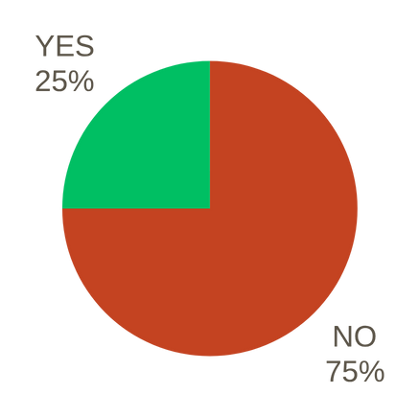
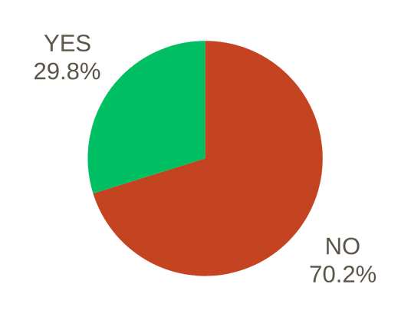
Outcomes
03
Has an AI policy been adopted at the university?
Has an AI policy been adopted at medical schools?
Of the 57 academic universities analyzed, 40 do not have published regulations on AI, while 17 do
Of the 16 medical schools analysed, 12 do not have published regulations on AI, while 4 do
EAHIL | June 2025

Slide 4



04
Guidelines for the use of AI in theses and other written works
  the decision about whether to allow students to use this tool is left to individual lecturers
  the lecturer, together with the student, determines the purpose and scope of using AI at work
  It is recommended to continuously monitor the student’s progress in preparing the thesis using AI systems to ensure that is a student's work
  It is possible to use commonly available tools to determine the probability of undisclosed use of AI systems
EAHIL | June 2025

Slide 5
What can I use AI tools for when writing a paper?
05
Originality of thought: despite using generative AI tools, the main theses, arguments and conclusions come from the student.
Examples of artificial intelligence applications:
  translating the text into any foreign language
  helping with programming
  generating graphics based on the author's hand-drawn drawings
  creating text plans, abstracts and summaries
  reviewing sources
  creating diagrams, charts, figures, infographics according to detailed guidelines formulated by the author
  editing texts (changing style, correcting errors)
EAHIL | June 2025

Slide 6
06
But can I generate thesis text?
Most recommendations do not answer this question directly: the decision on the scope of AI application is made by the supervisor in consultation with the student.
Is AI a tool or a source of information?
  In one recomendation is clearly not allowed: “generating text (paragraphs, chapters), generating the first version of the text and then editing it yourself, expanding existing content (e.g. using prompts such as: "add two sentences to the paragraph")
  In this case is not allowed citing large-scale language models (LLM) or other generative AI tools as a source of information.
EAHIL | June 2025

Slide 7


07
How to report/describe AI usage?
When using AI, indicate which content was prepared using AI tools, because the Author is not the creator of this content
  In the Introduction/or Methods section
  What kind of system was used
  What was the purpose of using AI
  What was the method of using AI
All the fragments created using AI should be clearly marked in the work by providing the commands (prompts) used and the received output data (e.g. footnotes, appendix to the work).
EAHIL | June 2025

Slide 8
08
“Disclaimer: In the process of creating these recommendations, the support of the artificial intelligence ChatGPT (version 4.0) from OpenAI was used to clarify and supplement certain aspects of the document”.
Source: Dobre praktyki wykorzystania sztucznej inteligencji w pisaniu prac dyplomowych https://www.ue.wroc.pl/p/dziekan_ds._ksztalcenia/2023_pisma_okolne/zalacznik_1_do_po_4_2023___ai_w_pisaniu_prac_plomowych.pdf, Wroclaw University of Economics and Business
EAHIL | June 2025

Slide 9

09
  using AI as an idea generator in brainstorming on a selected topic
  creating teaching materials that engage students more (generating questions, quizzes and scenarios)
  creating lesson plans
  preparing tests and an assessment criteria
Recommendation
for lecturers
  automatic grading of short answers
  faster preparation of the syllabus for classes
EAHIL | June 2025

Slide 10

10
AI and research
This topic is discussed less frequently in recommendations.
  to identify research trends, theories, research problems, research gaps, research methods
  to prepare literature reviews
  to search in collection of articles (e.g. to extract key information from large collections of articles)
  simulation of diffrent experimental scenarios and searching for the optimal one
  analysis of research data
EAHIL | June 2025

Slide 11
11
A short look
at the diffrent european universities (1)
The University of Amsterdam - The Nederlands
The University of Oslo - Norway
  University policy currently does not allow students and lecturers to use AI tools such as ChatGPT for teaching and assessment purposes
  GPT University of Oslo - privacy friendly chat GPT
  One of the approved AI tools at the University of Oslo
  Allows to use OpenAI's ChatGPT within the requirements sets for privacy
  This data will never be used to further train the model.
Why?
  due to privacy and security issues. It is not clear what happens to the user data or the data entered.
EAHIL | June 2025

Slide 12
12
A short look
at the diffrent european universities (2)
The University of Latvia - Latvia
Indicate the use of AI tools in study works as openly as possible.
If AI is used in the work or studies, it is necessary to provide a reference to it. It is possible to use:
  APA-style
  Harvard University-style
  MLA-style.
EAHIL | June 2025

Slide 13
13
A short look
at the diffrent european universities (3)
Oxfort University - Great Britain
Charles University - Czechia
  Universities will support students and staff to become AI-literate.
  AI as a support when writing texts (in terms of grammar and structure)
  AI-based tools can be adapted to a student’s disability
  In the context of scientific research, the University recommends following the recommendations of publishers and scientific associations.
  Charles University pays attention to creating an atmosphere of mutual trust in the academic environment
  warning against providing AI tools with materials that are university’s intellectual property
  students should declare the use of AI tools in their work using guidelines (e.g. those provided by Elsevier publishing)
EAHIL | June 2025

Slide 14
14
The role of libraries
What role could libraries play in light of the policies?
Unfortunately, policies often do not provide specific guidance.
Policies recommend to provide training and share knowledge about AI.
  provide information on both the risks and benefits of using AI
  identifing useful AI-based tools
  inform about the methods of reporting the use of AI
  promote the use of various sources of knowledge
  provide AI literacy training
  enabling access to paid AI tools
  provide training on ethical use of AI in the context of plagiarism
  promote a critical approach to AI-generated content
EAHIL | June 2025

Slide 15
Thank you for your attention!
Iwona Kosowska
e-mail: iwona.kosowska@uj.edu.pl
EAHIL | June 2025

