Slide 1


Slide 2


Slide 3


Slide 4

Low thresholds and quick responses
– the perks of a member driven national network
Maja Kärrman Fredriksson¹, Alena Lindfors²
¹ SBU (Swedish Agency for Health Technology Assessment and Assessment of Social Services)
² Dalarna University

Slide 5

How it all started…
Grown demand for assistance with systematic literature reviews
Many new to the method
Small working groups
Need for collaboration
No existing forum for easy discussion in a Swedish context

Slide 6

How it all started…
In 2019, the Swedish network for systematic searching in a scholarly context (SSIVK) was started by two university libraries. The purpose was to explore interest in a network.
After the meeting, a steering group was formed, and the network was named Nätverket för systematisk sökning i vetenskaplig kontext (SSIVK) (approx The Network for Systematic Searching in a Scholarly Context (SSIVK) )
In April 2025, the network had 380 members.

Slide 7
Aim of the network
To facilitate the exchange of knowledge and experiences, regardless of organisation, subject, and prior knowledge
To promote skill development and method advancement
To enhance the quality of information retrieval and documentation/reporting
To serve as a forum for questions and discussion

Slide 8
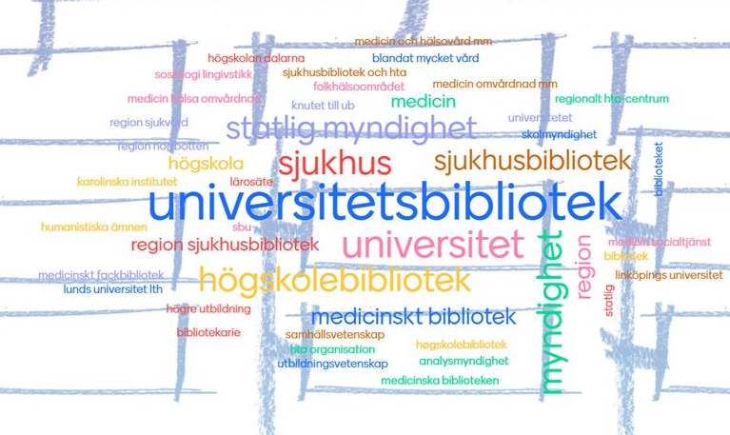
Who are we?
Librarians and information specialists working at
Universities
Hospitals
HTA agencies
Government agencies
etc.

Slide 9
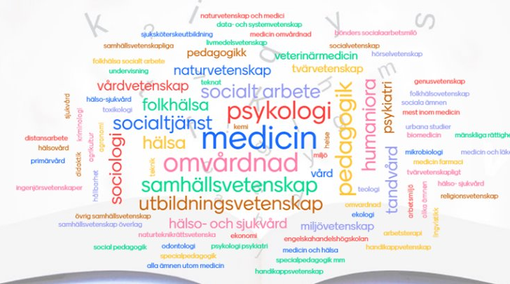
In what disciplines are we working?
Working within for example
Medicine, health related disciplines
Educational sciences
Humanities
Agricultural sciences
Environmental sciences
Social sciences

Slide 10

Activities
Monthly informal digital gatherings on various topics
Annual network meetings
Presentations/workshops
Journal clubs
Teams-channel for information, questions, discussions
The steering group hosts a web page and a LinkedIn page
Photo by Chris Montgomery on Unsplash

Slide 11
Organisation
Steering group with six members:
  Non-hierarchical and informal
  Shared responsibility
  No budget
  Representation from different organisations
  No bylaws
Anyone can join the network – this will add them to the Teams-channel.

Slide 12

Challenges
Technical:
  Web-site – payment & administration
  Teams – a good place for discussion, needs a host-organisation
Commitment from members:
  Challenging to keep up, find organisers for activities

Slide 13

Success factors
A moderately large and active steering group with members who have the support from their management
Minimal bureaucracy
Focus on searching as a process/activity – not on subject, type of organisation or experience
Mostly digital – geographical location not important
Low threshold – easy to ask questions in Swedish in a chat and get answers quickly
Easy for members to take own initiatives – bottom up

Slide 14
Discussion
Advantages and disadvantages with a network compared to a more formal association
Are there other similar networks, and could we cooperate in some way?

Slide 15

Maja Kärrman Fredriksson and Alena Lindfors
https://www.ssivk.se/
Maja.KarrmanFredriksson@sbu.se
alli@du.se

Slide 16


