Slide 1

Mapping Researcher Awareness of Research Support Library Services at KU Leuven Libraries – 2Bergen
Norin Hamouda¹*, Mark Verbrugge²*, Maarten Jackers², Thomas Vandendriessche^{1,2}
Affiliations:
¹ KU Leuven Libraries – 2Bergen – Learning Centre Désiré Collen, Herestraat 49 – P.O. Box 411, B-3000 Leuven, Belgium.
² KU Leuven Libraries – 2Bergen – Arenberg Library Campus, Willem de Croylaan 6 – P.O. Box 2000, B-3001 Leuven, Belgium.
* These authors contributed equally.

Slide 2

What services do we provide?
KU Leuven Libraries 2Bergen offers a broad range of research support services that fall under three main domains:
Information Retrieval (IR)
Research Data Management
Scholarly Publishing
2

Slide 3
What services do we provide?
KU Leuven Libraries 2Bergen offers a broad range of research support services that fall under three main domains:
Information Retrieval (IR)
It involves searching the literature systematically and efficiently by constructing a search strategy for the topic of interest and using it to search relevant sources.
2

Slide 4
What services do we provide?
KU Leuven Libraries 2Bergen offers a broad range of research support services that fall under three main domains:
Information Retrieval (IR)
Training
Sessions
Customized training
Consultation
1-on-1 meeting
Group meeting
Advice on Searching literature in scientific databases and additional sources
As well as deduplicating and screening search results
2

Slide 5
What services do we provide?
However, despite the great demand we receive for these services, it still remained unclear:
How easily researchers found us
Whether we effectively reached everyone
If researchers had extra suggestions & feedback for us
3

Slide 6

Why did we bother?
Inform
Manage
A.I.
Grow
Integrate
Network
Explore
4

Slide 7
Why did we bother?
Inform
Manage
A.I.
Grow
Integrate
Network
Explore
Explore the familiarity of the researchers with our services
4

Slide 8
Why did we bother?
Inform
Manage
A.I.
Grow
Integrate
Network
Explore
Explore the familiarity of the researchers with our services
Inform the researcher who are not familiar about our services
4

Slide 9
Why did we bother?
Inform
Manage
A.I.
Grow
Integrate
Network
Explore
Explore the familiarity of the researchers with our services
Inform the researcher who are not familiar about our services
Maximise our Network with the researchers by identifying the best communication channel(s)
4

Slide 10
Why did we bother?
Inform
Manage
A.I.
Grow
Integrate
Network
Explore
Explore the familiarity of the researchers with our services
Inform the researcher who are not familiar about our services
Maximise our Network with the researchers by identifying the best communication channel(s)
Gathering the feedback of the researchers to Integrate it wherever possible so we can eventually Grow
4

Slide 11
Why did we bother?
Inform
Manage
A.I.
Grow
Integrate
Network
Explore
4

Slide 12

How did we do it?
1. Conduct Focus Groups
5

Slide 13


How did we do it?
1. Conduct Focus Groups
5

Slide 14
How did we do it?
1. Conduct Focus Groups
5

Slide 15
How did we do it?
1. Conduct Focus Groups
2. Analyse Data
3. Report Data
5

Slide 16
How did we do it?
1. Conduct Focus Groups
Biomedical Sciences
6/14 Departments
12 Participants
= 8 focus groups
Science, Engineering & Technology
8/14 Departments
10 Participants
6

Slide 17
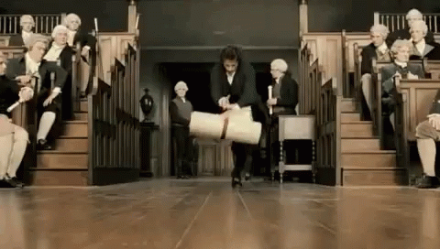
How did we do it?
1. Conduct Focus Groups
Biomedical Sciences
6/14 Departments
12 Participants
Science, Engineering & Technology
8/14 Departments
10 Participants
6

Slide 18
How did we do it?
1. Conduct Focus Groups
Biomedical Sciences
Content of our support
Familiarity of researchers with our services
Use of our services
Usefulness of services and what is missing
Quality of support received
Practical aspects of support (format & communication channels)
6/14 Departments
12 Participants
Science, Engineering & Technology
8/14 Departments
10 Participants
6

Slide 19
How did we do it?
2. Analyse Data: Thematic Analysis
7

Slide 20
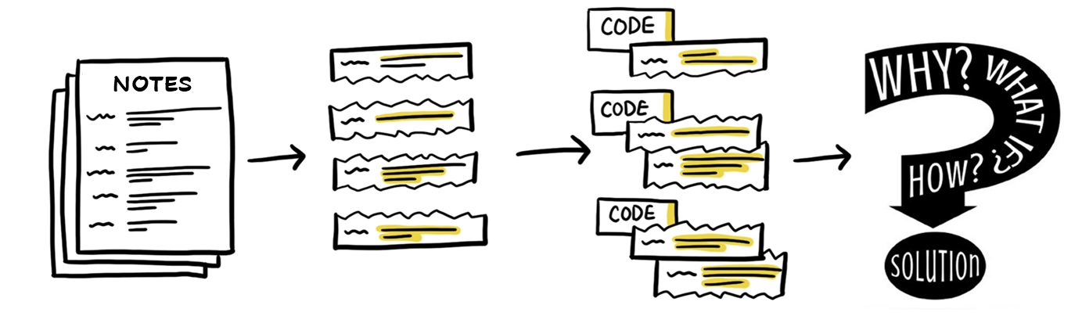
How did we do it?
2. Analyse Data: Thematic Analysis
2.1: Getting familiar with our notes
7

Slide 21

How did we do it?
2. Analyse Data: Thematic Analysis
2.1: Getting familiar with our notes
2.2: Giving codes to each sentence or section
7

Slide 22
How did we do it?
2. Analyse Data: Thematic Analysis
2.1: Getting familiar with our notes
2.2: Giving codes to each sentence or section
2.3: Grouping related codes into themes
7

Slide 23
How did we do it?
2. Analyse Data: Thematic Analysis
2.1: Getting familiar with our notes
2.2: Giving codes to each sentence or section
2.3: Grouping related codes into themes
2.4: Answering the research questions
7

Slide 24
How did we do it?
3. Report Data: Familiarity with IR Services
Yes
Biomedical Sciences
Unclear
6/14 Departments
12 Participants
No
Science, Engineering & Technology
8/14 Departments
10 Participants
8

Slide 25
How did we do it?
3. Report Data: Familiarity with IR Services
Yes
Not familiar with IR services
Unclear
No
Familiar with IR services but had not used them
Familiar with IR services & had used them
8

Slide 26
How did we do it?
3. Report Data: Familiarity with IR Services
Not familiar with IR services
Familiar with IR services but had not used them
Physical visits to the library
Newsletters or mailings sent by doctoral school
Through colleagues or Ph.D. students
Toledo: virtual learning environment
Familiar with IR services & had used them
8

Slide 27
How did we do it?
3. Report Data: Use & Relevance of IR Services
Use of IR Services
Yes
Biomedical Sciences
No
6/14 Departments
12 Participants
Science, Engineering & Technology
8/14 Departments
10 Participants
9

Slide 28
How did we do it?
3. Report Data: Use & Relevance of IR Services
Use of IR Services
Yes
IR services are not used/relevant
No
IR services, among other services, are very relevant
IR services are number one most relevant for daily needs
IR are the only services used
9

Slide 29
How did we do it?
3. Report Data: Use & Relevance of IR Services
IR services are not used/relevant
Because in their fields systematic searching/review is not needed
Because they do not know about the services (Familiarity)
IR services, among other services, are very relevant
IR services are number one most relevant for daily needs
IR are the only services used
9

Slide 30
How did we do it?
3. Report Data: Obstacles when using IR Services
We teach rather than execute
Preparation before booking a meeting
10

Slide 31
How did we do it?
3. Report Data: Obstacles when using IR Services
We teach rather than execute
Other universities build the search strategies for researchers
Opinion of 3 participants
Preparation before booking a meeting
10

Slide 32
How did we do it?
3. Report Data: Obstacles when using IR Services
We teach rather than execute
Preparation before booking a meeting
Filling in the form & watching a pre-recorded lesson
Opinion of 1 participant
10

Slide 33
What can we improve?
Not familiar with IR services
IR services are not used/relevant
11

Slide 34
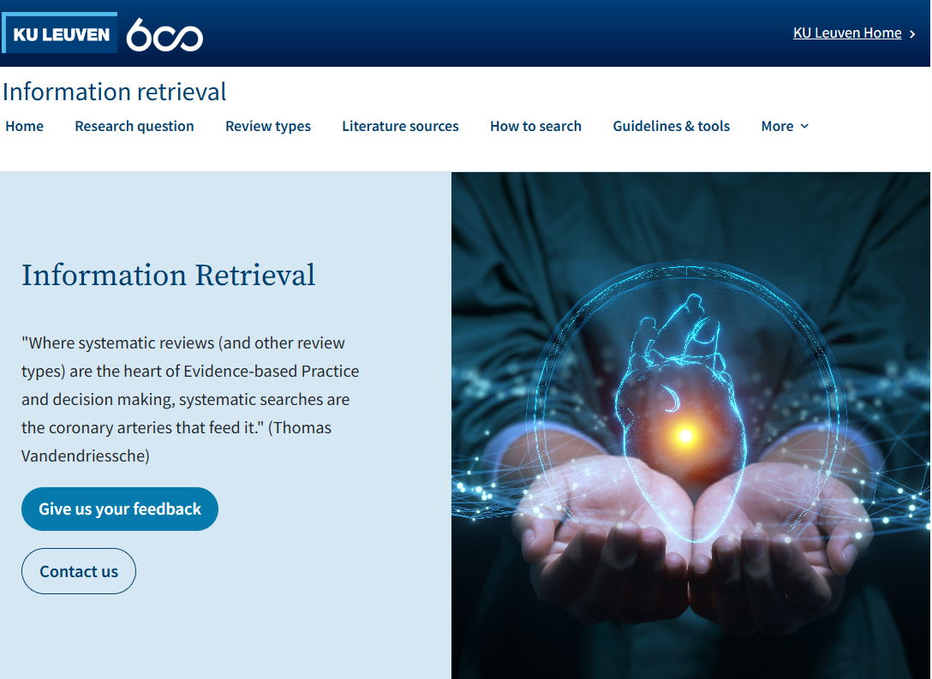
What can we improve?
Not familiar with IR services
IR services are not used/relevant
11
https://bib.kuleuven.be/english/research/information-retrieval/

Slide 35
What can we improve?
Not familiar with IR services
IR services are not used/relevant
11
https://bib.kuleuven.be/english/research/information-retrieval/

Slide 36

What can we improve?
Not familiar with IR services
IR services are not used/relevant
?
11

Slide 37
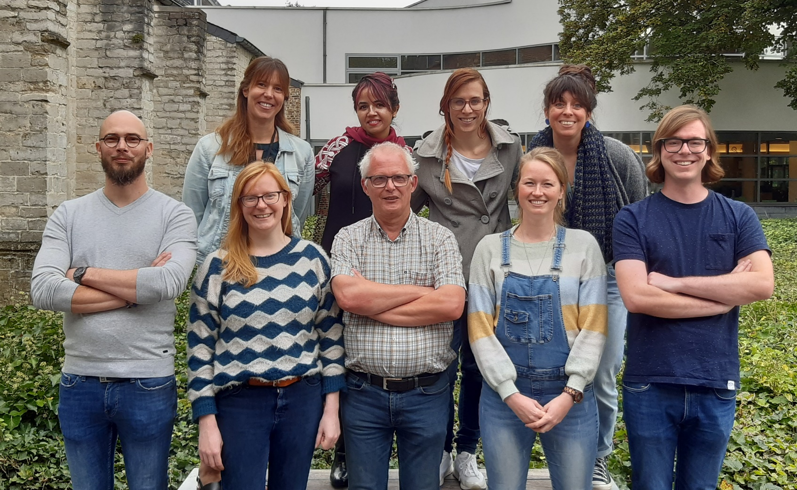
Acknowledgements
Domain manager: Thomas Vandendriessche
Campus
Arenberg
Learning Centre
Désiré Collen
12
Contact: onderzoek2bergen@kuleuven.be

Slide 38


Slide 39


