Slide 1


Open gamified learning material about information retrieval in health sciences
Päivi Helminen¹, Mari Hietala¹, Sanna Kujala¹, Tiina Heino¹, Katri Larmo¹, Taisa Sallinen², Tuulevi Ovaska², Jaakko Nyrönen².
¹Helsinki University Library
²University of Eastern Finland Library
Presenting authors: Katri Larmo and Taisa Sallinen
Licence for the presentation: CC-BY (apart from pictures and screen shots that have licences of their own)
Picture from geralt service Pixabay (www.pixabay.com). Pixabay Content Licence.

Slide 2
Background
In Finland, the learning material of scientific information retrieval in health sciences are often accessed only by organizational credentials. Moreover, not all organizations have access to learning material nor databases and are therefore depended on openly available sources. In addition, the skills of health information retrieval need to be updated by the employees every now and then. Also, finding reliable health information is a crucial skill for everyday life.
Helsinki University library and University of Eastern Finland library had similar objectives for enhancing open education and the use of open learning materials, especially for users outside universities.
In Summer 2022 the libraries decided to create an open learning material about the openly available information and databases in health sciences. The learning material was made by the pedagogical professionals as well as the information specialists from both university libraries.
In Fall 2024, the open learning material was published in Finnish Library of Open Educational Resources (AOE).

Slide 3

Goals for the open learning material
Picture source: Pixabay (www.pixabay.com). Pixabay Content Licence.
The goals and target groups for the learning material about information retrieval in health sciences were as follows:
Goal 1: To demonstrate current and reliable openly available medical and health science information sources.
Target group 1: Everyone interested from laypersons to professionals.
Goal 2: To make the process of publishing open learning materials more visible.
Target group 2: Higher education teachers, others interested in the subject.

Slide 4

Open gamified learning material about information retrieval in health sciences
Picture source: Pixabay (www.pixabay.com). Pixabay Content Licence.
The learning material consists of
Introductory material about open and reliable health information sources.
Web-based Game about open and reliable health information sources.
The introductory material (.docx) presents open and reliable e-sources related to health sciences and explains on what basis the reliability of the sources can be assessed. In the game (ThingLink), the user gets to test their knowledge of open information sources in health sciences and the evaluation of their reliability.

Slide 5
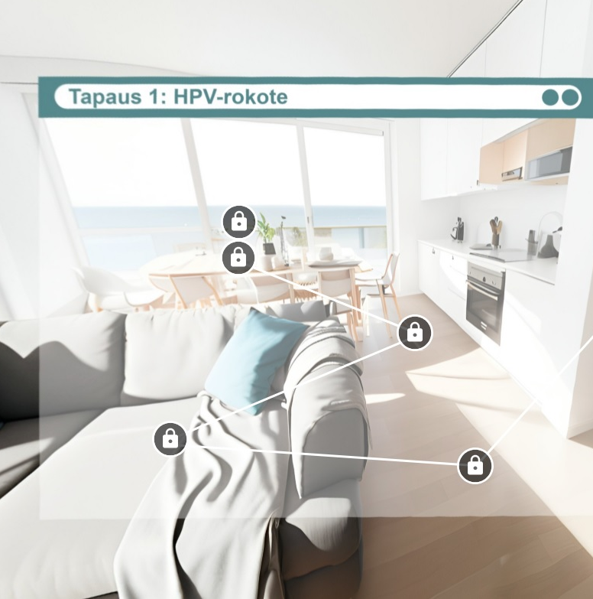
Health Sciences Open Resources -game
A screenshot from the game on ThingLink.
All rights reserved.
Case: HPV Vaccination
In the game, the player can choose how much he or she wants to learn from open data in health sciences: the game includes three different levels of case studies to solve
  1: "Vaccine for a child"
  2: "Local newspaper reporter"
  3: "Health professional"
The game is implemented on the ThingLink platform. ThingLink does not operate under an open license, but the game scripts are open source so that they can be used in teaching.

Slide 6
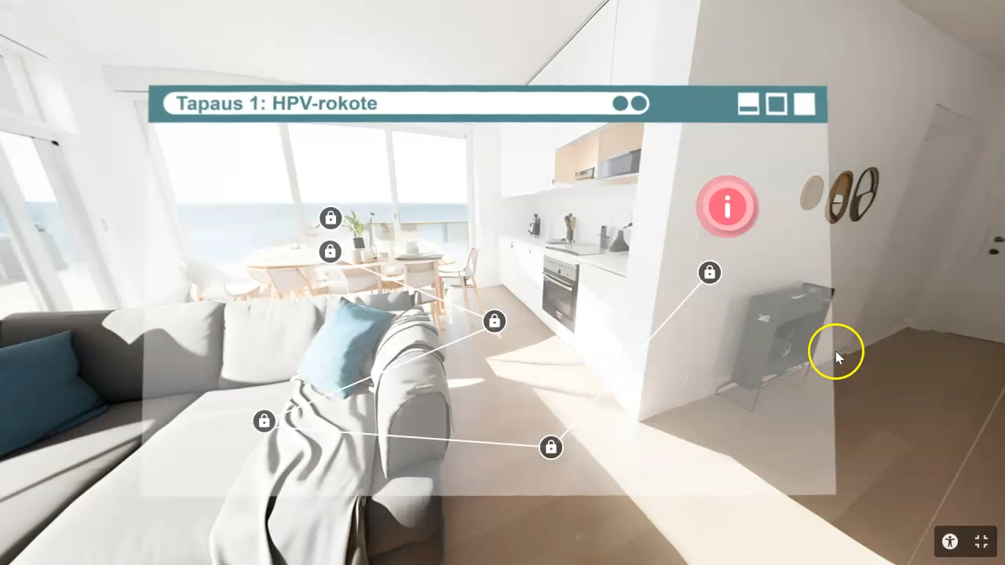
Case: HPV Vaccination
ThingLink is in use at the University of Helsinki under Education licence.
As a platform, it is very accessible, provides pre-defined textual versions of all virtual environments, without collecting information about the users.
Wide range of features including 360° virtual rooms, guided tours and embedding of questions in the virtual environment.

Slide 7
Experiences of the collaboration process
We (Helsinki University Library and University of Eastern Finland library) started with a very loose initial idea: to produce an open educational material
It took some time find the focus and the best ways to work.
Luckily, we were able to decide the schedule amongst ourselves, since this was an extra project among our daily duties.
In addition to the two original goals (to create the actual learning material and the game, presented in slide 3), we believe we also learned from this multiorganization process: how to transform a preliminary and somewhat unclear idea into a shared vision. This involved working with colleagues from diverse backgrounds (e-learning, health information, etc.)

Slide 8
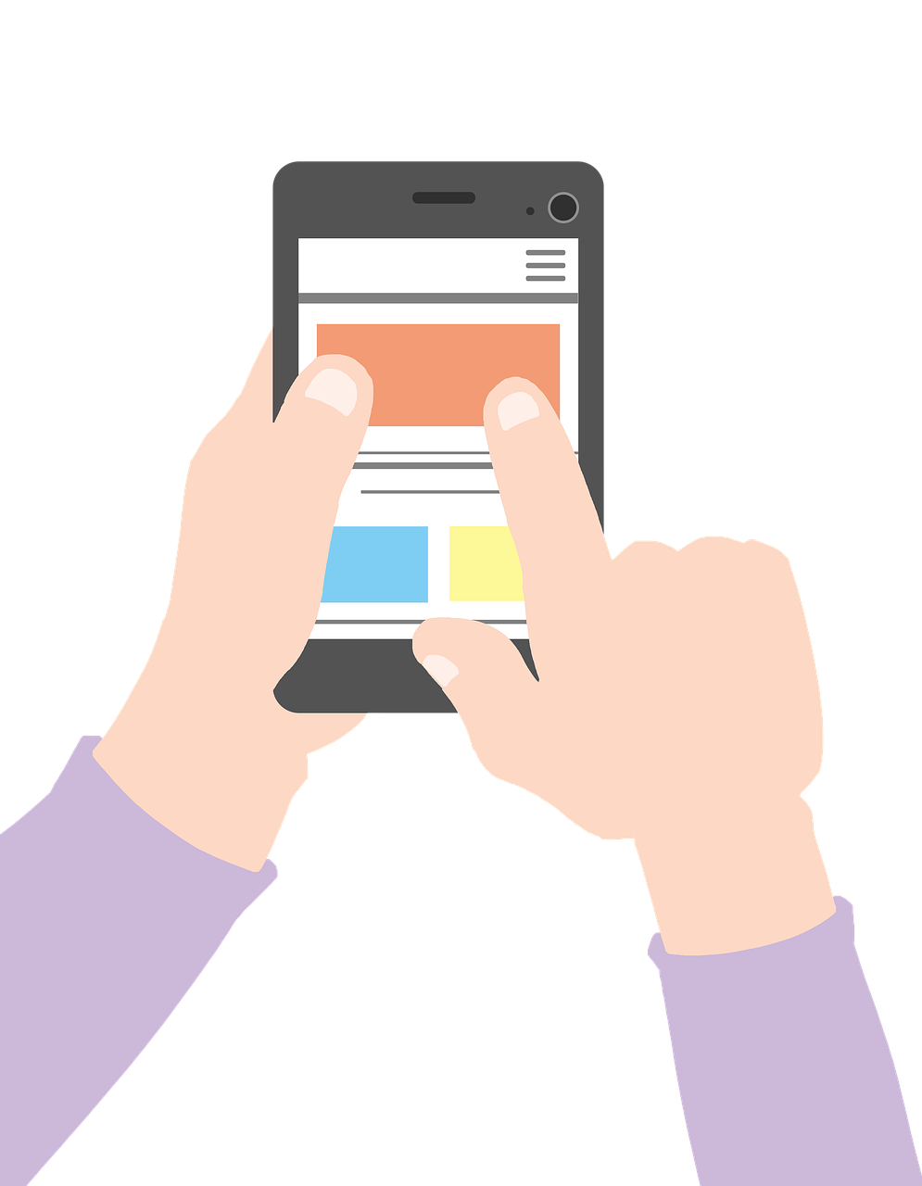
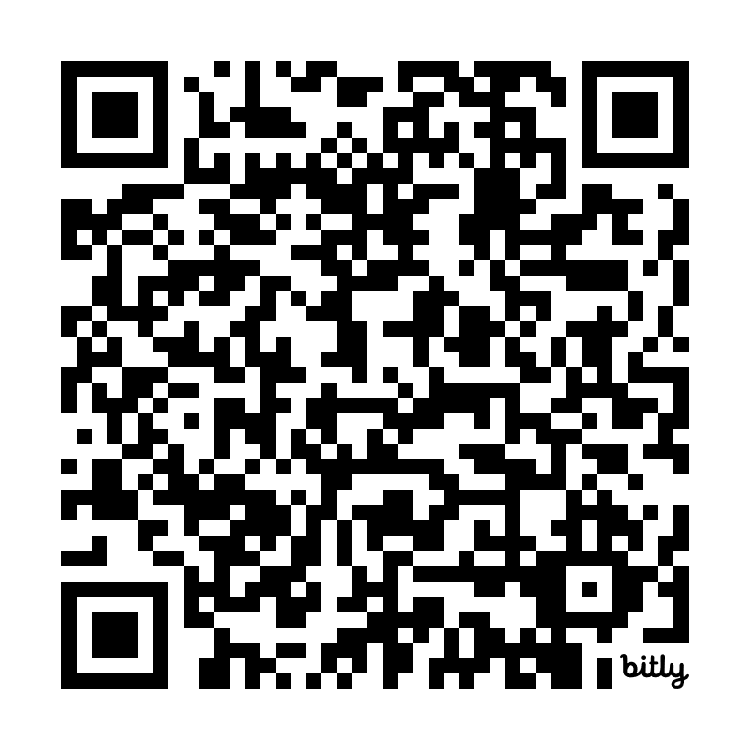
Check out the learning material and play the game!
Please note: the materials and game are in Finnish
You can find the learning material in the Open Learning Materials Library:
bit.ly/TerveystieteidenAvoimetAineistot
Or by scanning the QR code:
Play the game (in Finnish)
Image by ijmaki from Pixabay (www.pixabay.com). Pixabay Content Licence.

Slide 9
Further links & learning material terms of use
Library of Open Educational Resources
University of Helsinki: Open Learning
University of Eastern Finland. Open Learning
Unesco: Open Educational Resources
Produced by Helsinki University Library & University of Eastern Finland Library
The learning material (introductory material for the game and the scripts for the case studies) is published under the CC BY (Attribution) licence.
Please note that ThingLink is not released under an open license.

Slide 10


Thank you!
Questions?
Katri Larmo
katri.larmo@helsinki.fi
Taisa Sallinen
taisa.sallinen@uef.fi

Slide 11


