Slide 1

Managing and monitoring open access in an institutional CRIS : Experiences of the UMCG in registering nearly 100% open access
Robin Ottjes¹
¹ Medical Library, University Medical Center Groningen, The Netherlands.

Slide 2
Contents
Current situation: Ranking and monitoring
How did we reach nearly 100%?
Open access policy & publisher deals
Using our Current Research Information System (CRIS)
Dutch copyright law: “Taverne”

Slide 3
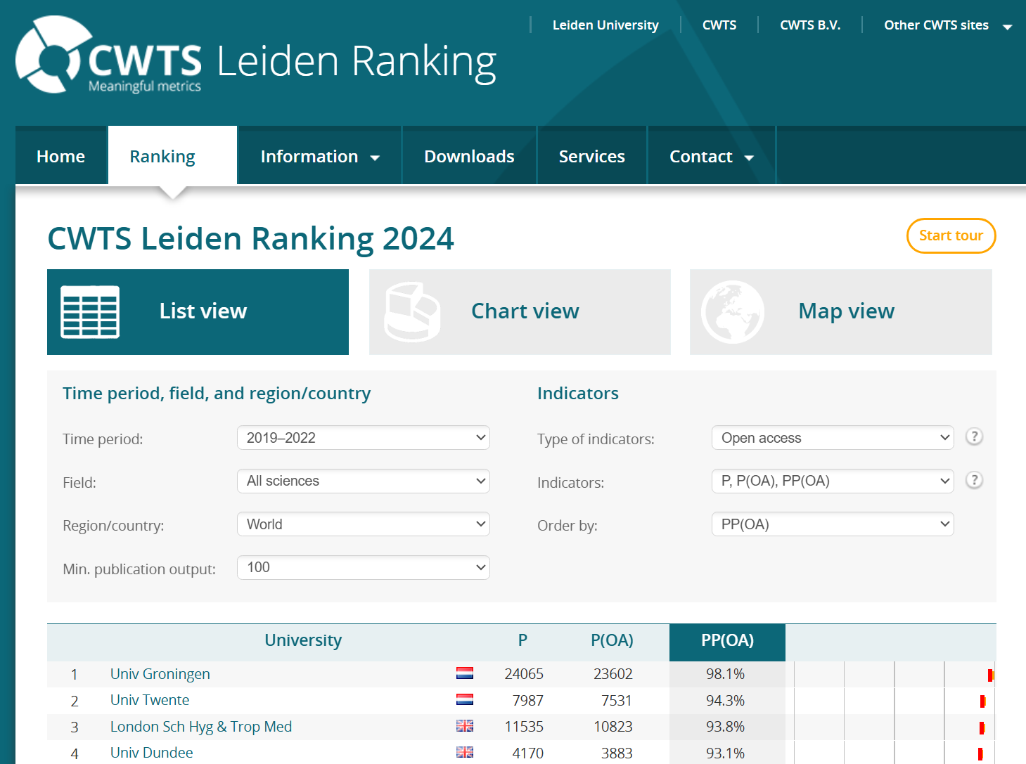
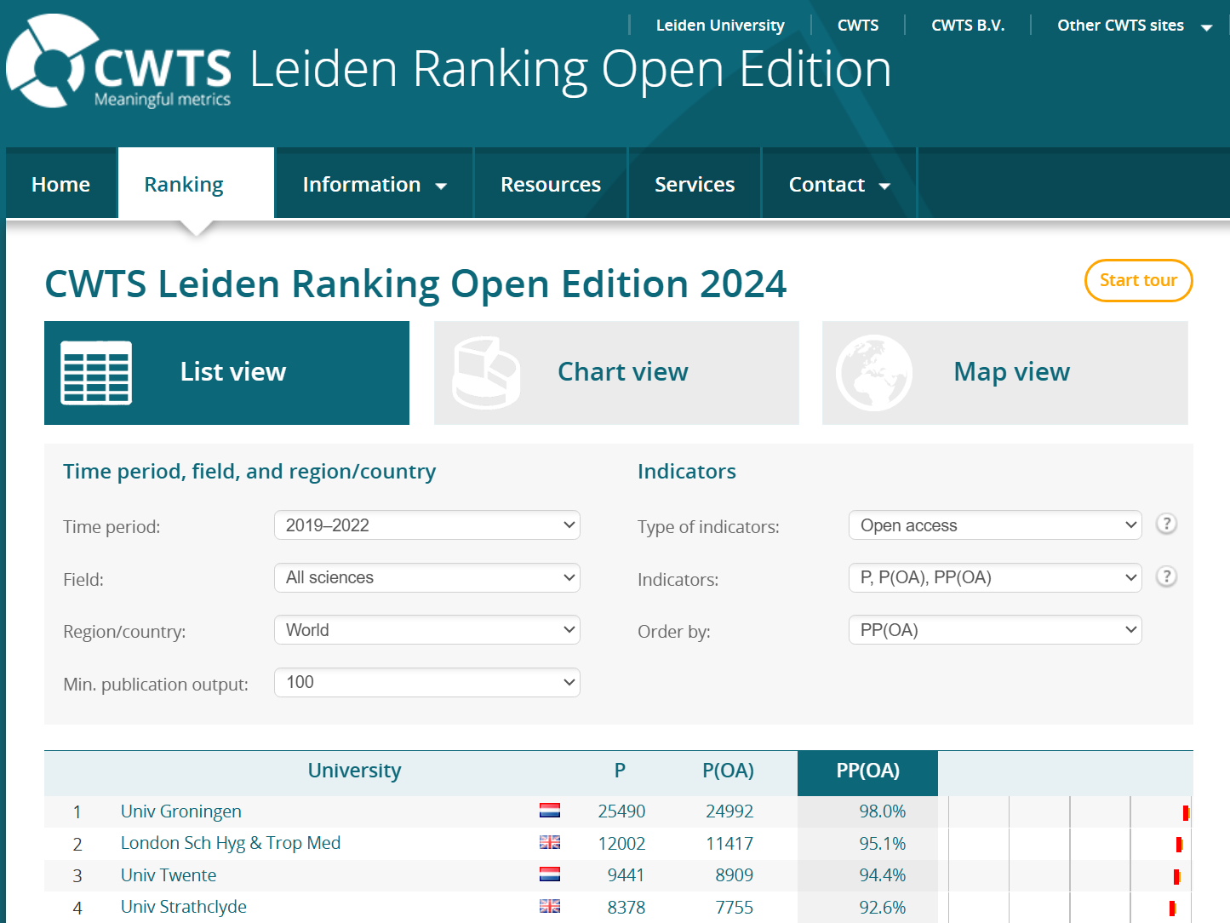
Ranking and monitoring

Slide 4
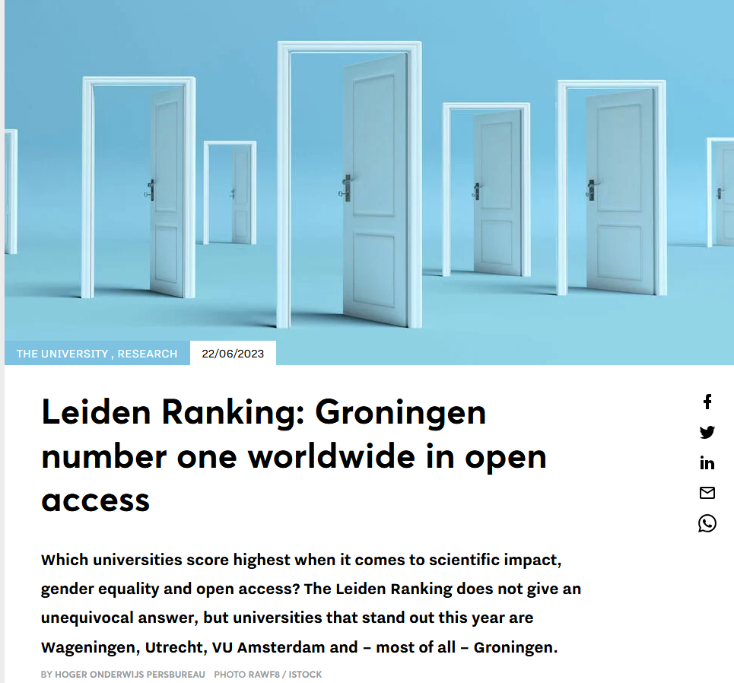

Slide 5
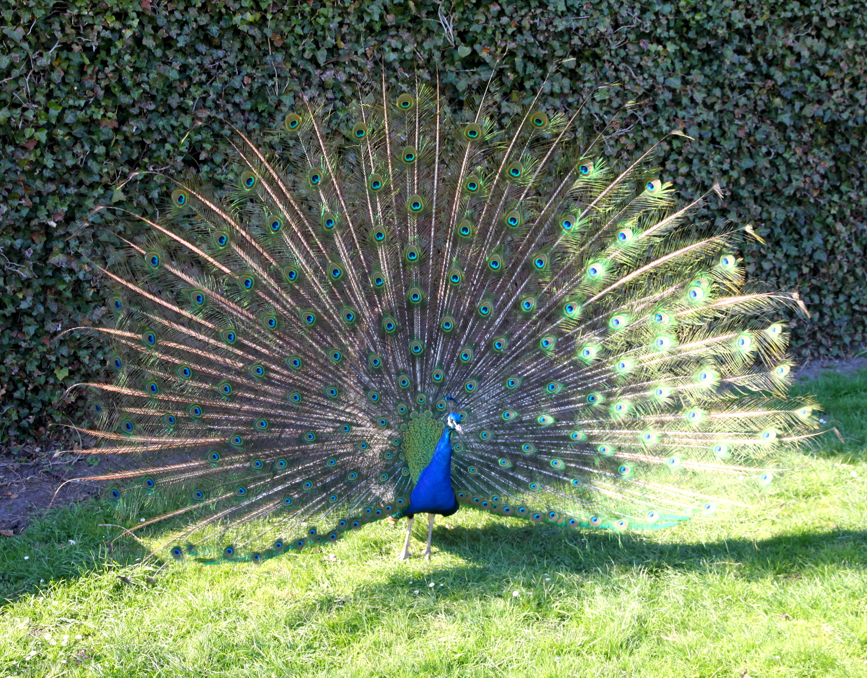
How?
Enough bragging… lets see how we managed this
Two components:
Open access policy & national publisher deals
Dutch copyright law & our CRIS
Source

Slide 6
Open Access policy
2021-2026: Strategic Plan university
(Open access encouraged > Improve support and financial infrastructure for making open access publishing simpler and more feasible in every discipline).
2024: Open access policy
Commit to 100% open access
Two routes: immediate and via CRIS

Slide 7

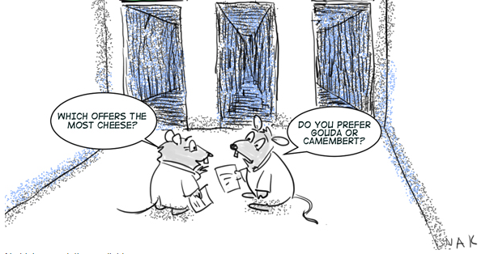
Types of OA
Gold
Gold Open access journals (APCs)
Hybrid journals Often large discounts(15-100%!)
Green
Copyright law Article 25fa (“Taverne”)
Publishers version (free)
Made available via CRIS after embargo
Green
Author accepted manuscript(free)
Made available via CRIS
gold
green
Open Access Journal
Hybrid Journal
Taverne
green
Repository
Repository
Source

Slide 8
National open access deals
Multiple organisations working together:
Association of Universities in the Netherlands
Dutch consortium of University Libraries and Royal library (UKB)
Netherlands Organization for Scientific Research (NWO)
Netherlands Federation of University Medical Centers (NFU)
National deals with publishers about APC discount
Discount ranging from 15-100%

Slide 9
Policy & national deals summary
Around 75% Open Access
How to get the last 25%?
Green open access & CRIS

Slide 10

Using our CRIS
In 2017 project for ‘Green open access’
“Author accepted manuscript” in our CRIS
Not mandatory. Dependent on researchers
Source

Slide 11
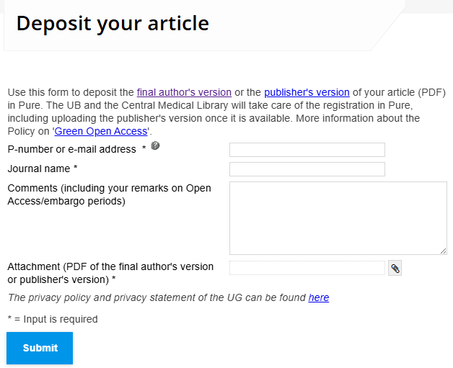
How to get the AAM?
A form on the website.
Emailing researchers directly.
Labor intensive!

Slide 12
Creating awareness
Talking with researchers
Showing the data and open access opportunities

Slide 13
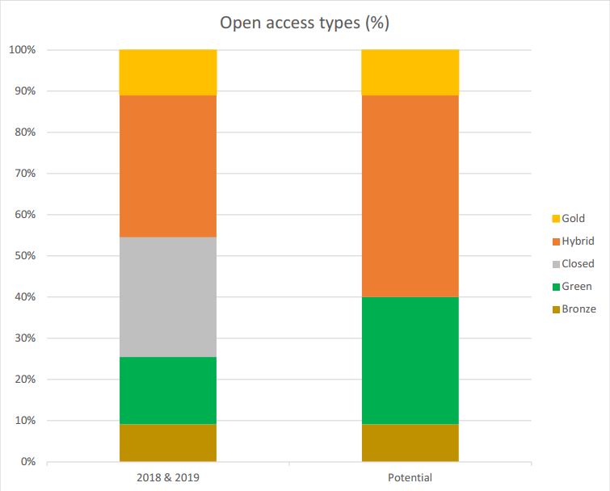
Showing missed chances
Within impact analysis or department yearly reports show the open access potential.
Most of the time: could have been 100% if all services from the library had been used

Slide 14
Creating awareness
“Open Access Publication of the month”
Starting 2021: “Taverne”

Slide 15
Dutch copyright law: “Taverne”
Article 25fa to the Dutch Copyright law
Passed in parlement with 148 votes in favor and 2 abstained (out of 150) in 2015.
Named ‘Taverne amendment’ after the politician Edzo Taverne.

Slide 16
"The maker of a short scientific work, the research for which has been paid for in whole or in part by Dutch public funds, shall be entitled to make that work available to the public for no consideration following a reasonable period of time after the work was first published, provided that clear reference is made to the source of the first publication of the work." (Dutch Copyright Act 2015)
Notes:
Together, Dutch universities have decided to interpret 'short scientific work' as journal articles, proceedings papers and book chapters, and 'a reasonable period of time' as six months.

Slide 17

‘Taverne’ in practice
National pilot in 2019
Full adoption in 2020
Difference between institutions
Opt-in or opt-out?

Slide 18
Workflow in CRIS
Publication is added to the CRIS [Researcher or Library]
CRIS-team checks the record, adds PDF and embargo
When embargo ends, publication is available on research portal

Slide 19
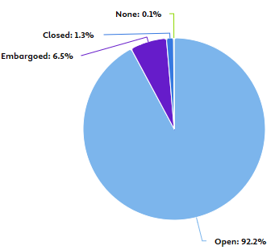
Data quality checks
Insight:
What is our OA percentage this year?
Quality:
Our goal is 100% open access
Why is 1,3% closed? Why 0,1% none?
Check the records
Try to make them open

Slide 20
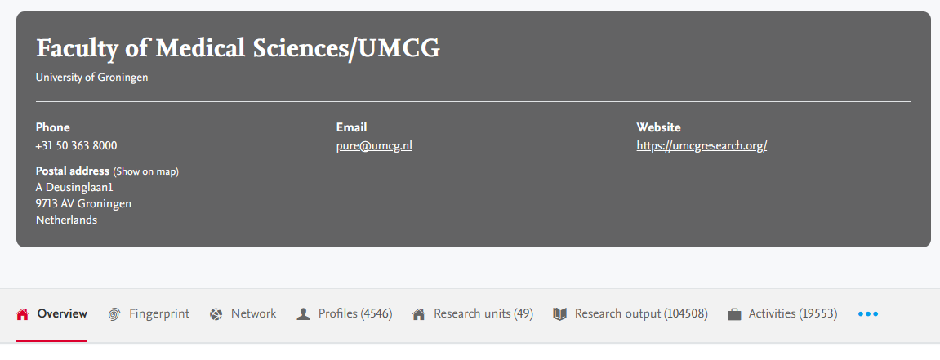



How to access?
Available via Research Portal: https://research.rug.nl/

Slide 21
Future
We are happy with our current Open Access workflow and percentage
It is labor intensive – especially on library staff
Looking to automate the process

Slide 22

Thank you for your attention!
Any questions?
E-mail me: r.f.ottjes@umcg.nl
or come talk to me here in Łódź!

Slide 23


