Slide 1



Evaluating the utility of GPT4 for automated keywording of health promotion research
Claire Stansfield
Senior Research Fellow
EPPI-Centre, UCL Social Research Institute,
University College London

Slide 2
Funding and acknowledgements
Funder: National Institute for Health and Care Research Policy Review Facility (NIHR200701)
Thank-you to Sergio Graziosi, Ailbhe Finnerty, Gillian Stokes (EPPI-Centre) Claire Khouja, Gary Raine at University of York, Isaac Yen-Hao Chu (London School Hygiene and Tropical Medicine)

Slide 3
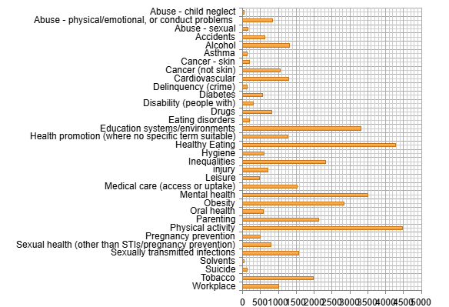
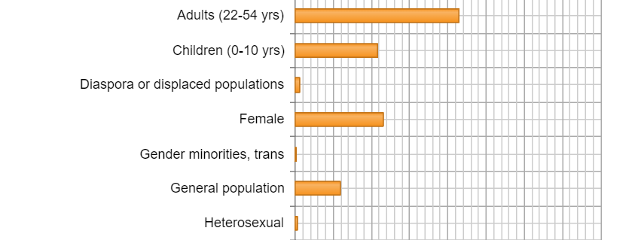
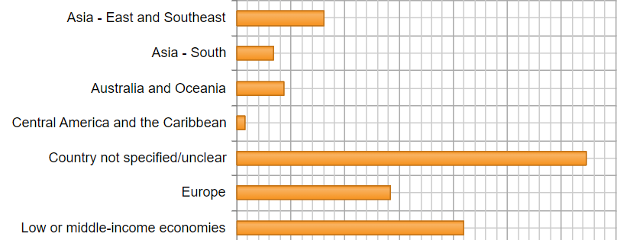
  Background: Research registers of Health Promotion Interventions
  TRoPHI - controlled trials and DoPHER - effectiveness reviews
TRoPHI = 22,000+ controlled trials
DoPHER = 10,000+ reviews

Slide 4
How accurately can GPT4 assign health promotion descriptive codes
– based on title/abstracts?
Boolean prompts developed per code
-Descriptive codes
-Identify records out of scope and mis-coding
Preliminary evaluation (approx. 350 pre-labelled records)
- per individual record, identify poor performance, improve prompts, re-test
Limitations
    Pre-existing human coding not gold standard
    Accuracy and consistency vary
        Task involves interpretation of codes and abstracts
        Task involves assigning multiple codes
    Title/Abstracts
    Varied quality and content of abstracts

Slide 5
How accurately can GPT4 assign health promotion descriptive codes
– based on title/abstracts?
Method: developed and tested 90+ prompts: study design, topic, population, country groupings
Tool: GPT4 in EPPI-Reviewer: OpenAI "GPT-4o", model version = 2024-08-06
https://eppi.ioe.ac.uk/cms/Default.aspx?tabid=3921
Measures: Inter-Rater Reliability (Krippendorff’s Alpha and others)
TRoPHI
Evaluation set (n=527)
Validation set #1 (n=116)
Further fine-tuning – mainly on role of GPT4.
Validation set #2 Human (historical) -robot (n=3,041)
DoPHER
Validation set Human-robot (n=2,277)
Human 1 (historical), human 2, two iterations of robots.
Random and stratified sampling

Slide 6
Prompt components
Label
Type of question
Role of GPT
Question
Example:
#1 child_neglect: boolean // Your role is to answer this question about the title and abstract of a research study. Is the intervention or any outcome about child or infant neglect or child or infant maltreatment, child protection or child welfare, or poor parenting?
# 2 child_neglect: boolean // The text provided summarises a research study. Is the intervention or any outcome about child or infant neglect or child or infant maltreatment, child protection or child welfare, or poor parenting?
(#2 performs less well than #1)

Slide 7
Example Prompts
  Central America and the Caribbean
  intervention_location_is_in_Central_America_or_Caribbean_and_not_Mexico: boolean// The text provided is a title and abstract of a research study. Your role is to answer this question about it: Does the title or text provided indicate an intervention takes place within Central America, the Caribbean or in any of the following countries: Anguilla, Antigua, Barbuda, Aruba, Bahamas, Barbados, Belize, British Virgin Islands, Cayman Islands, Costa Rica, Cuba, Curacao, Dominica, Dominican Republic, El Salvador, Grenada, Guatemala, Guadeloupe, Haiti, Honduras, Jamaica, Montserrat, Navassa Island, Nicaragua, Panama, Puerto Rico, Saint Barthelemy, Saint Kitts, Nevis, Saint Lucia, Saint Martin, Saint Vincent, Grenadines , Sint Maarten, Trinidad, Tobago , Turks Islands, Caicos Islands or Virgin Islands? Do not answer true if an intervention is only taking place in Mexico. Do not answer true if the country location is not clear in the title or text provided.

Slide 8
How accurately can GPT4 assign health promotion topic codes for trials?
Topics Example: Inter-Rater Reliability
Human-Robot (n=3,041), Human-Human coding (n=643)
Strong IRR
Krippendorff’s Alpha

Slide 9
How accurately can GPT4 assign descriptive codes for reviews of health promoting interventions?
DoPHER – Human-robot title/abstracts (n=2,277)
Currently no keywords presented in public version.
IRR moderate or lower for all topics, study design codes
Challenges:
Human historical keywords on full-text, Robot applied to title/abstract
Further investigation to see if suitable coding possible and useful from abstract only for reviews

Slide 10
Conclusions (1)
Evaluating performance
Measuring Inter Rater Reliability of human-human and human-robot keywording helps understand performance without either as a gold standard.
Challenges include:
Defining acceptable performance
Low sample size of some keywords and availability of data
Understanding how prompts perform less well over varied dataset

Slide 11
Conclusions (2)
Challenges of applying Robot keywording
Titles/abstracts – ambiguity, non-structured
Using clear instructions and definitions for prompting
Trade-off with time spent developing and testing prompts and time saved
Opportunities for Robot keywording
Large-scale rapid approach (once prompts are developed and tested)
Extend size and global range of content of registers (e.g from OpenAlex or multiple databases)
Potential re-use of common prompts

Slide 12

Claire Stansfield
c.stansfield@ucl.ac.ukon

